Slide 1
Managing Diverse Employees in a Multicultural Environment

Slide 2
Learning Objectives
Discuss the increasing diversity of the workforce and of the organizational environment.
Explain the central role that managers play in the effective management of diversity.
Explain why the effective management of diversity is both an ethical and a business imperative.
Discuss how perception and the use of schemas can result in unfair treatment.
List the steps managers can take to effectively manage diversity
Identify the two major forms of sexual harassment and how they can be eliminated.

Slide 3
The Increasing Diversity of the Workforce and the Environment
Diversity
  Dissimilarities/differences among people in age, gender, race, ethnicity, religion, sexual orientation, socioeconomic background, and capabilities/disabilities
Notes:
3
The ethical imperative for equal opportunity
Effectively managing diversity can improve organizational effectiveness
There is substantial evidence that diverse individuals continue to experience unfair treatment
Diversity
Dissimilarities/differences among people in age, gender, race, ethnicity, religion, sexual orientation, socioeconomic background, and capabilities/disabilities, and any other characteristic used to distinguish between people

Slide 4
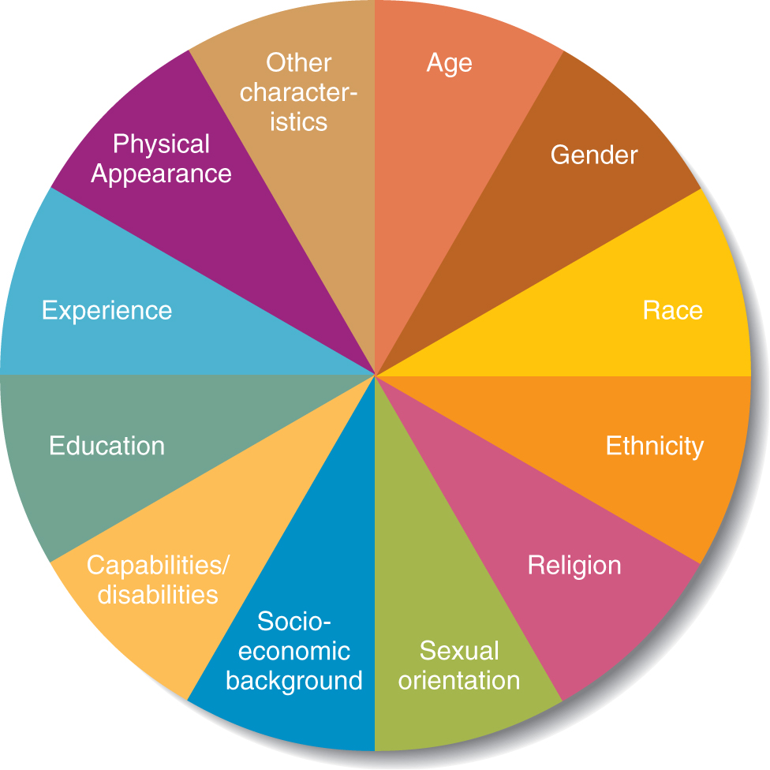
Sources of Diversity in the Workplace
Figure 5.1

Slide 5
The Increasing Diversity of the Workforce and the Environment
Glass ceiling
  alludes to the invisible barriers that prevents
  minorities and women
  from being promoted
  to top corporate
  positions

Slide 6
Workforce Diversity: Age
Aging U.S. Population
  Median age in the United States is 36.2 years, by 2030 20 per cent of the population will be over 65
Federal Age Discrimination Laws
  1964 Title VII of the Civil Rights Act of 1964
  1967 Age Discrimination in Employment Act

Slide 7
The Legal Environment of HRM
Equal Employment Opportunity (EEO)
  The equal right of all citizens to the opportunity to obtain employment regardless of their gender, age, race, country of origin, religion, or disabilities.
  Equal Employment Opportunity Commission (EEOC) enforces employment laws.
Notes:
7

Slide 8
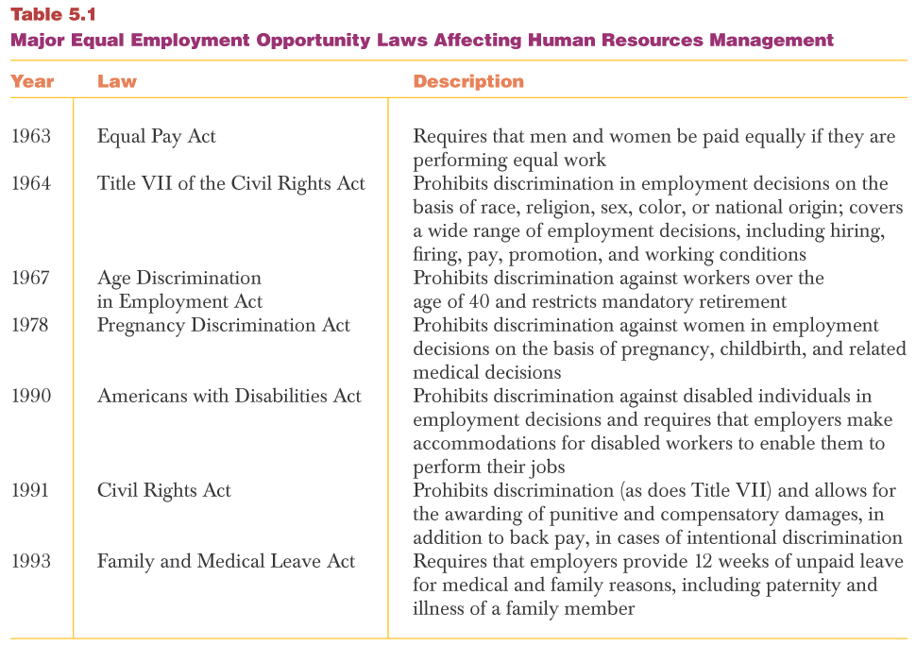
Major EEO Laws
Insert Table 5.1

Slide 9
Workforce Diversity: Gender
Women in the Work Place
  U.S. workforce is 46.5% percent female
  Women’s median weekly earnings are $638 compared to $798 for men
  Women hold only 15.4% of corporate officer positions

Slide 10
Race and Ethnicity
Census Bureau distinguishes between the following races
  American Indian or Alaska Native, Asian Indian, Black, African American, Chinese, Filipino, Japanese, Korean, Vietnamese, Other Asian, Native Hawaiian, Guamanian or Chamorro, Samoan, Other Pacific Islander, White , and other races
The racial and ethnic diversity of the U.S. population is increasing at an exponential rate
Notes:
Ethnicity refers to whether a person is Hispanic or not Hispanic
Most Hispanics prefer to be identified by their country of origin
10

Slide 11
Race and Ethnicity
Ethnicity refers to whether a person is Hispanic or not Hispanic
Most Hispanics prefer to be identified by their country of origin

Slide 12
Workforce Diversity: Religion
Accommodation for Religious Beliefs
  Scheduling of critical meetings
  Providing flexible time off for holy days
  Posting holy days for different religions on the company calendar

Slide 13
Workforce Diversity: Capabilities and Disabilities
Disability Issues
  Providing reasonable accommodations for individuals with disabilities
  Promoting a nondiscriminatory workplace environment
  Educating the organization
  about disabilities and AIDS

Slide 14
Workforce Diversity:
Socioeconomic Background
Socioeconomic background
  refers to a combination of social class and income-related factors
Socioeconomic diversity requires that managers be sensitive and responsive to the needs and concerns of individuals who might not be as well off as others

Slide 15
Workforce Diversity: Sexual Orientation
Sexual Orientation Issues
  Employment and workplace discrimination
  Provision of same-sex partner benefits

Slide 16
Other Kinds of Diversity
Whether individuals are attractive or unattractive, thin or overweight, in most cases has no bearing on their job performance
Sometimes these physical sources of diversity end up influencing advancement rates and salaries

Slide 17
Critical Managerial Roles
Managers can take many more steps to become sensitive to the ongoing effects of diversity in their organizations, take advantage of all the contributions diverse employees can make, and prevent
diverse employees
from being unfairly
treated.
Notes:
Managers have more influence than rank-and-file employees
When managers commit to diversity, it legitimizes diversity efforts of others
Effective management of diversity hinges on two factors
Minorities start out at a slight disadvantage due to the ways in which they are perceived by others in the organization
Research suggests slight differences in treatment can cumulate and result in major disparities over time
17

Slide 18
The Ethical Imperative to Manage Diversity Effectively
Distributive Justice
  A moral principle calling for fair distribution of pay, promotions, and other organizational resources based on meaningful contributions that individuals have made and not personal characteristics over which they have no control.
Notes:
Distributive Justice
A moral principle calling for the distribution of pay raises, promotions, job titles, interesting job assignments, office space, and other organizational resources to be based on meaningful contribution that individuals have made and not personal characteristics over which they have no control.

Slide 19
The Ethical Imperative to Manage Diversity Effectively
Procedural Justice
  A moral principle calling for the use of fair procedures to determine how to distribute outcomes to
  organizational
  members.

Slide 20
Procedural Justice
Exists when managers:
  carefully appraise a subordinate’s performance
  take into account any environmental obstacles to high performance
  ignore irrelevant personal characteristics

Slide 21
Managing Diversity Effectively Makes Good Business Sense
What a Diversity of Employees Provides
  A variety of points of view and approaches to problems and opportunities can improve managerial decision making.
  Diverse employees can provide a wider range of creative ideas.
  Diverse employees are more attuned to the needs of diverse customers.
  Diversity can increase the retention of valued organizational members.
  Diversity is expected/required by other firms

Slide 22
Bias
Similar-to-me effect – perceive others who are similar to ourselves more positively than we perceive people who are different
Social status effect – perceive individuals with high social status more positively than those with low social status
Salience effect – focus attention on individuals who are conspicuously different

Slide 23
Overt Discrimination
Overt Discrimination
  Knowingly and willingly denying diverse individuals access to opportunities and outcomes in an organization
  Unethical and illegal
Notes:
Overt Discrimination
Knowingly and willingly denying diverse individuals access to opportunities and outcomes in an organization
Unethical and illegal
Violation of the principles of distributive and procedural justice
Subjects firm to lawsuits

Slide 24
Steps in Managing Diversity Effectively
Secure top management commitment
Strive to increase the accuracy of perceptions
Increase diversity awareness
Increase diversity skills
Encourage flexibility
Pay close attention to how organizational members are evaluated
Consider the numbers
Notes:
Steps in Managing Diversity Effectively
Secure top management commitment
Strive to increase the accuracy of perceptions
Increase diversity awareness
Increase diversity skills
Encourage flexibility
Pay close attention to how organizational members are evaluated
Consider the numbers
Empower employees to challenge discriminatory behaviors, actions, and remarks
Reward employees fro effectively managing diversity
Provide training utilizing a multi-pronged, ongoing approach
Encourage mentoring of diverse employees

Slide 25
Steps in Managing Diversity Effectively (cont.)
Empower employees to challenge discriminatory behaviors, actions, and remarks
Reward employees for effectively managing diversity
Provide training utilizing a multi-pronged,
ongoing approach
Encourage mentoring
of diverse employees

Slide 26
How to Manage Diversity
Mentoring
  A process by which an experienced member of an organization provides advice and guidance to a less experienced member and helps them learn how to advance in the organization and in their career.

Slide 27
Diversity Awareness Programs
Provide members with accurate information about diversity
Uncover personal biases and stereotypes
Assess personal beliefs, attitudes, and values and learning about other points of view
Develop an atmosphere in which people feel free to share their differing perspectives
Improve understanding of others who are different

Slide 28
Forms of Sexual Harassment
Quid pro quo
  Asking for or forcing an employee to perform sexual favors in exchange for receiving some reward or avoiding negative consequences.

Slide 29
Forms of Sexual Harassment
Hostile work environment
  Telling lewd jokes, displaying pornography, making sexually oriented remarks about someone’s personal appearance, and other sex-related actions that make the work environment unpleasant
  Interferes with their ability to perform their jobs effectively

Slide 30
Steps to Eradicate Sexual Harassment
Develop and clearly communicate a sexual harassment policy endorsed by top management
Use a fair complaint procedure to investigate charges of sexual harassment

Slide 31
Steps to Eradicate Sexual Harassment
When it has been determined that sexual harassment has taken place, take corrective action as soon as possible
Provide sexual harassment education and training to all organizational members, including managers

Slide 32
Factors to Keep in Mind About Sexual Harassment
Every sexual harassment charge should be taken seriously
Employees who go along with unwanted sexual attention in the workplace can be victims
Employees sometimes wait before they file complaints

Slide 33
Factors to Keep in Mind About Sexual Harassment
A firm’s sexual harassment policy should be communicated to each new employee and reviewed with current employees on a periodic basis
Suppliers and customers need to be familiar with a firm’s sexual harassment policy
Notes:
Managers should provide employees with alternative ways to report incidents of sexual harassment
Employees who report sexual harassment must have their rights protected
Allegations of sexual harassment should be kept confidential

Slide 34
Factors to Keep in Mind About Sexual Harassment
Managers should give employees alternative ways to report incidents of sexual harassment
Employees who report sexual harassment must have their rights protected
Allegations of sexual harassment should be kept confidential

Slide 35
Factors to Keep in Mind About Sexual Harassment
Investigations of harassment charges and any disciplinary action should proceed in a timely manner
Managers must protect employees from sexual harassment from any third-party employees

Slide 36
Recruitment
External Recruiting
  Looking outside the organization for people who have not worked at the firm previously.
  Newspapers advertisements, open houses, on-campus recruiting, employee referrals, and through the Internet.
Notes:
36
Advantages of External Recruiting
Having access to a potentially large applicant pool
Being able to attract people who have the skills, knowledge, and abilities an organization needs
Bringing in newcomers who may have a fresh approach to problems and be up to date on the latest technology
Disadvantages of External Recruiting
Relatively high costs
Candidates may lack knowledge about the inner workings of the organization
May need to receive more training
Uncertainty concerning whether they will actually be good performers

Slide 37
Recruitment
Advantages of External Recruiting
  Having access to a potentially large applicant pool
  Being able to attract people who have the skills, knowledge, and abilities an organization needs
  Bringing in newcomers who may have a fresh approach to problems and be up to date on the latest technology

Slide 38
Recruitment
Internal Recruiting
  Managers turn to existing employees to fill open positions
Benefits of internal recruiting:
  Internal applicants are already familiar with the organization
  Managers already know candidates
  Can help boost levels of employee motivation and morale
Notes:
38

Slide 39
Effective Performance Feedback
Formal appraisals
  An appraisal conducted at a set time during the year and based on performance dimensions that were specified in advance
Informal appraisals
  An unscheduled appraisal of ongoing progress and areas for improvement
Notes:
39

Slide 40
Effective Feedback Tips
Be specific and focus on behaviors or outcomes that are correctable and within a worker’s ability to improve.
Approach performance appraisal as an exercise in problem solving and solution finding, not criticizing.
Express confidence in a subordinate ability to improve.
Provide performance feedback both formally and informally.
Notes:
40
Praise instances of high performance and areas of a job in which a worker excels.
Avoid personal criticisms and treat subordinates with respect.
Agree to a timetable for performance improvements.

