Slide 1
Teams and Teambuilding:
How to Work Effectively with Others
Chapter 10

Slide 2
1. Why Do Leaders Need Teams?
Groups Are Mysterious
Complexities
People Are Complicated
Only See
  Individual Behaviors
  Collective Decisions
Questions regarding the best way to lead teams?
Notes:
Groups are complex and mysterious partly because people are complicated, and partly because you can’t always see what is going on between and among people in a group.
You can only see the individual behaviors and collective decisions that groups of people agree to implement.
An autocratic leader tends to make decisions without input from others.
Democratic leaders seek input and then either make a decision or engage the group in collective decision making.
Laissez-faire leaders remains at a distance from the decision-making process, allowing the group to make decisions without leadership intervention.
Researchers found that autocratic groups spent more time “working” than the democratic groups, who were even more productive than the lasses-faire ones.
Autocratic leadership, however, has negative consequences over the long term, while involving people in a democratic manner increases commitment to both the task and to the leader.

Slide 3
Groups, Teams and
Organizational Effectiveness
Group
  Two or more people who interact with each other to accomplish certain goals or meet certain needs.
Notes:
3

Slide 4
Groups, Teams and
Organizational Effectiveness
Team
  A group whose members work intensely with each other to achieve a specific, common goal or objective.
Notes:
4
Two characteristics distinguish teams from groups
Intensity with which team members work together
Presence of a specific, overriding team goal or objective

Slide 5
Groups, Teams and
Organizational Effectiveness
Two characteristics distinguish teams from groups
Intensity with which team members work together
Presence of a specific, overriding team goal or objective

Slide 6
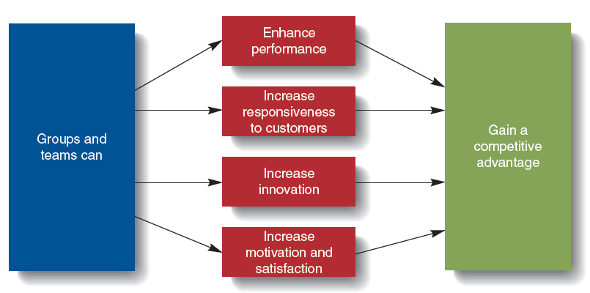
Groups’ and Teams’ Contributions to Organizational Effectiveness

Slide 7
Groups and Teams as Motivators
Members of groups, and particularly teams, are often better motivated and satisfied than individuals.
Team members are more motivated and satisfied than if they were working alone.
Notes:
7
Members of groups, and particularly teams, are often better motivated and satisfied than individuals.
Team members are more motivated and satisfied than if they were working alone.
Team members can see the effect of their contribution to achieving team and organizational goals.
Teams provide needed social interaction and help employees cope with work-related stressors.

Slide 8
The Types of Groups and Teams
Formal Group
  A group that managers establish to achieve organization goals.
Informal Group
  A group that managers or nonmanagerial employees form to help achieve their own goals or to meet their own needs.
Notes:
8
Cross-functional teams
composed of members from different departments
Cross-cultural teams
composed of members from different cultures or countries

Slide 9
Keys to Effective Self Managed Teams
Give the team enough responsibility and autonomy to be self-managing.
The team’s task should be complex enough to include many different steps.
Select members carefully for their diversity, skills, and enthusiasm.
Managers should guide and coach, not supervise.
Analyze training needs and be sure it is provided.
Notes:
9

Slide 10
Group Size
Advantages of small groups
Interact more with each other and easier to coordinate their efforts
More motivated, satisfied, and committed
Easier to share information
Better able to see the importance of their personal contributions

Slide 11
Group Size
Disadvantage of small groups is that members of small groups have fewer resources available to accomplish their goals.

Slide 12
Group Size
Advantages of large groups
  More resources at their disposal to achieve group goals
  Enables managers to obtain division of labor advantages
Disadvantages of large groups
  Problem of communication and coordination
  Lower level of motivation
  Members might not think their efforts are really needed

Slide 13
Group Leadership
Effective leadership is a key ingredient in high performing groups, teams, and organizations.
Formal groups created by an organization have a leader appointed by the organization.
Groups that evolve independently in an organization have an informal leader recognized by the group.

Slide 14
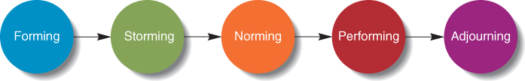
The Stages of Group Development
Figure 15.4

Slide 15
Stages of Group Development
Forming
  Group members get to know each other and reach common understanding and become identified as a group.
Storming
  Group members experience conflict because some members do not wish to submit to demands of other group members
Norming
  Group determines what the “rules” of behavior are for the members of the group (norms), who does what (roles), and how to best work together.
Notes:
15

Slide 16
Stages of Group Development
Performing
  The group begins to do its real work.
Adjourning
  Applies only to groups that eventually are disbanded.
Notes:
16

Slide 17
Reducing Social Loafing in Groups
Social loafing
  The tendency of individuals to put forth less effort in a group than individually.
  Results in possibly lower group performance and failure to
  attain group
  goals
Notes:
17

Slide 18
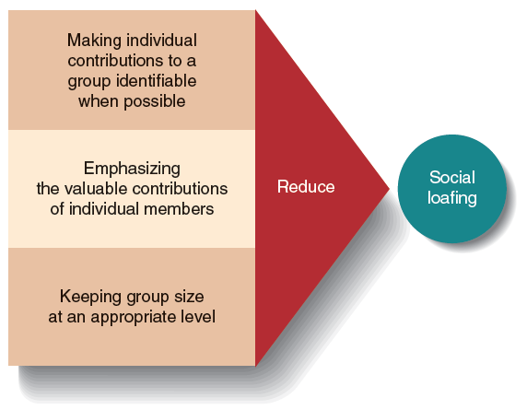
Three Ways to Reduce Social Loafing
Notes:
Reducing social loafing:
Make individual efforts identifiable and accountable.
Emphasize the valuable contributions of individual members.
Keep group size at an appropriate level.
18

Slide 19
Group Norms
Group Norms
  Shared guidelines or rules for behavior that most group members follow
Managers should encourage members to develop norms that contribute to group performance and the attainment of group goals

Slide 20
Group Norms
Conformity and Deviance
  Members conform to norms to obtain rewards, imitate respected members, and because they feel the behavior is right.
  When a member deviates, other members will try to make them conform, expel the member, or change the group norms to accommodate them.
Notes:
20
Conformity and deviance must be balanced for high performance from the group.
Deviance allows for new ideas in the group.

Slide 21
Organizational Conflict
Organizational Conflict
  The discord that arises when goals, interests or values of different individuals or groups are
  incompatible
  and those people
  block or prevent
  each other’s efforts
  to achieve their
  objectives.
Notes:
21

Slide 22
Organizational Conflict
Conflict is inevitable given the wide range of goals for the different stakeholders in the organization
Conflict can also exist between departments and divisions that compete for resources
Notes:
22

Slide 23
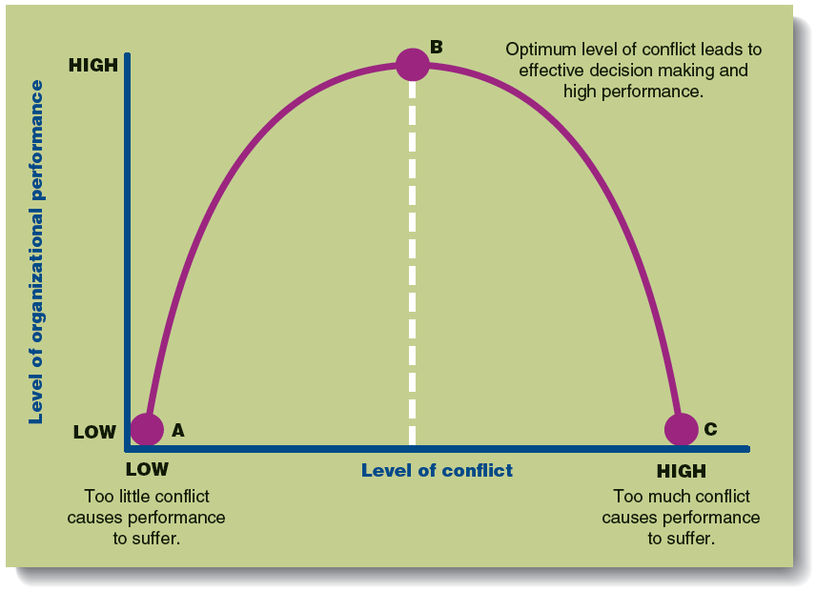
The Effect of Conflict on
Organizational Performance

Slide 24
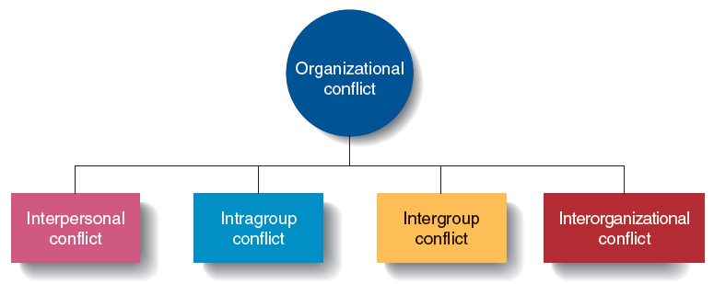
Types of Conflict

Slide 25
Types of Conflict
Interpersonal Conflict
  Conflict between individuals due to differences in their goals or values.
Intragroup Conflict
  Conflict within a
  group, team or
  department
Notes:
25

Slide 26
Types of Conflict
Intergroup Conflict
  Conflict between two or more teams, groups or departments.
  Managers play a key role in resolution of this conflict
Interorganizational Conflict
  Conflict that arises across organizations.
Notes:
26

Slide 27
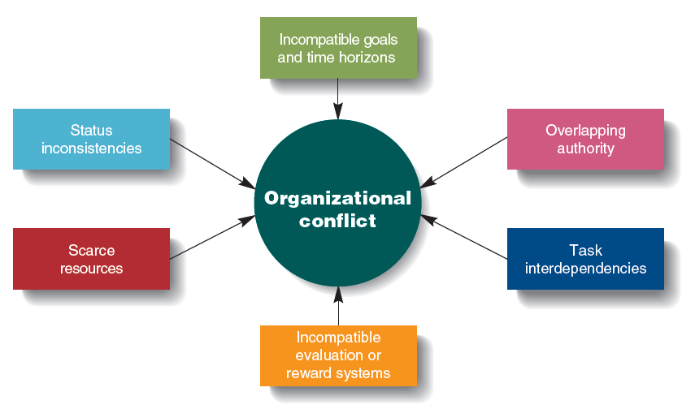
Sources of Conflict
Figure 17.3

Slide 28
Sources of Conflict
Different Goals and Time Horizons
  Different groups have differing goals and focus.
Overlapping Authority
  Two or more managers claim authority for the same activities which leads to conflict between the managers and workers.
Notes:
28

Slide 29
Sources of Conflict
Task Interdependencies
  One member of a group or a group fails to finish a task that another member or group depends on, causing the waiting worker or group to fall behind.
Notes:
29

Slide 30
Sources of Conflict
Different Evaluation or Reward Systems
  A group is rewarded for achieving a goal, but another interdependent group is rewarded for achieving a goal that conflicts with the first group.
Notes:
30

Slide 31
Sources of Conflict
Scarce Resources
  Managers can come into conflict over the allocation of scare resources.
Status Inconsistencies
  Some individuals and groups have a higher organizational status than others, leading to conflict with lower status groups.
Notes:
31

Slide 32
Conflict Management Strategies
Functional Conflict Resolution
  Handling conflict by compromise or collaboration between parties.
Notes:
32

Slide 33
Conflict Management Strategies
Compromise
  each party is concerned about not only their goal accomplishment but also the goal accomplishment of the other party and is willing to engage in a give-and-take exchange to reach a reasonable solution.

Slide 34
Conflict Management Strategies
Collaboration
  both parties try to satisfy their goals by coming up with an approach that leaves them both better off and does not require concessions on issues that are important to either party.

Slide 35
7. What Role Does Conflict Play in Teams?
Functional and Dysfunctional Conflict
Functional Conflict
  Moderate Amount Good for Group Creativity
Dysfunctional Conflict
  Undermines Group Success
Notes:
Functional conflict is allowing or encouraging differences of opinions among team members in order to yield better group outcomes. A moderate amount of conflict has been indicated as good for group creativity and group problem solving.
Dysfunctional conflict can involve aggression, personal attacks, or ways of expressing differences that undermine group success.

Slide 36
7. What Role Does Conflict Play in Teams?
Sources of Conflict in Groups
Resource Conflict
Cognitive Conflict
Relationship Conflict
Process Conflict
Overlapping Authority Conflict
Task Interdependency Conflict
Reward Conflict
Notes:
Resource conflict
Conflicts of interest within a group frequently happen when resources are scarce and each group member desires more rather than less of those resources.
Cognitive conflict
Conflict can occur when group members share the same group goals but disagree on how to best achieve the desired result.
Relationship conflict
Relationship conflict has to do with conflict among members of the team as people. This kind of conflict has been seen to negatively impact group performance.
Process conflict
Process conflict refers to conflict within teams about who should be doing what and how the group “should” operate.
Overlapping authority conflict
Overlapping authority is also a source of conflict when two or more people claim authority for the same tasks or functions. In many instances, redundant work by two different business units results in an overlap of managerial authority and employee scheduling.

Slide 37
7. What Role Does Conflict Play in Teams?
Conflict Management: Negotiating to Find the Win-Win
Negotiation Defined
  Both parties give, take, and make concessions to achieve solution to a conflict.
Different Scenarios
  Lose-Lose Scenario
  Win-Lose Scenario
  Win-Win Scenario
Notes:
Negotiation is a conflict resolution method in which both parties give, take, and make concessions to achieve a concordant solution to a conflict situation.
Lose-lose scenario is where neither party gets what it desires or needs from the negotiation.
Win-lose scenario is where one party reaches its desired goal in the negotiation while the other party does not.
Win-win scenario is where both parties achieve their desired goals, and the conflict is resolved.

Slide 38
8. How Can HR Support
Effective Team Performance?
How HR Can Help with Team Building
Provide Training
Professional Development and Support for Teams
Processes to Evaluate Team Performance
Recognize Outstanding Teams
Incentive Programs
Establish High-Performance HR Teams
Notes:
Provide training and development about how to set up and lead teams to team leaders.
Pay attention to the personal transitions in and out of groups, especially at the leadership level.
Provide high-quality professional development and support for teams, especially in the important formation phase.
Develop processes to evaluate team performance that include level of team effectiveness in addition to goal achievement.
Recognize outstanding teams – teams that get results and that people are happy to join. Highlight their best practices so other teams can learn from them.
Develop team-based incentive programs.
Model all of the above and establish high performance HR teams.

