Slide 1
Lab 3b
More Fun with Correlation and Regression

Slide 2
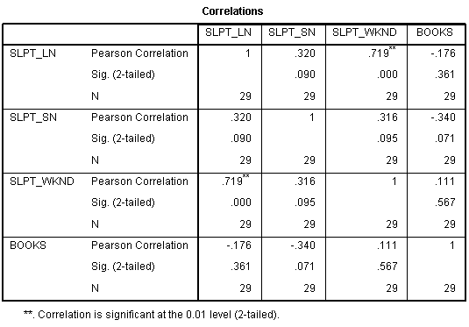
1. Open Dataset “Sleep,” correlate all the variables, and summarize all the correlations in the standard format [r(20) = 4.55, n.s.].

Slide 3
1. Open Dataset “Sleep,” correlate all the variables, and summarize all the correlations in the standard format [r(20) = 4.55, n.s.].
r(27)=.320, n.s.
r(27)=.719, p<=.05
r(27)=.176, n.s.
r(27)=.316, n.s.
r(27)=-.340, n.s.
r(27)=.111, n.s.

Slide 4
2. Identify the variable pairs with the weakest and strongest correlations in #1.
Strongest:
Slpt_wknd & Slpt_ln
Weakest:
Books and Slpt_wknd

Slide 5
3. Identify the amount of variance Weekend Sleep accounts for in amount Slept Last Night.
r =.719
r² = .5170

Slide 6
4. If appropriate, provide the formula for predicting Hours Slept Last Night based on Hours Slept Last Weekend.
y’ = bx + a
y’ = 1.061(x) – 2.406

Slide 7
5. If appropriate, predict Hours Slept Last Night based on Hours Slept on School Night.
Not appropriate. Correlation not significant.

Slide 8
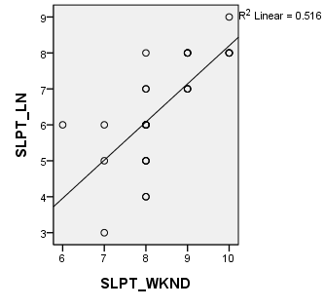
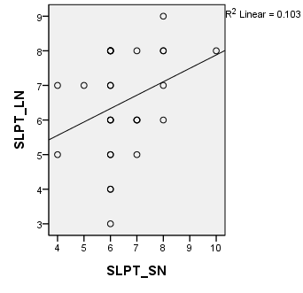
6. Using SPSS, create a scatterplot for #4 with a regression line. Roughly sketch axes and line below.
7. Using SPSS, create a scatterplot for #5 with a regression line.

Slide 9
8. Predict Hours Slept Last Night if Weekend Hours Slept is 5.
y’ = bx + a
y’ = 1.061(x) – 2.406
y’ = 1.061(5) – 2.406
y’= 2.899

Slide 10
9. State the correct symbols and values for #8:
a. Coefficient of Determin: r²= .516 b. Std Err of the Residual: Sy’ = 1.064 c. Chance that ρ = 0: p = .000 (actually p<.001) d. Pearson’s Corr. Coeff: r = .719

Slide 11
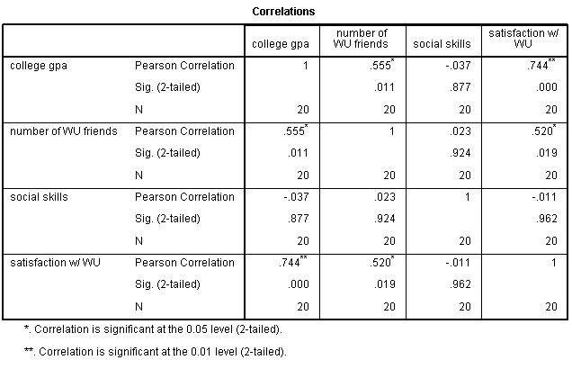
10. Open Dataset Bogus Winthrop. Summarize all correlations among the interval and ratio data.
r(18)=.555, p<=.05
r(18)=-.037, n.s.
r(18)=.744, p<=.05
r(18)=.023, n.s.
r(18)=.520, p<=.05
r(18)=-.011, n.s.

Slide 12
11. Identify the two strongest and two weakest correlations in previous problem – state the two variable pairs.
Strongest: Satisfaction & GPA
Weakest: Satisfaction & Social Skills

Slide 13
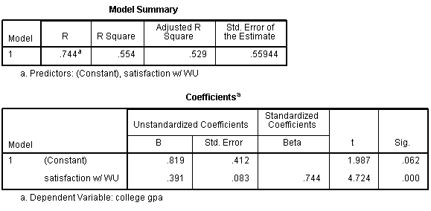
12. If appropriate, state the formula for predicting GPA based on Satisfaction.
y’ = bx + a
y’ = .391(x) + .819

Slide 14
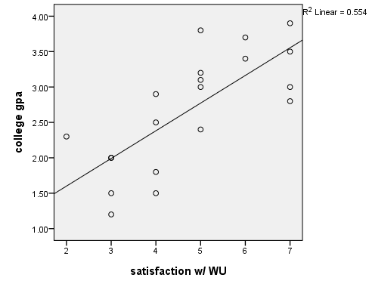
13. Do a scatterplot with a regression line for previous problem. Roughly sketch the axes and line here.

Slide 15
14. State the correct symbols and values for #12.
a. Coefficient of Determin: r²= .554 b. Std Err of the Residual: Sy’ = .5594 c. Chance that ρ = 0: p = .000 (actually p<.001) d. Pearson’s Corr. Coeff: r = .744

Slide 16
15. Predict GPA if Satisfaction is 6.
y’ = bx + a
y’ = .391(x) + .819
y’ = .391(6) + .819
y’ = 3.165

