Slide 1
Objective Setting and Budgeting

Slide 2
Chapter Objectives
After reading this chapter you should be able to:
Understand the process of marcom objective setting and the requirements for good objectives.
Appreciate the hierarchy-of-marcom effects model and its relevance for setting marcom objectives.
Discuss the Integrated Information Response Model and how it helps determine the integration of advertising and direct product experience under different levels of involvement.
Comprehend the role of sales as a marcom objective and the logic of vaguely right versus precisely wrong thinking.
Know the relationship between a brand’s share of market (SOM) and its share of voice (SOV) and the implications for setting an advertising budget.
Understand the various rules of thumb, or heuristics, that guide practical budgeting.

Slide 3
Marcom Objectives and Tools
Marcom Objective | Marcom Tool
Facilitate the successful introduction of new brands | Brand naming, packaging, advertising, sales promotions, word-of-mouth buzz generation, point-of-purchase P-O-P) displays, and social media
Build sales of existing brands by increasing the frequency of use, the variety of uses, or the quantity purchased | Advertising and sales promotions
Inform the trade (wholesalers, agents or brokers, and retailers) and consumers about brand improvements | Personal selling and trade-oriented advertising
Create brand awareness | Advertising, packaging, social media, and P-O-P messages.
Enhance a brand’s image | Brand naming and packaging, advertising, social media, event sponsorship, cause-oriented marketing, and marketing-oriented public relations
Generate sales leads | Advertising

Slide 4
Marcom Objectives and Tools (cont’d)
Marcom Objective | Marcom Tool
Persuade the trade to handle the manufacturer’s brands | Trade-oriented advertising and personal selling
Stimulate point-of-purchase sales | Brand naming and packaging, P-O-P messages, and external store signage
Increase customer loyalty | Advertising, social media, and sales promotions
Improve corporate relations with special interest groups | Marketing-oriented PR
Offset bad publicity about a brand or generate good publicity | Marketing-oriented PR
Counter competitors’ communications efforts | Advertising and sales promotions
Provide customers with reasons for buying immediately instead of delaying a purchase | Advertising and sales promotions

Slide 5
Why Setting Marcom (Advertising) Objectives Is Important
Expression of management consensus
Guides the budgeting, message, and media aspects of advertising strategy
Provide standards against with results can be measured

Slide 6
Marcom (Advertising) Objectives
Who
*What*
Where
When
How Often
Several categories of marcom (advertising) objectives that
can guide strategy
* The “what” arguably is the most difficult objective.

Slide 7
Hierarchy of Effects Models
Communication Objectives (Indirect)
Sales Objective (Direct)
Awareness
Knowledge
Preference
Purchase
Conviction
Liking
] Cognitive Stage
] Affective Stage
] Conative Stage
Hierarchy of Effects Orderings:
Traditional Learning Hierarchy (high involvement):
Cognition → Affect → Conation
Low Involvement Hierarchy:
Minimal Cognition → Conation → Affect

Slide 8
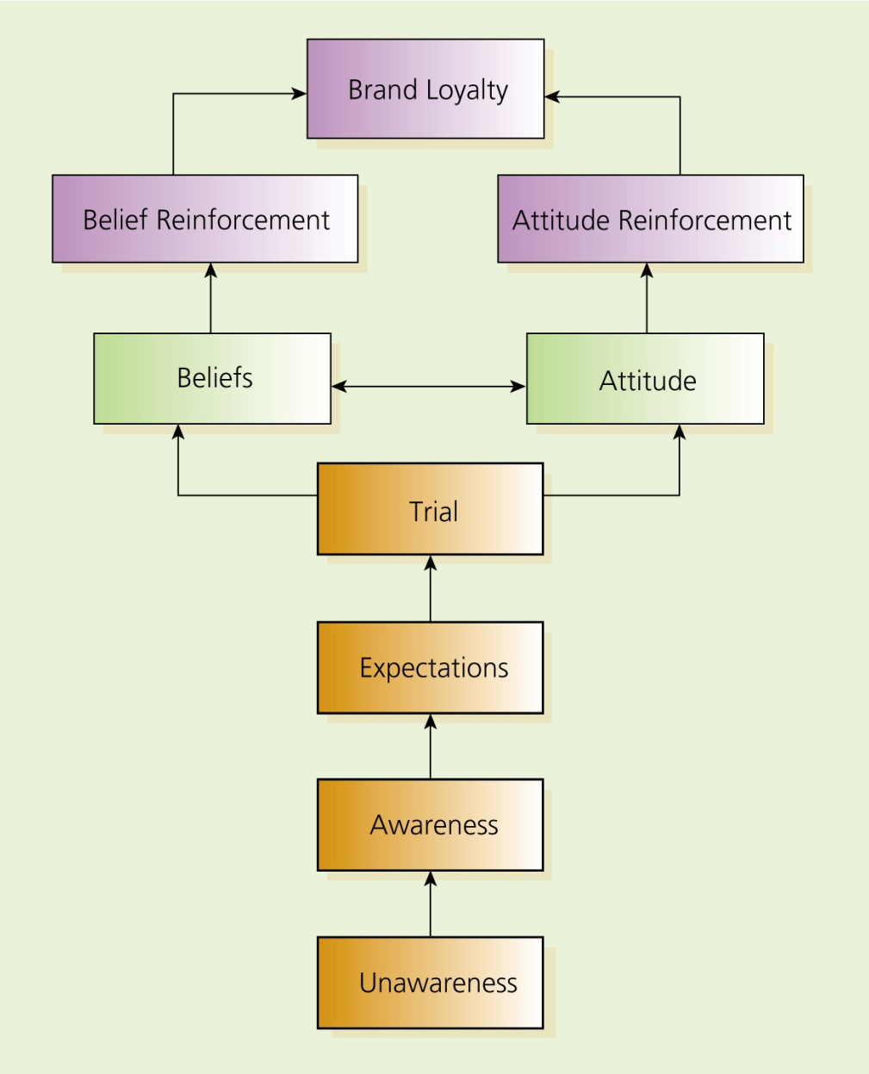
Figure 8.1: The Hierarchy of Marcom Effects
The hierarchy of effects metaphor implies that for marketing communications to be successful it must move consumers from one goal to the next goal.

Slide 9
Figure 8.2: An Advertisement Illustrating Hierarchy of Marcom Effects by Creating Expectations

Slide 10
Questions/Issues from the Hierarchy Model
Which comes first, attitude or behavior?
Which is more important, advertised information or personal experience?
Is brand loyalty guaranteed?
What are the implications for objective setting (e.g., awareness, expectations, trial, reinforce beliefs, ...)?

Slide 11
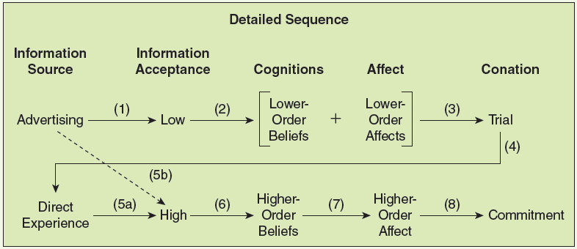
Fig. 8.3: Integrated Information Response Model (Smith and Swinyard 1982 Journal of Marketing)

Slide 12
Figure 8.4: Setting Good Marcom (Advertising) Objectives
Include a precise statement of who, what, and when
Be quantitative and measurable
Specify the amount of change
Be realistic
Be internally consistent
Be clear and put it in writing

Slide 13
Should Marcom Objectives Be Stated in Terms of Sales?
Communications (Indirect) Objectives
attempt to increase the target audience’s brand awareness, enhance their attitudes toward the brand, shift their preferences from the competitors’ brand and so on.
Sales (Direct) Objectives
mean the marcom objective literally is to increase sales by a particular amount.

Slide 14
Situations in which Sales (Direct) Objectives May Be Appropriate
Advertising by retailers
Direct-response advertising
Sales promotion advertising
Business-to-business advertising
Also: Where is the Target Market in the Stages of the Decision-making Process?
Problem recognition
Search
Evaluation
Choice
Outcomes

Slide 15
Should Marcom Objectives Be Stated in Terms of Sales?
Traditional View (Thesis)
Sales volume is the consequence of a host of factors in addition to marcom
Effect of marcom efforts is delayed

Slide 16
Sales Volume as a Marcom Objective
Heretical View (Antithesis)
Marcom’s purpose is to generate sales
Sales measures are “vaguely right”

Slide 17
One View: “The Logic of Vaguely Right Vs. Precisely Wrong Thinking”
Vaguely
Right
Measurement
Accuracy
Issue
Choice of
Objective
Issue
Versus
Precisely
Wrong

Slide 18
Practical Budgeting Methods
Percent-of-Sales Budgeting
Objective-and-Task Method
Competitive Parity Method (match competitors’ method)
Affordability Method

