Slide 1
The Role of Gender in Myths
ENGL 508x
June 18, 2009

Slide 2
Review: Goddess Character Types
Literary Character Types
  Great Mother, Universal Womb, “births, feeds, clothes, teaches, and guards all living things” (Leonard and McClure 114)
  Queens of the Underworld, witches, sorceress, mediums, wise women; can control sterility and fertility (Leonard and McClure 115-116)
  “appear as virgins and nymphs, as objects of sexual desire, and as sponsors of and the inspiration for everything beautiful” (Leonard and McClure 118)
Goddess of Life:
Goddess of Death:
Goddess of Regeneration:

Slide 3
“A Taste of Earth”
Vietnamese Myth
Au Co, “youngest and loveliest goddess,” solely creates the sun and the moon.
Desiring to bath in the warmth of the sun, she and her sisters transform themselves into birds and fly to the earth.
Out of curiosity, Au Co tastes the earth, which hinders her ability to fly back home with her sisters.
She befriends the Dragon Prince, who eventually becomes her husband and the father of her half-human and half-dragon children.
They live a seemingly happy life together teaching their children until the Dragon Prince has to return to his underwater home to inherit the throne.
The myth leaves off with his promise to return while she calls longingly for him.

Slide 4
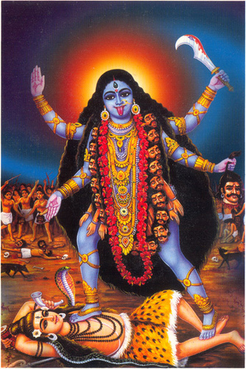
Kali: Indian Goddess of Destruction

Slide 5
“Kali Beheaded”
Indian Myth
Kali, known as a “terrible goddess,” is beautiful, yet she “(gives) herself away” to lowly men.
Knowing this, what does this quotation mean?
She is decapitated by jealous gods; in an act of penance, the gods seek to restore her wholeness but mistakenly attach a prostitute’s body to the goddess’ head.
She becomes distraught and even allows a man to “overtake her.”
She is bitter and kills insects, animals.
The Master of Great Compassion assures Kali that no one is complete and that she is destined for perfection.
“But Kali, a perfect flower, ignored her own perfection and, pure as the day itself, had no knowledge of her own purity.”

Slide 6
Discussion Point One
Do the goddesses from these myths encompass more than one goddess archetype? Does there seem to be a blend of archetypal characteristics with the goddesses as we found to be true with the male gods, or do they remain singular?
With an established family, does the role of the goddess shift/change?

Slide 7
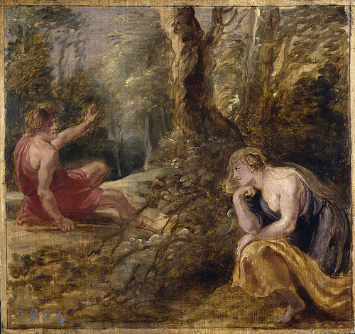
Cephalus and Procris
Cephalus and Procris

Slide 8
Cephalus and Procris
Cephalus, a devoted husband, aided his country in a time of distress by sending out his dog to capture a savage fox.
Tired from the hunt, Cephalus rested in the woods and said aloud, “Come, sweet breeze, come and fan my breast, come and allay the heat the burns me” (Bulfinch 22).
Nosey maidens told his wife that he was in the woods calling for another lover.
In an effort to learn the truth, his wife set out to the woods, there finding her husband.
Upon hearing a noise, Cephalus threw his trusty javelin, killing his wife.
With her dying words, she pleaded with him not to marry the other woman named, “Breeze.”

Slide 9
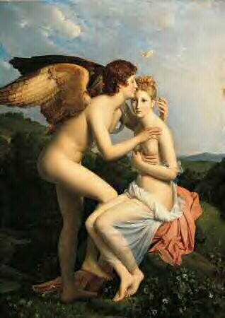
Cupid and Psyche

Slide 10
Cupid and Psyche
Venus was enraged that Psyche was being praised with the same affections as she was, so she commanded her son, Cupid, to cast a spell upon her that would make her love the lowliest monster.
Cupid mistakenly wounds himself with his own arrow, and he does not fulfill the wishes of his mother.
Psyche learns of her fate and goes by a mountainside where she falls asleep. Upon awaking, she is catered by invisible hosts.
She “marries” her host, who she is not allowed to see.
Overly intrigued (and encouraged by her sisters), she betrays her husband and looks at him while he sleeps; she discovers that it is Cupid.
In order to win Cupid’s heart back, she endures a series of tests from his mother Venus all the while being aided by various gods.
She becomes immortal, and she and Cupid are once again bound by love.

Slide 11
Discussion Point Two
Curiosity: Consider the myths of Au Co, Cephalus and Procris, and Cupid and Psyche. What is the resulting consequence from curious action?
Typically, the goddesses are curious when it comes to their male partners. What does this say about the female gender as well as the male gender?
  Consider why the women feel the need to be curious; do women consider men to be untrustworthy? Do the women consider the men to be their property?

Slide 12
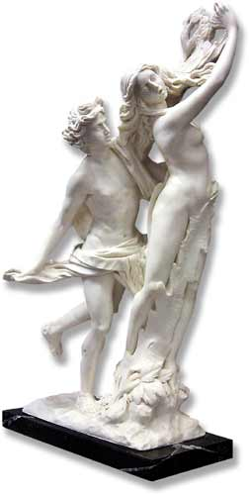
Apollo and Daphne
Apollo and Daphne

Slide 13
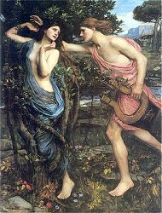
Apollo and Daphne

Slide 14
Apollo and Daphne
After mocking Cupid, Apollo is punished with love: he is made to love Daphne while she abhors him.
Apollo constantly pursues Daphne while she simply leads him on a chase.
Apollo almost “captures” Daphne in a chase, but before he is able to do so, she calls upon the gods for help. To her avail, she becomes a tree.
Apollo vows to be with her forever. She will be worn upon his head as his crown.

Slide 15
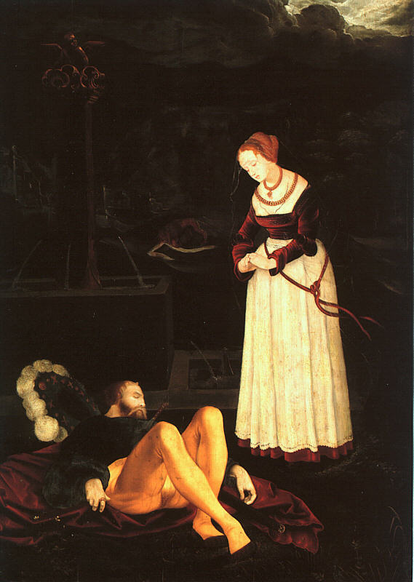
Pyramus and Thisbe

Slide 16
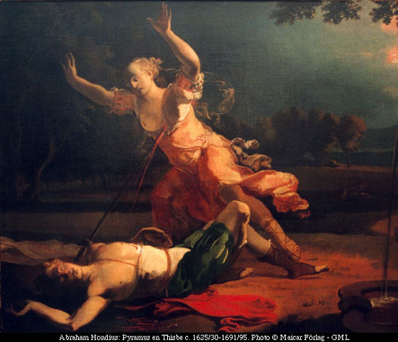
Pyramus and Thisbe
Pyramus and Thisbe

Slide 17
Pyramus and Thisbe
Pyramus and Thisbe are young lovers whose parents disapprove of their union.
They are able to secretly converse with one another through a crack in a wall their dwellings share.
They devise a plan in order to meet in the night at a secret location.
While waiting for Pyramus, Thisbe becomes frightened by a lioness and hides in the hollow of a rock. Along the way, she accidentally drops her veil.
When Pyramus comes to the meeting spot, he finds Thisbe’s veil bloodied by the lions. Thinking that she is dead, Thisbe takes his own life.
Upon finding Thisbe dead, Pyramus too commits suicide.

Slide 18
Discussion Point Three
Oftentimes in literature, we find that the female equates her dependency for her partner’s love with her actual life capacity. (For example, the myth of Ceyx and Halcyone). How do the aforementioned myths conflict with this previous notion?

