Slide 1
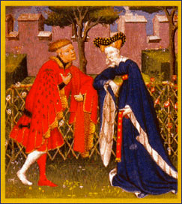
This “Courtly Love” Thing
Truths, Half-Truths, and Misconceptions

Slide 2
We are talking about an age
That did not have paternity testing (or chastity belts!)
That was organized around primogeniture determining inheritance rights
That was governed by a church that taught that adultery was a mortal sin that would send the sinner to hell for eternity
Where women were both powerful and powerless
And where marriage (especially among the aristocracy) was often much more of an economic and political arrangement than an emotional union

Slide 3
We are also talking about an age
Where the political and economic circumstances of great aristocratic families required moving from estate to estate to spread the economic impact and to administer the family holdings; husbands and wives sometimes had separate households (even to the point of separate bookkeeping)
Where wars and crusades separated families for long periods of time
Where young aristocratic men had to be socialized into “polite” society—no longer the ethos of the warrior band

Slide 4
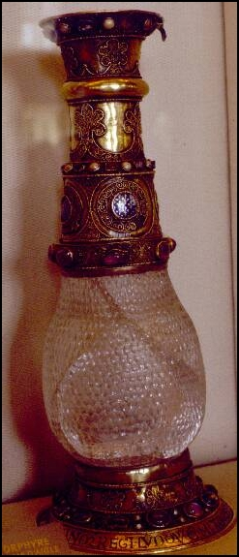
Troubadour Poetry
Troubadours are lyric poets employing the Romance vernacular called Provençal or Occitan.
Muslim influence (many as prisoners in court of William VIII of Poitiers)
William IX of Poitier (1071-1126) is the first recognized troubadour poet
Eleven of William’s songs survive

Slide 5
The Roots of Troubadour Poetry
Major focus of troubadour poetry is unrequited love—or the pursuit of love that is difficult to obtain
Blended with classical stances adopted from Ovid
Theorists don’t agree on why it flourished
Muslim, Classical, Christian
Mariology & Affective Prayer
Response to Hegemony of Women

Slide 6
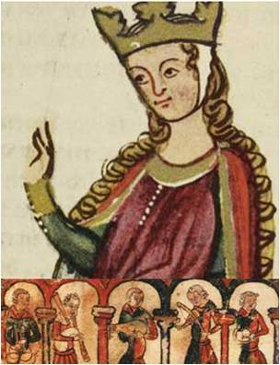
Guess who’s back…
Eleanor of Aquitaine is the granddaughter of William IX.
In 1168, Eleanor of Aquitaine and Henry II separated; she took up residence in her ancestral lands of Poitou.
Eleanor's court drew vassals paying homage, squires training to be knights, young ladies acquiring their education, and a circle of musicians, philosophers, artists, and literati
“Fin’amor” comes from her court

Slide 7
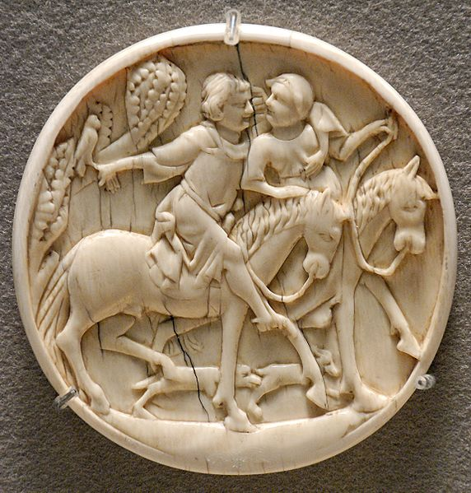
The Golden Age
Of more than 2500 surviving troubadour poems, more than half are from 1180-1220
The troubadour tradition seems to have begun in western Poitou and Gascony, from there spreading over into eastern Aquitaine, Champagne, and Provence.
Many poems are debates in which each voice defends a position on a topic relating to love or ethics—drawn from university teaching practices

Slide 8
Any evidence?
No historical records offer evidence of its presence in reality. Historian John Benton found no documentary evidence in law codes, court cases, chronicles, or other historical documents.
Courtly love probably found expression in the real world in customs such as the crowning of Queens of Love and Beauty at tournaments.

Slide 9
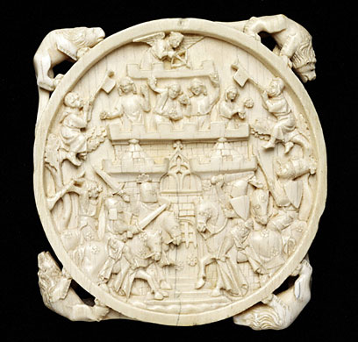
In OTHER WORDS….
IT’S A LIVE ACTION ROLE-PLAYING GAME

Slide 10
Sociology of the Game
Used language of feudalism: poets declare themselves the vassal of the lady and addressing her as midons (my lord),
The troubadour's model of the ideal lady was the wife of his employer or lord, a lady of higher status, usually the rich and powerful female head of the castle.
The poet gave voice to the aspirations of the courtier class, for only those who were noble could engage in courtly love.
Nobility not based on wealth and family history, but on character and actions, thus appealing to poorer knights who saw an avenue for advancement.

Slide 11
How Far Did It Go?
All courtly love was erotic to some degree, and not purely platonic—the troubadours speak of the physical beauty of their ladies and the feelings and desires the ladies rouse in them.
Unclear what a lover should do: live a life of pure love, channeling his energies to higher ends, or seek physical consummation.

Slide 12
What is “pure love”?
Andreas Capellanus: Pure love binds together the hearts of two lovers with every feeling of delight. This kind consists in the contemplation of the mind and the affection of the heart; it goes as far as the kiss and the embrace and the modest contact with the nude lover, omitting the final solace, for that is not permitted for those who wish to love purely.... That is called mixed love, which gets its effect from every delight of the flesh and culminates in the final act of Venus.

Slide 13
And the adultery?
The "courtly love" relationship typically was not between husband and wife, not because the poets and the audience were inherently immoral, but because it was an idealized sort of relationship that could not exist within the context of "real life" medieval marriages.
The audience for romance was perfectly aware that these romances were fables, not models for actual behavior. The adulterous aspect that bothers many modern readers was somewhat beside the point, which was to explore the potential influence of love on human behavior.

Slide 14
Why did society need fin’amor?
Fin’amor may have provided a model of behavior for unmarried young men who might otherwise have threatened social stability.
Younger brothers without land of their own (hence unable to support a wife) became members of the household of the feudal lords whom they served.
The lady in the courtly love relationship is typically older, married and of higher social status than the knight ; modelled on the wife of the feudal lord, who might naturally become the focus of the young, unmarried knights' desire.
Köhler and Duby posit that the literary model of the courtly love provides these young men with a model for appropriate behavior, teaching them to sublimate their desires and to channel their energy into socially useful and morally improving behavior

Slide 15
Stages of Courtly Love
Attraction to the lady, usually via eyes/glance
Worship of the lady from afar
Declaration of passionate devotion
Virtuous rejection by the lady
Renewed wooing with oaths of virtue and eternal fealty
Moans of approaching death from unsatisfied desire (and other physical manifestations of lovesickness)
Heroic deeds of valor which win the lady's heart
Consummation of the secret love
Endless adventures and subterfuges avoiding detection

Slide 16
Andreas Capellanus
From Troyes or thereabouts by dialect
Flourished in late 1180s
May have been a chaplain to Marie’s court
Known for Liber de arte honeste amandi et reprobatione inhonesti amoris (c. 1185) in 3 books
Bk 1: What Love is, what it does, how to get it
Bk. 2: How to keep Love, sustain it, and lose it
Bk. 3: Don’t practice anything in bks. 1 &2; show God you can withstand the temptation

Slide 17
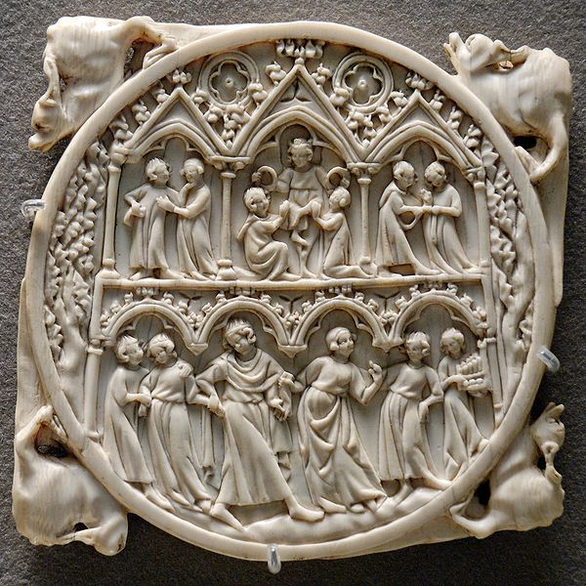
Courts of Love
Andreas describes tribunals staffed by 10 to 70 women who would hear a debate or “case” (tenso) about love & rule on it based on the rules of love. Motif shows up in art.
19th century historians took these courts as fact, but no evidence suggests they ever existed outside literature.
According to Diane Bornstein, they may have been literary salons or social gatherings, where people read poems, debated questions of love, and played word games of flirtation.

Slide 18
Debate over how to read De arte
Ironic view of the conventions of courtly love, written from an educated milieu outside the conventions of courtly literature (think The Onion)
Treatise attests to the popularity of the literary conventions of "fin'amors" within courtly society—you can’t mock something that does not exist!

Slide 19
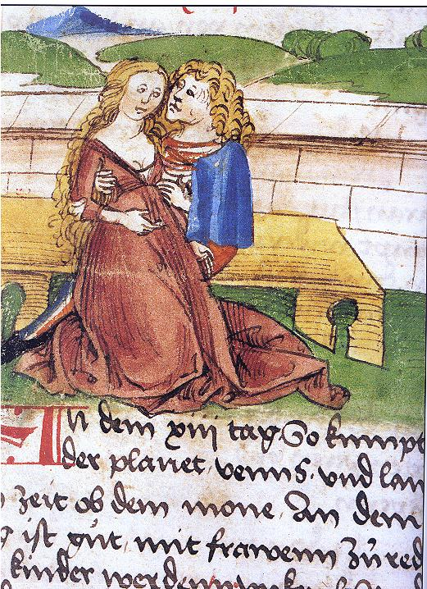
Literary Theory of fin’amor
In the middle ages, the term used was amour fine (in Occitan, fin’amor), pure love or refined love
In the late 18th and early 19th c, scholars called it “amour chevaleresque.”
In the late 19th c, the scholar Gaston Paris coined the term “courtly love” in an article on The Knight of the Cart

Slide 20
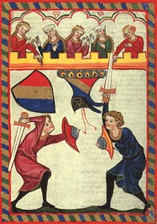
What characterizes amour chevaleresque?
The term amour chevaleresque centers emotion on the male lover-hero, a lover who is also a knight.
He fights, at least in part, because inspired by love, and is loved, at least in part, because of his successes as a knight.
Individual emotionexpresses itself primarily in action, which, although placed at the service of the lady, also serves the interests of community since the hero's opponents merit their defeat.

Slide 21
Amour Courtois
The term amour courtois highlights instead the virtues of decorum and discretion in love.
It helps direct our attention to the ways in which love is regulated by principles of exchange in the same way as other feudal and courtly institutions.
The lover is involved in a complex way with his community, since the court helps to define his status and identity, and he in turn contributes to its welfare by his heroic actions. Individual emotion is framed by social pressure and communal interest.

Slide 22
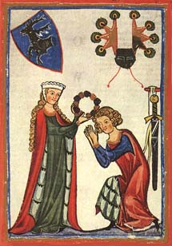
Fin’amor
Places the emphasis much more firmly on the individual behavior of the lover, on his or her moral conduct and personal inspiration.

Slide 23
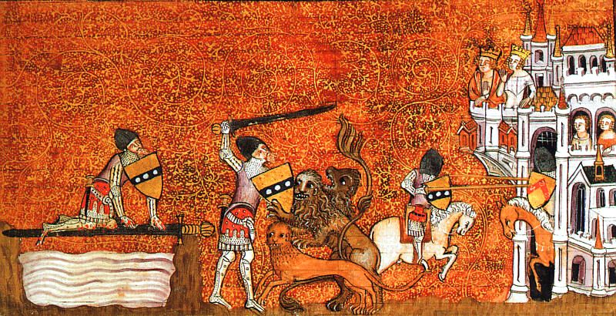
Fin’amor & Arthurian Lit

Slide 24
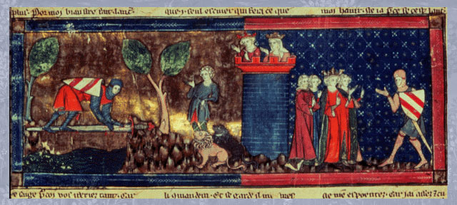
Why such a good fit?
Lots of knights whose adventures can be debated
Most unattainable lady (Guenevere)
Reputation for feats of arms, moral excellence

Slide 25
When the streams cross…

