Slide 1
Reapportionment and Redistricting

Slide 2
Reapportionment
Determining the number of seats each state gets as a result of the Census; moving seats from states losing/gaining population slowly to states gaining population rapidly
Reapportionment is conducted using the “method of equal proportions”

Slide 3
Redistricting
Once a state’s number of seats has been determined, the district lines must be redrawn within the state so that each district has almost exactly equal population.
In most states, this is controlled by the state legislature and is a highly partisan process.

Slide 4
South Carolina 1970’s

Slide 5
South Carolina 1980’s

Slide 6
South Carolina 1990’s

Slide 7
South Carolina 2000’s

Slide 8
Gerrymandering

Slide 9
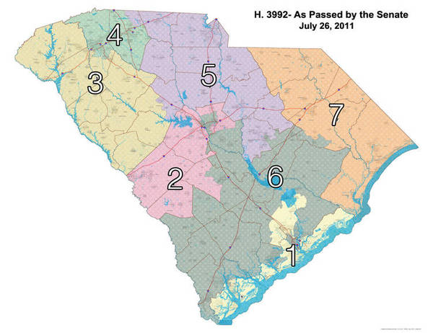
South Carolina 2010’s

Slide 10
Your turn!
http://gardow.com/davebradlee/redistricting/launchapp.html
Launch Dave’s Redistricting 2.2
Click on <Select State> (upper left-hand corner) and choose South Carolina
Set the number of districts at seven (use the buttons or the slider)
Divide South Carolina into seven districts with population variance of less than 100. (This site doesn’t allow you to split precincts, so exact population equality is extremely difficult if not impossible to achieve.)

Slide 11
The districts must be contiguous, that is, they have to touch at all points – you can’t skip over territory.
Note that this uses the election results from the Obama/McCain presidential race, rather than Congressional races. These will be proxies for Democratic and Republican votes for Congress.
Produce two different maps, using your choice of any of the following criteria:
1. Maximize the Republican advantage (draw as many Republican-majority districts as possible).
2. Maximize the Democratic advantage (draw as many Democratic-majority districts as possible).
3. Construct as many black-majority population districts as possible.
4. Create four Republican districts and three Democratic districts (which most closely reflects the actual vote distribution in the state).

