Slide 1
142520 | 136266
136872 | 143771
92005 | 166643
99171 | 167428
130064 | 140970
132354 | 143985
129463 | 135833

Slide 2
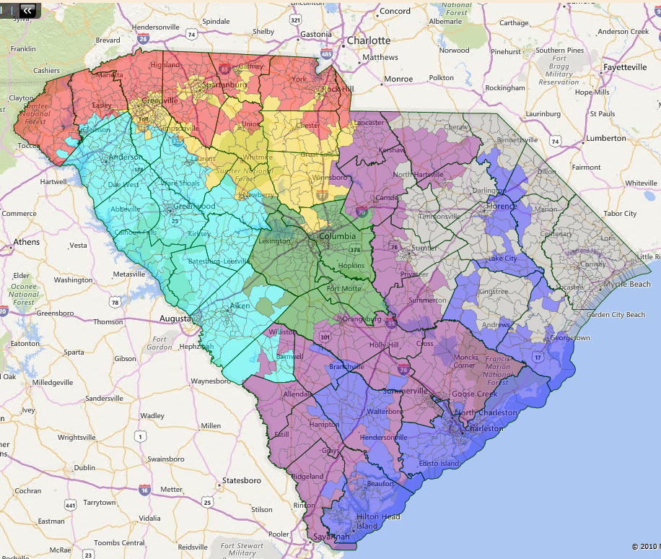
142512 | 142400
140451 | 140193
130257 | 130253
82074 | 188499
130525 | 130283
101057 | 167818
135573 | 135450

Slide 3
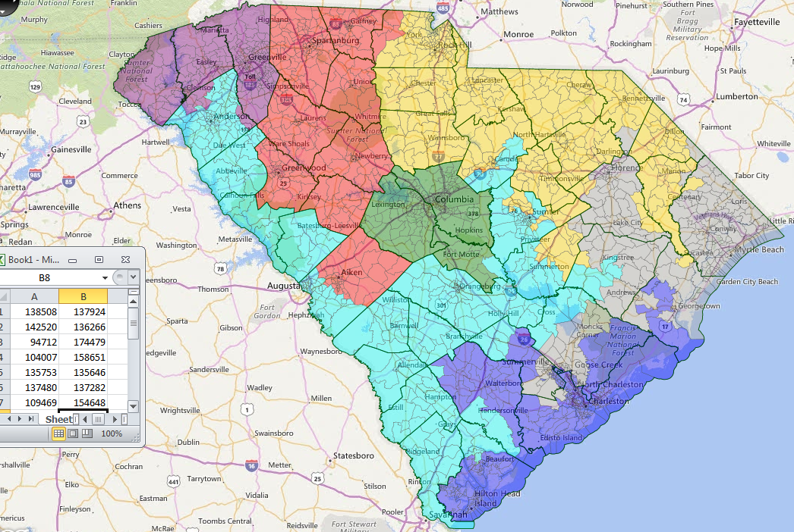

Slide 4
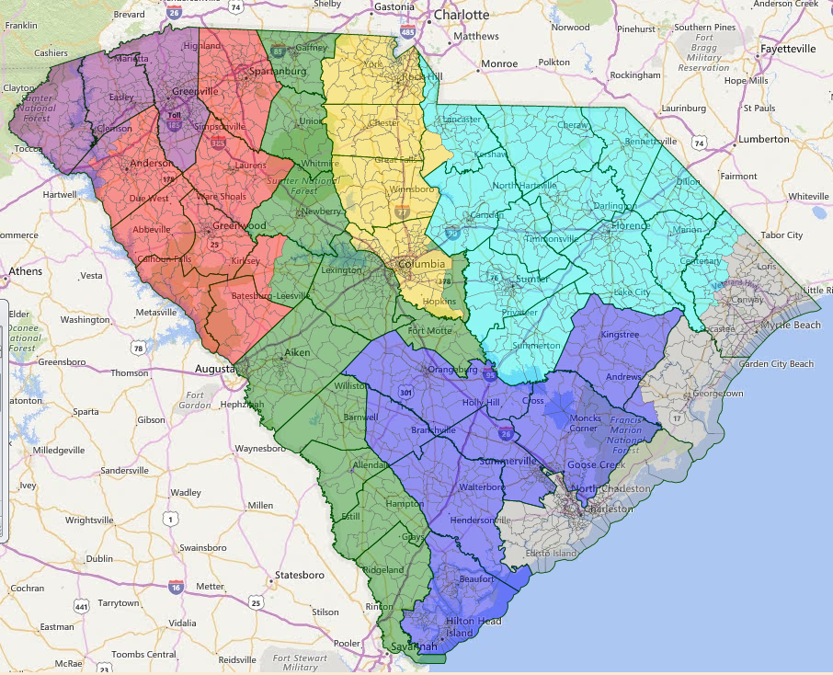
132266 | 132251
106967 | 169711
94737 | 174426
99514 | 158037
156464 | 121943
138072 | 133993
134429 | 144535

Slide 5
