Slide 1
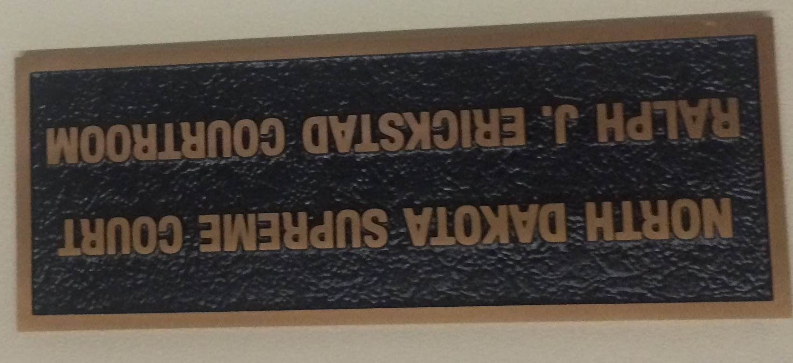
STATE JUDICIAL SYSTEMS AND CRIMINAL JUSTICE

Slide 2
State Courts
State courts handle 97% of the cases filed each year – most federal crimes involve special circumstances such as crossing a state line
In the 2010’s, 250,000 federal civil cases and 77,000 criminal cases
25 million cases in state courts
Each state has a similar structure of trial courts and courts of appeal (Dye and MacManus, p. 255)
Stare decisis: Courts tend to respect precedent and prior decisions (this is the basis of common law)
State Supreme Courts are the final authority on state laws unless the case involves someone’s rights under the U.S. Constitution
State courts play a major role in enforcing state laws
Some state Constitutions have more expansive Bills of Rights than the U.S. Constitution does

Slide 3
Criminal vs. Civil
Criminal law involves offenses which are punishable by fine or imprisonment (felonies and misdemeanors)
Civil law involves cases such as divorces, landlord-tenant disputes, etc.

Slide 4
Principal Methods of Selecting Major State Judges
Major methods listed by state in Dye and MacManus, pp. 259-260
Partisan election (candidates run as Democrats or Republicans)
Nonpartisan election (no party label on ballot)
NC is about return to partisan for some elections
Legislative election (used only in SC and VA)
In 2014, the SC General Assembly narrowly re-elected Chief Justice Jean Toal after she was challenged by Associate Justice Costa Pleicones (although she was elected to a ten-year term, she had to retire in 2015 at age 72, and Pleicones was elected to succeed her, but he was only able to serve one year.)

Slide 5
(Screen cap from a campaign commercial in a North Carolina Supreme Court race)

Slide 6
Judicial Campaign Ads
https://www.youtube.com/watch?v=4Du_WEHjMMw
https://www.youtube.com/watch?v=9HxaGFrViOE

Slide 7
Principal Methods of Selecting Major State Judges
Gubernatorial appointment + confirmation
State Senate: Delaware, Maine, New Jersey, Utah
Entire legislature: Connecticut, Rhode Island, Vermont
Executive Council: New Hampshire
Governor’s Council: Massachusetts (they serve life terms)
The Executive Council in NH and the Governor’s Council in MA are elected members of the executive branch
Appointment plus retention election
The judge is appointed by the Governor for a short term and is then subject to an up-or-down popular vote for a longer term.
Any of these may be used in combination with a merit selection commission.
Each has advantages and disadvantages.

Slide 8
Unique state methods of selecting judges
In Hawaii, the Governor appoints and the Senate confirms Supreme Court Justices; the Chief Justice appoints and the Senate confirms lower court judges.
In Illinois, judges originally run in partisan elections and then run for re-election in uncontested retention elections (“yes or no”).
In New Mexico, the governor nominates a judge who then runs in a partisan election, followed by re-election in retention elections.
In Ohio, judges are nominated in partisan primaries but then run in nonpartisan general elections.

Slide 9
South Carolina Courts
Unified state court system established by constitutional amendment in 1976.
These are elected by the General Assembly with a retirement age of 72:
Supreme Court: five members, ten-year terms
Court of Appeals: nine members, six-year terms
Appellate courts don’t review facts, just procedural issues
Circuit Courts, six-year terms
16 judicial circuits (groups of counties)
http://www.judicial.state.sc.us/circuitCourt/circuitMap.cfm
49 judges throughout the state, at least one resident in each circuit
These are the major trial courts in the state
Notes:
http://www.judicial.state.sc.us/circuitCourt/circuitMap.cfm

Slide 10
South Carolina Courts
Family Court
Master-in-Equity (county official)
Probate Court
Popularly elected in each county
Municipal Court
Jurisdiction over city ordinances
Magistrate Court:
300 county-level officials throughout the state
Appointed by the Governor and confirmed by the Senate
Not required to be attorneys; were not required to be college graduates until 2005
Minor civil and criminal offenses
Register of Deeds
Elected or appointed for the county
Clerk of Court
Elected administrative official in each county

Slide 11
Law enforcement in SC
Public defenders
Circuit solicitors (district attorneys)
Elected by judicial circuit
State law enforcement
State Law Enforcement Division (SLED)
Highway Patrol
State Transport Police
Bureau of Protective Services
Local law enforcement
Sheriff, primarily unincorporated areas of county
Popularly elected
City/town police

Slide 12
SC Criminal Justice Statistics
http://www.doc.sc.gov/research/statistics.jsp
SC has the highest crime rate in the country (D&M p. 269) but not the highest incarceration rate (15th).
61% of the inmates in the SC correctional system are black men.
The most common offenses are drug-related and homicide.
Racial disparities in incarceration:
Higher crime rates
Inequitable access to resources (e.g., private attorneys vs. legal aid)
Legislative decisions (e.g., disparity in sentencing for crack cocaine v. powder)
Overt racial bias

Slide 13
What you can buy from prison labor in Texas:
http://www.tci.tdcj.state.tx.us/

Slide 14
Capital punishment
Most states have it (map, D&M p. 285)
Now applicable only for murder by a mentally competent adult (no other crime merits capital punishment, perpetrator must be at least 18, not retarded, not insane)
http://www.deathpenaltyinfo.org/number-executions-state-and-region-1976
Texas execution calendar:
http://www.tdcj.state.tx.us/death_row/dr_scheduled_executions.html
Pending issue: Does lethal injection constitute cruel and unusual punishment in violation of the Eighth Amendment?

Slide 15
Capital punishment
Disparities in application based on race of perpetrator and race of victim
UNC study (2001) found that the black killer of a white victim was 3.5 times as likely to receive the death penalty as the white killer of a black victim in North Carolina
The race of the victim is more significant in determining the penalty than the race of the killer
http://www.deathpenaltyinfo.org/race-death-row-inmates-executed-1976#defend

Slide 16
Capital punishment
McCleskey v. Kemp (1987): US Supreme Court ruled that a black inmate could not use statistical evidence of disparities in sentencing to contest his death sentence; he had to prove discriminatory intent in his own case (In GA at that time, black killer of white victim was 16 times more likely to receive the death penalty than vice versa)
In 2009, North Carolina enacted the Racial Justice Act, which did allow inmates to challenge death sentences on grounds of racial bias, including introduction of statistical evidence. Four death sentences were converted with life without parole as a result. The RJA was repealed in 2013.

Slide 17
Felon disenfranchisement (Data as of 2009)
5.85 million ex-felons are ineligible to vote after their criminal sentences have been served
7.7% of black adults nationally, 23% in Florida
In Florida, Iowa, Kentucky and Virginia, disenfranchisement is permanent after any felony conviction
In Arizona, it’s permanent after a second felony conviction
In Nebraska, it lasts until 2 yrs. after probation is completed
In AL, MS, NV, TN, and WY disenfranchisement is permanent after conviction for at least some types of felonies
In CA, CO, CT and NY, you have no voting rights while on parole
In 31 states incl. SC, you have no voting rights while on parole or probation for a felony
In ME and VT, you can vote while in prison

Slide 18
capitaL punishment
The Constitution explicitly permits capital punishment – if you may not be “deprived of life, liberty or property without due process of law,” then you MAY be deprived of life, liberty or property WITH due process of law; however, some Justices in recent decades (most recently Stephen Breyer and Ruth Bader Ginsburg) have argued that society’s evolving standard of “cruel and unusual punishment” means that the death penalty now violates the Eighth Amendment.

Slide 19
CAPITAL PUNISHMENT
Pope Francis called for the abolition of the death penalty in his speech to Congress on Sept. 24, 2015.
Updates to map on p. 285 in textbook: Maryland abolished capital punishment in 2013
Nebraska abolished capital punishment in May 2015 (the legislature overrode the governor’s veto) – this means that every state with capital punishment now uses lethal injection as its primary method of execution

Slide 20
CAPITAL PUNISHMENT
Dye and MacManus, pp. 283-284
No state administered an execution between 1967 and 1977
Furman v. Georgia (1972): US Supreme Court ruled that death penalty as then applied was cruel and unusual punishment
Gregg v. Georgia (1976): Supreme Court ruled that capital punishment is not inherently cruel and unusual if due process is followed

Slide 21
CAPITAL PUNISHMENT
When New Mexico abolished capital punishment in 2009, they did not convert the death sentences for existing death row inmates
Washington, Oregon, Colorado and Pennsylvania currently have moratoria in place
Georgia, Ohio have postponed all executions because of concerns about availability of drugs

Slide 22
CAPITAL PUNISHMENT
Recent Supreme Court decisions restricting application of capital punishment:
Atkins v. Virginia (2002): People with mental disabilities (including retardation or insanity) may not be executed.
Roper v. Simmons (2005): People who were under 18 when the crime was committed may not be executed.
Kennedy v. Louisiana (2008): The victim must have died (in other words, capital punishment is now only applicable for murder, though accessories/co-conspirators may be executed even though they didn’t commit the actual murder).
Some state statutes (including in SC) still provide for capital punishment for offenses such as raping a child, but these are now unenforceable.

Slide 23
CAPITAL PUNISHMENT
The Innocence Project:
http://www.innocenceproject.org/
Increased availability and use of DNA evidence has led to findings that people were wrongly convicted, including in cases many years ago (the technology has vastly improved in recent years).
You can release a wrongly convicted person from prison if they are subsequently found to be innocent, but you can’t undo an execution.
Justice Antonin Scalia, 2009: If the conviction was carried out in accordance with due process, a subsequent finding of actual innocence does not entitle you to have the conviction reversed. (This was a dissent, not a Court opinion.)

Slide 24
Recent Developments
Increased availability of life without parole as a sentencing option has dropped both the frequency of execution and public support for capital punishment.
Texas made life without parole an option in 2005
Average of 10.5 new death sentences a year in TX since then (48 in 1999)
Nationally:
Fewest death sentences in 40 years imposed in 2014 (72)
Fewest executions in 20 years carried out in 2014 (35)

Slide 25
More information:
Race of defendant and race of victim:
http://www.deathpenaltyinfo.org/race-death-row-inmates-executed-1976#Vic
http://www.deathpenaltyinfo.org/documents/FactSheet.pdf (frequency)
http://www.deathpenaltyinfo.org/upcoming-executions
(schedule)
All states now use lethal injection as the primary method, but some allow alternatives, particularly if lethal injection drugs are unavailable or ineffective (South Carolina still has the electric chair):
http://www.deathpenaltyinfo.org/methods-execution?scid=8&did=245#nm
Drugs used in lethal injections:
http://www.deathpenaltyinfo.org/state-lethal-injection
Midolazam – Supreme Court upheld use in 2015 despite the fact that it has sometimes been ineffective and led to botched executions

Slide 26
Racial Disparities in the Criminal Justice System
Black drivers are more likely than whites to be pulled over.
If pulled over, they are more likely to be searched.
Black people are more likely to be arrested for drugs (even though white and black use and deal at same rates).
Black suspects are more likely to be jailed while awaiting trial, as opposed to being released on bail.
Black suspects are more likely to be offered plea deals that include imprisonment.
Black potential jurors are more likely to be struck because of race.
Convicted black criminals receive longer sentences than white criminals convicted of the same offense.

Slide 27
Black Lives Matter movement
Originated in response to black deaths in police custody and acquittal of George Zimmerman in the Trayvon Martin case

