Slide 1
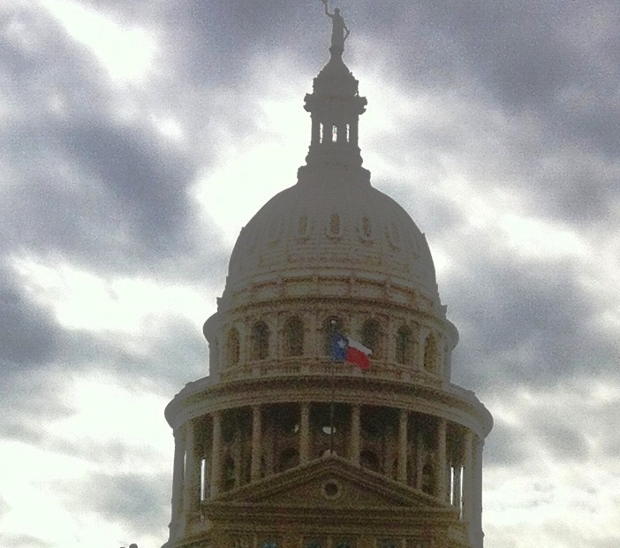
GOVERNORS AND EXECUTIVE BRANCHES
GOVERNORS AND EXECUTIVE BRANCHES

Slide 2
Historical developments
Hamiltonian vs. Jeffersonian concept of executive power
Hamilton favored a stronger executive
Jefferson favored a stronger legislative branch and a comparatively weaker executive.
Originally, the Hamiltonian model prevailed in the North and the Jeffersonian model in the South (this is still true to some extent)

Slide 3
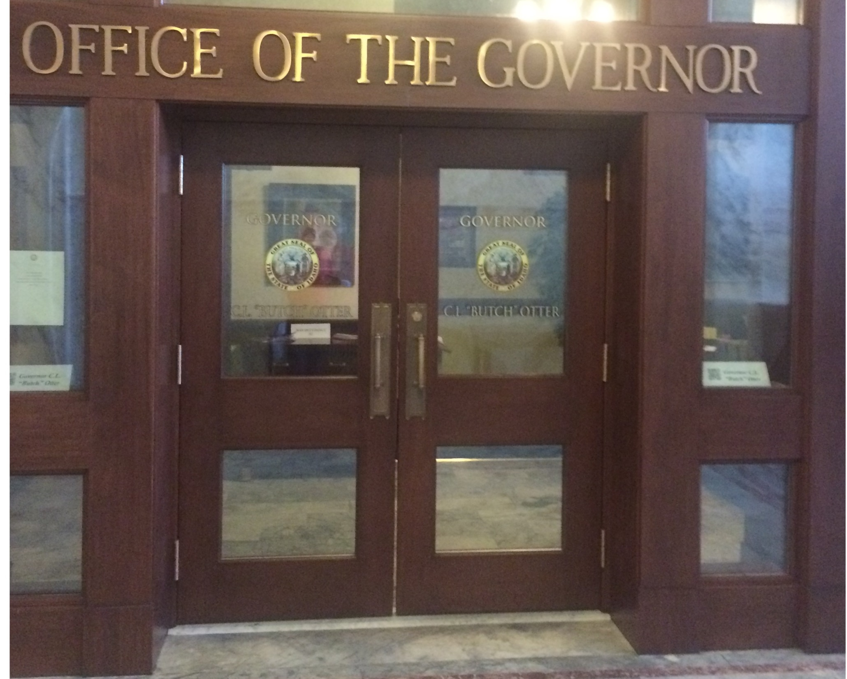

Slide 4
Historical developments
Colonial governors were sometimes elected by legislatures
Popular elections became widespread in early 19th Century
Veto power was nonexistent or weak
States readmitted post-Civil War were required to have weak governors with short (2-year) terms.
Terms have generally grown from one year to two, to four; every state but VT and NH now has a four-year term

Slide 5
Statewide elections
34 states elect the Governor in the midyear election between Presidential elections (e.g. 2014, 2018).
9 states elect in the Presidential election year.
Louisiana, Kentucky and Mississippi elect the year before the Presidential election.
New Jersey and Virginia elect the year after the Presidential election.
Vermont and New Hampshire elect the Governor in every even-numbered year (2-yr. term).

Slide 6
Statewide elections
After 2017 elections: 32 R, 17 D, 1 “nonpartisan” (Alaska)
In 2014, the Democratic candidate for Governor of Alaska dropped out and became the running mate (for Lt. Gov.) of the Independent candidate. Their ticket defeated the incumbent Republican Governor who had succeeded Sarah Palin. The Lt. Gov. has now become an Independent. They are running for re-election in 2018 on a nonpartisan ticket.

Slide 7
Progressive Movement
Early 20th Century
Sought to weaken gubernatorial power
Election of state agency heads, rather than appointment by governor’s patronage (taking partisan politics out)
Emergence of state civil service systems also weakened governors
Jobs should be filled on merit and not political loyalty

Slide 8
Demographics of Governors
44 men, six women (AL, IA, NM, OK, OR, RI)
First woman Governor in history: Nellie Tayloe Ross
Wyoming, won a special election to succeed her husband in 1924
First woman Governor who did not succeed her husband: Ella Grasso, Connecticut, served 1975-1981
Two of the currently serving women are D’s and four are R’s
Nikki Haley was the first woman Governor in SC history
She resigned on Jan. 24, 2017, to become US Ambassador to the United Nations.
Beverly Perdue (served 2009-2013) was the first woman Governor in NC history
Douglas Wilder (Virginia, 1990-1994) and Deval Patrick (Massachusetts, 2007-2015) are the only African Americans elected governor in U.S. history. Two others have succeeded to the office.

Slide 9
Roles of Governor (Dye and MacManus, pp. 196-198)
Chief administrator
Limited by independent boards and commissions
South Carolina reorganization act of 1993 strengthened Governor by creating executive departments headed by Gov.’s. appointees instead of independent agencies whose heads were chosen by the General Assembly
Chief legislator
Agenda-setting role, identifying issues as important for the state and building public support for them (Mark Sanford was extremely unsuccessful at this because of his poor relations with the General Assembly)
Party leader
May recruit and fundraise for candidates of his party

Slide 10
Roles of Governor
Ceremonial head
Chief negotiator
Discussions with federal and local governments, representing the state’s interests
Most if not all states have offices in Washington with lobbyists
Opinion leader
Crisis manager
Jim Hodges was significantly harmed politically by his failure to respond quickly to Hurricane Floyd in 1999
Gov. McMaster declared a state of emergency for the Sept. 2017 hurricanes in SC
Gov. Blanco of Louisiana was seen as incompetent in her response to Hurricane Katrina

Slide 11
Strength of Governor
Dye and MacManus, pp. 206-212
Power to appoint other officials (and choose Lt. Gov. running mate) as opposed to having them separately elected– this makes for a more powerful Gov.
In four states the Gov. is the only elected state officer
South Carolina has nine independently elected state officials
Governor
Lieutenant Governor (until 2018)
Secretary of State
Attorney General
Superintendent of Education
State Treasurer
Comptroller General
Commissioner of Agriculture
Adjutant General (until 2018)
After the 2010 elections, for the first time in history, all nine of these officials were Republicans. This was repeated in 2014.

Slide 12
Strength of Governor
Veto power
The text incorrectly states that the Gov. of NC has no veto power – he has had a limited veto since 1996
Line-item veto (44 Governors, but not the Pres.)
Ability to sign part of a bill into law while vetoing part of it – makes for a more powerful Gov.
Governors of Wisconsin have used the line-item veto to remove digits, letters, and words from bills
Ability to run for re-election
VA does not allow consecutive terms
33 states allow only two consecutive terms
DE allows two terms lifetime
Other states have no term limits

Slide 13
Qualifications of Governor
Vary by state
The Governor of South Carolina must be at least 30, a state resident for at least five years, and not an atheist (but this is unconstitutional and thus unenforceable).

Slide 14
Powers of Governor
Call special sessions of the legislature
Commander-in-Chief of state militia
Pardons and reprieves
Drafting the state budget (most significant?)
Constituency service
Executive reorganization (must be approved by legislature)
Executive orders
The recent trend in public administration has been to give more power to a centralized executive branch (SC 1993)
Governor’s office in SC includes the Office of Executive Policy and Programs

Slide 15
Political leadership
Gov. as symbolic head of state, leader of public opinion
Party leader in the state
Executive-legislative relations: Governors can be more effective when their party controls the legislature (though both Sanford and Haley have had poor relationships with the Republican-controlled SC General Assembly)
Other statewide officials may be elected separately, members of opposition party (Hodges had a Republican Lt. Gov.)

Slide 16
Gubernatorial politics
Most governors have come from the legislature, US House or occasionally the Senate, private sector
Governors who seek re-election are usually successful - most significant factor is state of economy
Other statewide officials (Lt. Gov., Atty. Gen.) do not have a successful track record of being elected Gov. in SC or elsewhere (Bob Peeler, Andre Bauer, Charlie Condon, etc.)

Slide 17
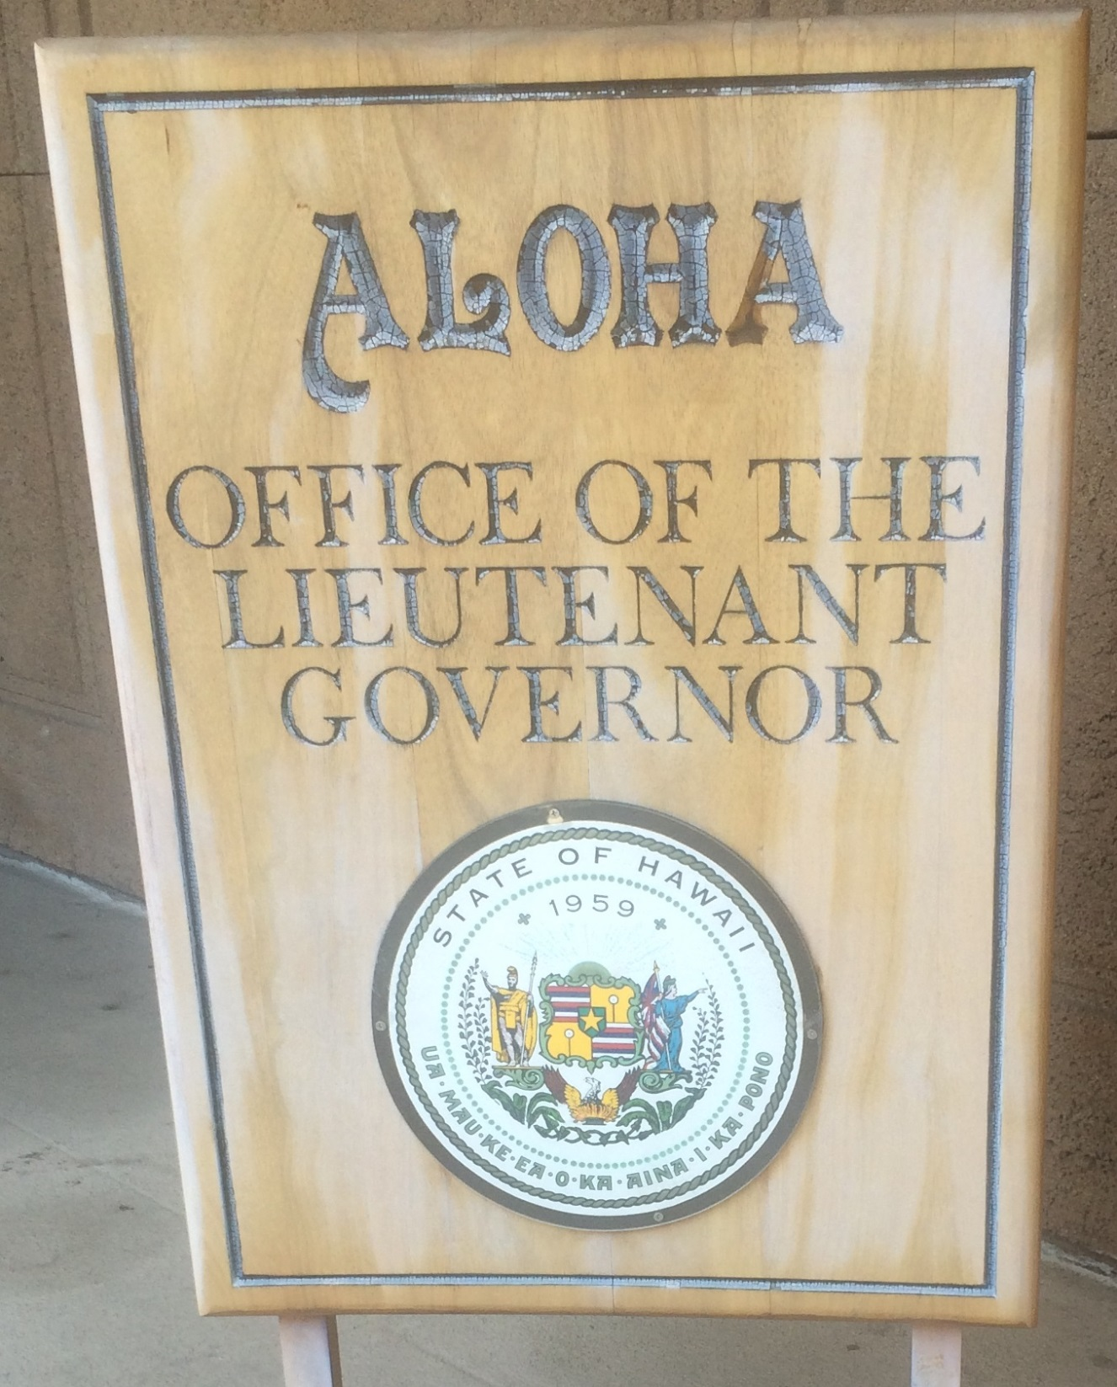

Slide 18
Other statewide officials
Lieutenant Governor
45 states; in TN and WV, elected by the Senate
President of the Senate in 25 states; may also have executive responsibilities (SC Lt. Gov. is head of the Office of Aging and will not be President of the Senate after 2018)
New Jersey did not have an elected Lt. Gov. until recently when two consecutive Governors resigned and a state Senator became acting Gov.
In 25 states, the Gov. and Lt. Gov. are elected as a ticket (+ SC beginning in 2018)
In 18 states, they’re elected separately and may be of different parties (SC through 2014)

Slide 19
Lieutenant Governor of SC
When the Constitutional amendment takes place as of the 2018 election, if there is a vacancy in the office of Lt. Gov. of SC, the Governor will appoint a replacement, to be confirmed by the Senate
Until then, the President pro tempore of the Senate becomes Lt. Gov.

Slide 20
Five Lieutenant Governors of SC Since 2011
Ken Ard elected 2010
Glenn McConnell 2012
Ard resigns due to criminal charges.
McConnell is Senate PPT
Yancey McGill 2014
McConnell resigns to become president of the College of Charleston.
Sen. John Courson resigns as PPT rather than become LG.
McGill, a Democratic Senator, is elected PPT because no Republican wants the job. He then becomes LT for the remainder of the term. (McGill later switched parties and is now running for Gov. as a Republican)
Henry McMaster elected 2014
Kevin Bryant 2017
Gov. Haley resigns to become UN Ambassador
McMaster becomes Governor
Sen. Hugh Leatherman resigns as PPT rather than become LG.
Sen. Kevin Bryant is elected PPT and becomes LG.
Leatherman is returned as PPT one day later.

Slide 21
Other statewide officials
Attorney General: “the state’s lawyer”
Popularly elected in 43 states
Appointed by Governor in 5 states
Elected by Legislature in 2 states
Supervise law enforcement
Represent the state in court
Exercise legal oversight of state government

Slide 22
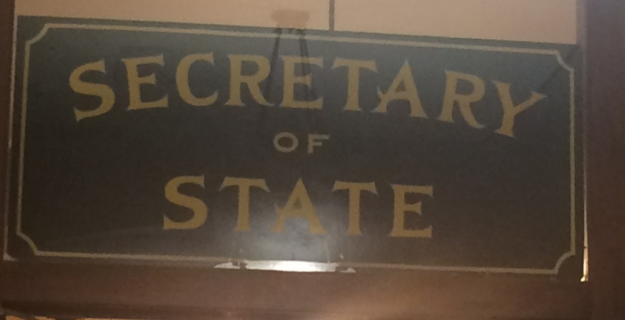
Examples of other statewide officials
Secretary of State/Commonwealth (47 states)
The Lt. Gov. of Hawaii also performs this function
Next in line for Gov. in AZ, DE, WY, which have no Lt. Gov.
Elected in 36 states
Others are appointed by Gov. or elected by Legislature
Keep state records
Responsible for incorporation of businesses
In some states, they are also responsible for the administration of elections

Slide 23
Examples of other statewide officials
Superintendent of Education
Elected in 13 states, appointed in 37
Agriculture Commissioner
Elected in 12 states, mostly in the South; otherwise apptd. by Gov.
Labor Commissioner (elected in 4 states)
Insurance Commissioner (elected in 11 states)
Public Service Commissioners (multiple, elected in 11 states)

Slide 24
Examples of other statewide officials
Treasurers, Auditors, Comptrollers
Treasurers (elected in 36 states) collect taxes, invest state funds, pay the state payroll and bills
Auditors and comptrollers (elected in 24 states) audit programs and expenditures of public money
Florida has an elected Chief Financial Officer who performs both functions
Unique statewide officials
SC is the only state that elects its Adjutant General (military commander of the National Guard); this will change to appointment by the Governor in 2018
Arizona has an elected Mine Inspector
Texas elects a Land Commissioner and three Railroad Commissioners
North Dakota elects a Tax Commissioner

Slide 25
State bureaucracies
Both the governor and the legislature play a role in oversight of the state bureaucracy
Agencies, departments, commissions
Policy implementation
Regulations, licensing
Adjudication
Civil service-based merit system has replaced political patronage in most states
Civil servants may be difficult to fire
Trend toward privatization
Some attempts at privatization have been more effective than others – private garbage collection is better than private prisons

Slide 26
Major functions of state government
Each of these has to be administered by a state agency, commission, or cabinet department
South Carolina reorganization of 1993 consolidated 145 agencies into 11 cabinet departments whose heads are appointed by the governor
Department of Transportation still headed by an independent commission, which Gov. Haley wanted to abolish
Public welfare
Administration of TANF, Medicaid, SNAP (food assistance)
Education
On a national basis, local governments spend more on education than state governments do, but states usually have policymaking authority
Transportation
Maintenance of state roads, interstates within the state
Other programs
Includes veterans, aging, pension fund, disability services

Slide 27
South Carolina Executive Departments after 1993 reorganization
Department of Public Safety
Traffic and motor vehicle laws, driver’s licenses and car registration, law enforcement training, security for state officials and properties.
Operates a nationally recognized Criminal Justice Academy near Columbia which his used to train officers by law enforcement officers around the country.
State Law Enforcement Division (SLED)
State police.
Department of Social Services
Welfare, food assistance, adoption, foster care, child support enforcement.
Department of Juvenile Justice
Custodial care and rehabilitation of juveniles who are incarcerated, on probation or parole, or in community placement; operates schools and work programs for clientele.

Slide 28
South Carolina Executive Departments after 1993 reorganization
Department of Health and Human Services
Public health programs, primarily Medicaid; senior citizens, child care, and other programs.
Department of Insurance
Department of Alcohol and Other Drug Abuse Services
Department of Labor, Licensing and Regulation
Fire safety, labor-management relations, inspection of elevators and amusement rides, occupational safety and health.

Slide 29
South Carolina Executive Departments after 1993 reorganization
Department of Probation, Parole and Pardon Services
Supervises offenders after return to society and provides victim services
Department of Commerce
Promotes state businesses, interstate and international commerce
Department of Parks, Recreation and Tourism
Department of Corrections
State prison system: 22,000 inmates in 26 institutions
Department of Revenue
Collects state taxes

Slide 30
Budgeting
In most states, the Governor writes a budget and submits it to the Legislature
Incrementalism: Start with last year’s budget and make adjustments
Zero-based budgeting: Start from zero, evaluate need for each program and each expenditure each year
State budgets grew significantly beginning in the 1960’s with state responsibility for programs like Medicaid, welfare, etc.

