Slide 1
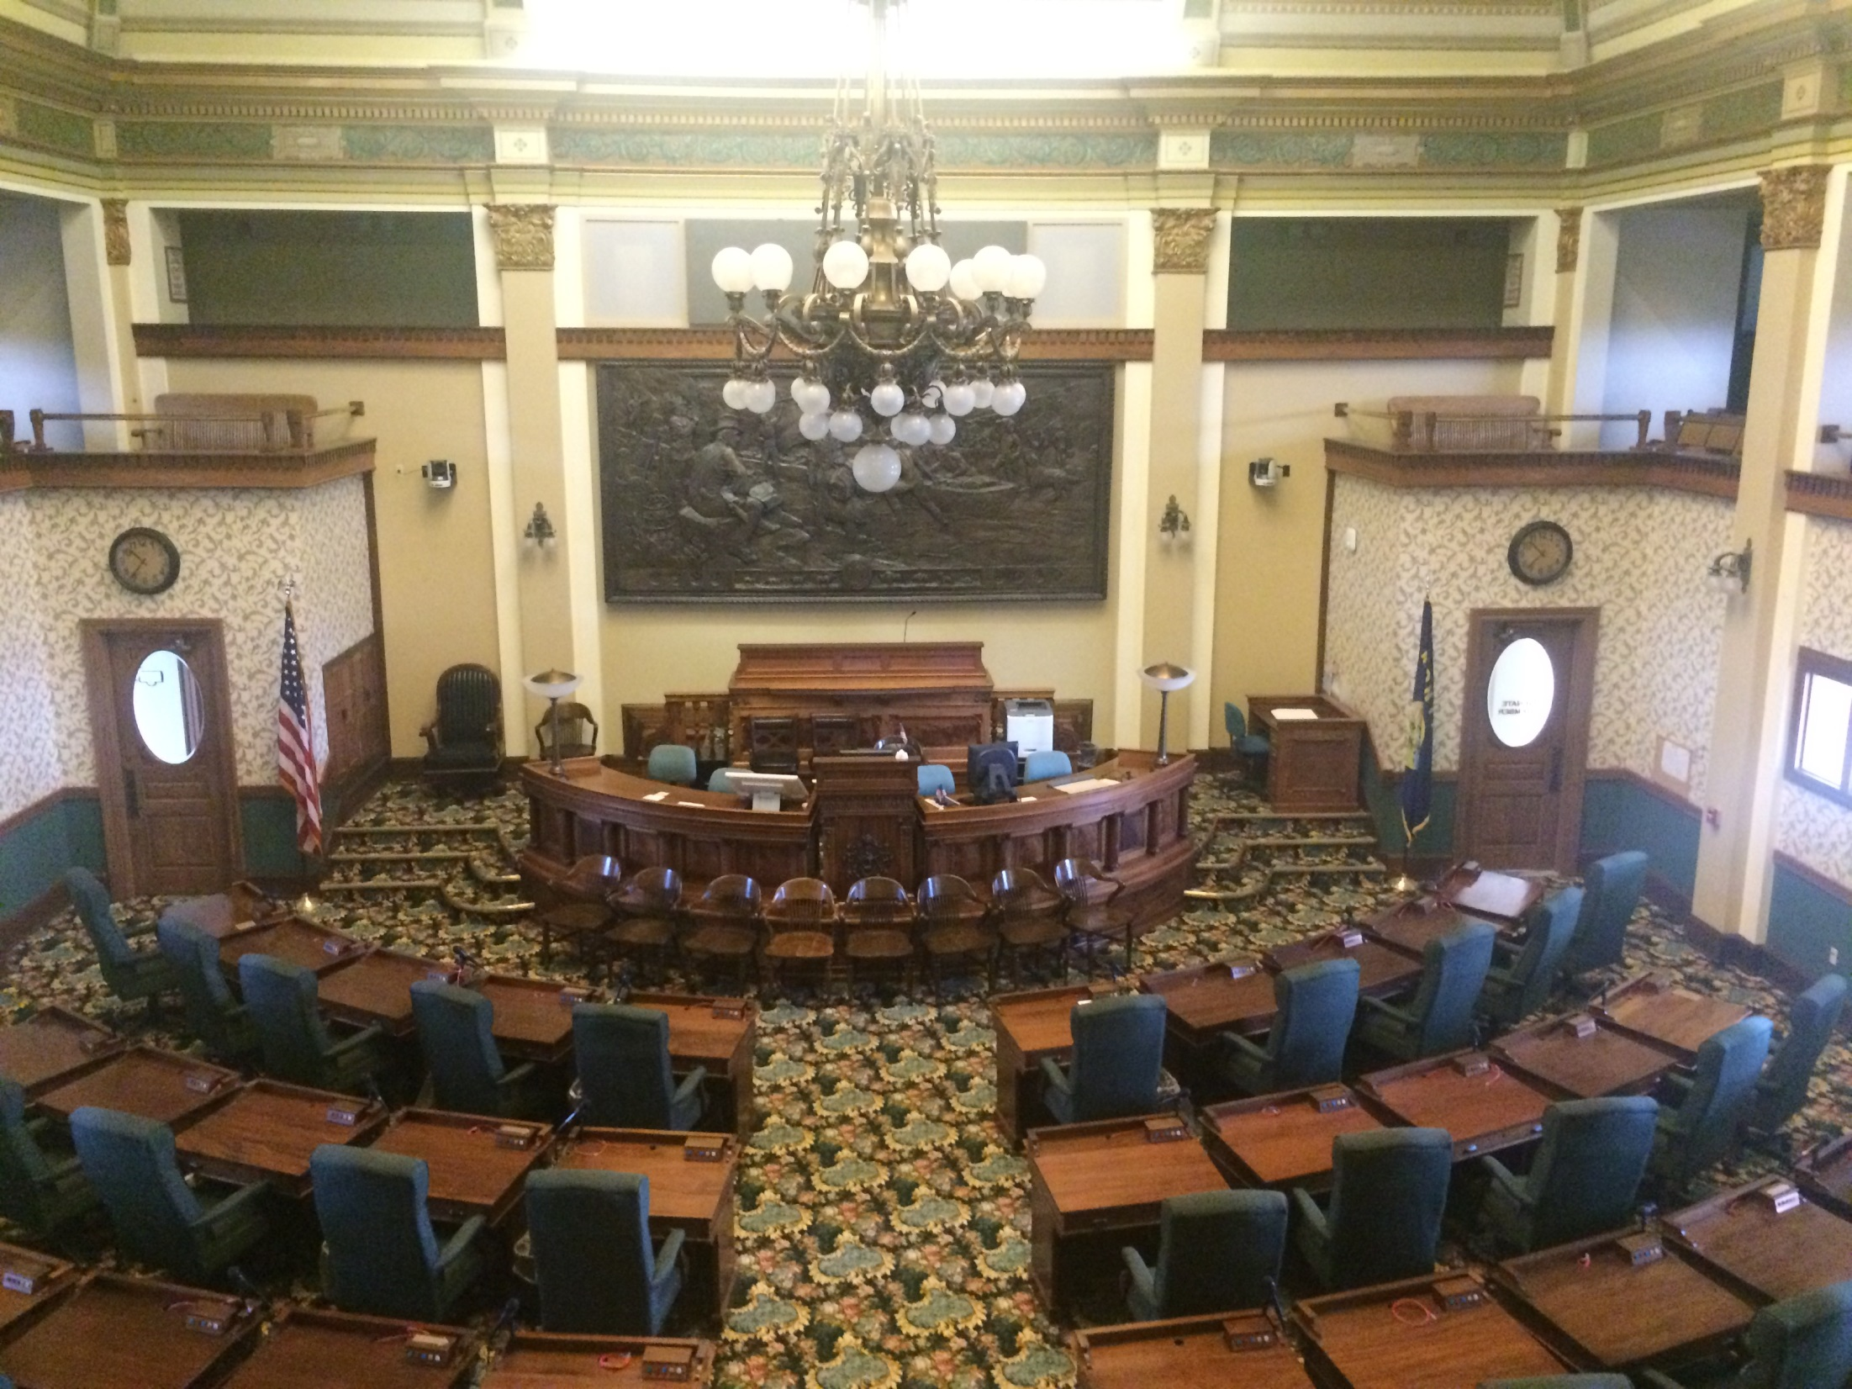
State Legislatures
(This is the Montana Senate)

Slide 2
Structure
49 states have a bicameral (two-house) legislature modeled on US Congress
Senate
House of Representatives/House of Delegates/Assembly
Four states have 4-year terms for both houses
12 have 2-year terms for both houses
31 have 4-year Senate terms and 2-yr. House terms
IL and NJ have 2-yr. House terms and rotating 2/4 yr. Senate terms.
In 25 states, the Lieutenant Governor is President of the Senate (this will change in SC in 2018)
In the other states, the Senate elects one of its members as the president
The Speaker of the House/Assembly is elected from the membership

Slide 3
Structure
Nebraska has a unicameral (one-house) and nonpartisan legislature
Both of these aspects are unique
Referred to as the Senate or “the unicameral”
Four-year terms
House of Reps. was abolished as a cost-saving measure during Depression
Made legislative process much more efficient
The Lieutenant Governor is President of the Senate and the Speaker (who presides in the Lt. Gov.’s absence) is elected from the membership

Slide 4
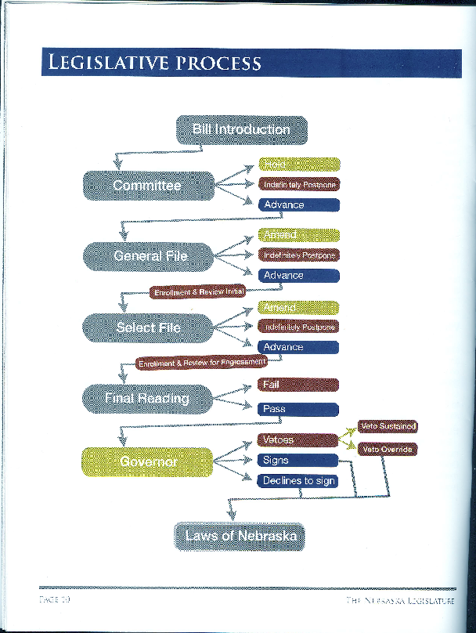
Unicameral
Legislative
Process –
Nebraska
Compare
this to the
bicameral
Florida process on p. 178 of D&M. It’s much simpler and more efficient.

Slide 5
Types
Distinguished by length of time in session
Professional – full-time job, full-time salary, meets year-round, large professional staff
California meets full-time, salary is $116,208
Citizen – part-time job, meets only occasionally
Wyoming meets 60 days in two years
New Hampshire salary is $200/year
Hybrid (or “professional/citizen”)
SC: three days a week, Jan.-June, $12,000
The National Conference of State Legislatures (ncsl.org) Website distinguishes these as green, gray, gold (just descriptive terms)
http://www.ncsl.org/legislatures-elections/legislatures/full-and-part-time-legislatures.aspx

Slide 6
Responsibilities of Legislators
D&M, pp. 160-161
Enacting laws
Considering Constitutional amendments
Confirmation of governor’s appointments
Budgets
Constituent service (responding to expressions of opinion, help with state agency problems, etc.)
Oversight of state agencies

Slide 7
Size of Legislative Body
Dye and MacManus, pp. 181-182
Smallest total membership: Nebraska, 49
Smallest Senate and Smallest House:
Alaska - 20 Sens., 40 Reps.
Largest House of Reps.
New Hampshire, 400
Second largest: Pennsylvania, 203
Largest Senate:
Minnesota, 67

Slide 8
Size of Constituency
http://www.ncsl.org/research/about-state-legislatures/2010-constituents-per-state-legislative-district.aspx
Average number of people represented
California Senator 931,349
Texas Senator 811,847
U.S. Representative > 660,000
New Hampshire Representative 3291
Vermont Representative 4172
(Note: These are from the NCSL and are not exactly the same as the numbers given by the Dye and MacManus text, but this is to illustrate the general idea)

Slide 9
Partisan Control of State Legislatures 2018
32 states: Both houses controlled by Republicans
13 states: Both houses controlled by Democrats
4 states: One house controlled by each party
Nebraska is nonpartisan
State legislatures are affected by national political trends, and 2010 was a heavily Republican year up and down the ballot; this means that in many states, Republicans controlled the districting process for the decade.

Slide 10
Virginia 2018
The Virginia House of Delegates has 51 Republicans and 49 Democrats.
One House election in November resulted in an apparent tie.
The winner, a Republican, was drawn from a hat.

Slide 11
Electoral Formula and District Magnitude
40 states use single-member districts (SMD)
One person elected from each district
Each person represents a share of the state’s population roughly equal to (1/number of seats in the body)
State legislative seats may vary in population more than U.S. House seats, which have to be almost exactly equal within a state
South Carolina has 46 Senators and 124 Representatives, each elected from a single-member district
Senate districts: http://rfa.sc.gov/files/S815_statewide.pdf
House districts: http://rfa.sc.gov/files/H3991_statewide.pdf

Slide 12
Multi-Member Districts
10 states use multi-member districts
MMD elects more than one person
Arizona, Idaho, New Jersey, North Dakota, South Dakota, Washington - each district elects one Senator and two Representatives
New Hampshire – each House district elects a varying number of representatives (from 1 to 11); this is the 400-member House
West Virginia – two Senators per district, one or two Delegates per district
Vermont uses a combination of SMD/MMD for both House and Senate
Maryland – each Senate district is split in thirds, each third elects one Representative
Multi-member districts have been phased out in many areas as discriminatory against minority candidates, but research argues that they are more conducive to the election of women

Slide 13
Elections in Multi-Member Districts Example: Electing 3 Reps.
“FREE-FOR-ALL”
Post-specific
All run on the same ballot, each voter votes for three people, top three vote-getters win
Mr. A.
Ms. B.
Ms. C.
___________
Mr. D.
Ms. E.
Mr. F.
Seat 1: A vs. B.
Seat 2: C vs. D.
Seat 3: E vs. F.
Each voter votes for one person in all three races. The person who gets the most votes for each seat wins.

Slide 14
Redistricting
States redraw their district lines every ten years following the US Census
Members of a legislative body within a state are supposed to represent roughly the same number of people (a two-member district may have twice as many people as a one-member district)
Gerrymandering: Drawing lines in a way that benefits a particular party, group or candidate
D&M argue that most legislative elections are uncompetitive
Due to gerrymandering in favor of the Republican Party, South Carolina has the lowest percentage of competitive legislative races in the country
In 2016:
91 of 124 House races had only one major-party candidate (57 R, 34 D)
39 of 46 Senate races had only one major-party candidate (27 R, 12 D)

Slide 15
Gerrymandering
Majority-minority districting: Drawing a district a majority of whose voters are members of a racial minority group, in order to maximize the possibility that a member of that group will be elected
Required by US Justice Department under Voting Rights Act Amendments of 1982, but challenged repeatedly in court during 1990’s
US Supreme Court ruled in a series of cases that race may not be the predominant characteristic in drawing district lines
There is no bar to gerrymandering for partisan reasons (e.g., to maximize the number of Republican seats)

Slide 16
Malapportionment
Gross disparity in the numbers of people represented by different members of the same body
SC Senate was originally one Senator per county regardless of population
In the 1960’s:
McCormick Co.: 7000 people, one Senator
Richland Co.: 200,000 people, one Senator
Each person in McCormick had much more voting influence than each person in Richland; this is “vote dilution”

Slide 17
One Person, One Vote Equal Population Standards
Baker v. Carr (1962): US Supreme Court established principle of one person, one vote and concept of vote dilution
Tennessee had not redrawn its district lines in 60 years and some members of the legislature represented far more than others
This tended to advantage rural areas at the expense of urban areas

Slide 18
One Person, One Vote Equal Population Standards
Reynolds v. Sims (1964): US Supreme Court ruled that (unlike the US Congress) both houses of a state legislature must be apportioned based on population
SC Senators now represent districts of roughly equal population rather than whole counties regardless of population

Slide 19
Who Draws the Lines?
In most states, the legislature draws the lines for both legislative and congressional districts; this allows the majority party, who controls the process, to exaggerate and perpetuate its majority
Some states use independent (nonpartisan) redistricting commissions (D&M, pp. 176-177)

Slide 20
Types of primary elections
Open primary: All registered voters may vote; this is the case in states that don’t register by party, such as SC. You can vote in either party’s primary but not both in the same year.
Closed primary: Only voters registered as party members may vote (registered Republicans in Republican primary, registered Democrats in Democratic primary)
Closed primary states vary in whether they allow independents to vote in party primaries (“modified closed”)
Some states allow parties to decide (so, for example, D primary may be open and R primary closed)

Slide 21
Types of primary elections
Blanket or jungle primary
California and Louisiana: All candidates run in same primary election, top two (regardless of party) appear on general election ballot; Nebraska uses this for the legislature
Washington state: All candidates run in same primary election, top vote-getter in each party becomes the party nominee for the general election

Slide 22
State Legislatures 2017

Slide 23
A Tale of Two States
 | Kansas | S.C.
Trump % 2016 | 57 | 55
Clinton % 2016 | 36 | 41
Women on state Supreme Court | 2 of 7 | 2 of 5
First woman Governor | 1990 | 2010
Second woman Governor | 2002 | Not yet
First Congresswoman who didn't | 1932 | 1986
succeed her husband
First woman U.S. Senator | 1978 | Not yet
Second woman U.S. Senator | 1996 | Not yet

Slide 24
KANSAS SENATE 2017
40 members
31 Republicans, 9 Democrats
25 men, 15 women
20 Republican men
11 Republican women
5 Democratic men
4 Democratic women
Leadership positions held by women:
President of the Senate (R)
Assistant Majority Leader (R)
Majority Whip (R)
Minority Whip (D)
Assistant Minority Leader (D)
There are more Republican women Senators (11) than there are total Democrats (9).

Slide 25
What difference does it make?
Descriptive representation: Being represented by a member of your group, someone who “looks like you” (a woman if you’re a woman, African American if you’re African American)
Substantive representation: Being represented by someone who shares your policy views (a conservative Republican if you’re a conservative Republican, a liberal Democrat if you’re a liberal Democrat)

Slide 26
What difference does it make?
D&M, p. 163: The greater the proportion of black lawmakers, the greater concern is paid to issues of traditional concern to minority voters (civil rights, poverty, police brutality, etc.)
D&M, p. 168: The greater the proportion of women in a legislature (or other lawmaking body), the more attention is paid to issues traditionally of concern to women (education, child care, etc.)
Women are more likely to run for the legislature the closer they live to the state capital (family responsibilities and commuting vs. moving to the capital for several days a week) (Dr. Karen M. Kedrowski, Winthrop Prof. of Political Science and Director of the Center for Civic Learning)

