Slide 1
Comparing the states
Structures of Government
All states have a legislative, executive and judicial branch based on the federal model, but they vary within that structure

Slide 2
Governors
Hamiltonian (strong executive) originally predominant in the North
Jeffersonian (weak executive) originally predominant in the South
Governors vary in their powers
Gov. of NJ appoints other statewide officials
Gov. of NC didn’t have veto power until 1996, and it’s still limited

Slide 3
Legislatures
Southern legislatures tend to have more power, in accordance with the Jeffersonian model (opposite of executive)
Structure
49 states have bicameral legislatures modeled on US Congress (Senate + House of Representatives/Delegates/Assembly)
Nebraska has a unicameral legislature – abolished its House of Reps. as a cost-saving measure during the Depression, also made legislative process much more efficient
Nebraska is also the only nonpartisan legislature

Slide 4
Legislatures
Full-time vs. part-time
California legislators meet full-time, paid >$100K/yr.
Wyoming’s legislature meets 60 days in two years
New Hampshire legislators are paid $100/yr.
Size of districts
CA and TX state Senators represent more people than US Representatives
New Hampshire House has 400 members who each represent about 3000 people

Slide 5
State Judicial Systems
State judges are chosen in different ways
Popular elections – may be partisan or nonpartisan
Legislative election (VA and SC)
Gubernatorial appointment with Senate confirmation (modeled on federal system)
Merit selection commissions

Slide 6
Political Parties
Some states have much stronger party systems than others, as a result of variation in state election laws
Voter registration by party, or not
Open or closed primaries
Interest groups tend to be stronger in states where party systems are weaker

Slide 7
Local Governments
States vary in the amount of power they give to local governments (home rule)
Every state except Alaska has counties (although Louisiana calls them “parishes”)
In some states, counties are simply judicial circuits and in others they are units for purposes of government services and elections

Slide 8
Political characteristics and socioeconomic indicators
Rankings in various indicators of services (education, welfare spending)
As you remember, comparisons can be tricky
Rates of taxation
Economic development policies
Cost of living
Quality of life (wealth vs. poverty, education, health, environmental protections)

Slide 9
State Constitutions
Every state has a Constitution
Every state divides power into legislative, executive and judicial branches
Usually much more detailed than US Constitution

Slide 10
State Constitutions
Constitutions differ in terms of organization, format and longevity (D&M, pp. 30-31).
State constitutions are much longer and more detailed than the US Constitution because they make prescriptions for local government that the USC doesn’t make for states.
Massachusetts uses its original Const. from 1780 (largely written by John Adams)
Alabama’s is much longer than any other because it contains numerous local provisions
Most ex-Confederate states adopted new Constitutions after the Civil War and again after Reconstruction
Louisiana has had 11 different Constitutions
LA is different because its legal system is based on French civil law rather than on English common law as in the other states, so things that can be changed by ordinary statute law elsewhere require a Constitutional amendment in LA.

Slide 11
Bills of Rights
Most state Constitutions rephrase part of the Declaration of Independence or US Constitution
Guarantees that rights are respected in state laws and courts as well as federal, although state courts may interpret these rights differently than federal courts
Some states guarantee rights that are not found in the US Constitution
South Carolina has a state constitutional right to hunt and fish

Slide 12
US Constitution’s Bill of Rights
Incorporation of the Bill of Rights: principle that B of R applies to the actions of state governments as well as federal
This principle has been applied differently to different amendments at different times
When it says “Congress shall make no law respecting an establishment of religion,” the SC state government may also not establish a religion

Slide 13
State Constitutions
State Supreme Courts are the ultimate authority on their state’s constitution and laws unless a federal question is involved
The Florida Supreme Court’s decision in the 2000 election dispute was subject to appeal to the US Supreme Court only because it involved a presidential election conducted in accordance with the US Constitution
The US Supreme Court would have had no jurisdiction in a dispute over the election of the Governor of Florida

Slide 14
South Carolina Constitutions
1669: John Locke, Fundamental Constitutions of the Province of Carolina
1776: First state constitution, revised 1778 and 1780
1861: Confederate state constitution
1865, 1868: Reconstruction constitutions
1895: Benjamin Ryan Tillman, currently in effect

Slide 15
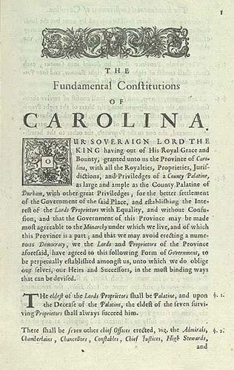
Fundamental Constitutions of Carolina, 1669, authored by John Locke

Slide 16
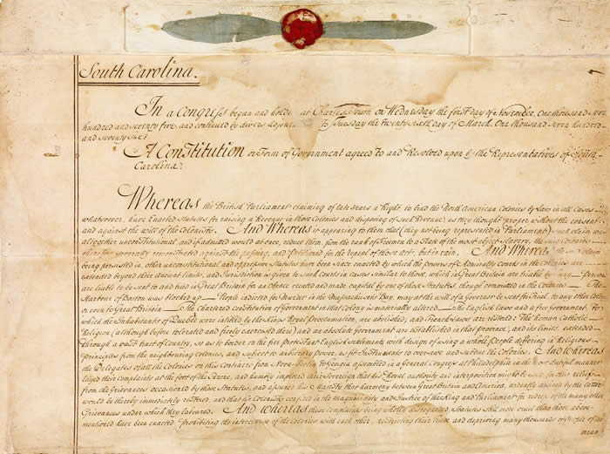
Constitution adopted after
Declaration of Independence, 1776

Slide 17
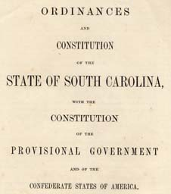
Constitution adopted as a Confederate state, 1861

Slide 18
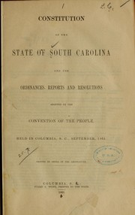
Postwar Constitution, 1865

Slide 19
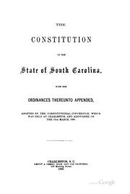
Postwar Constitution, 1868

Slide 20
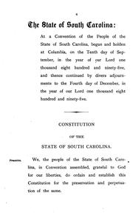
Current Constitution, 1895

Slide 21
Initiatives, Referenda, Recalls
Initiatives: Voters put questions on ballot by petition
Many times, this may lead to unconstitutional legislation which violates someone’s Constitutional rights; for example, many states enacted same-sex marriage bans through initiatives
Good idea: Direct democracy and popular control of government
Bad idea: Sometimes people have stupid or unconstitutional ideas
Referendum: Action of legislature is put on ballot for popular approval; all states but Delaware require that constitutional amendments be approved this way
Recall: Voters may prematurely end the term of an elected official (how Arnold Schwarzenegger became Gov. of CA in 2003, recall attempt against Gov. Walker of WI in 2012)

Slide 22
FEDERALISM
The Constitution grants (and denies) specific powers to both the national government and the states
Most criminal activity is subject to state jurisdiction unless federal law is involved or it crosses a state line
The federal government has been supreme since McCulloch v. Maryland, but didn’t become a major player in most domestic policy until the New Deal.

Slide 23
Devolution
Taking power and policy responsibility away from Washington and giving them to state and local government
Trend began under Nixon, accelerated under Reagan
Welfare reform in 1996 transformed AFDC, a federal program, into TANF, which is primarily a state program
Many current policy initiatives and reforms have originated at the state level rather than federal
More recent Presidents have been Governors (Carter, Reagan, Clinton, GW Bush) than Washington officials, have tended to favor a greater state role in policymaking

Slide 24
Laboratories of Democracy
Approaches to problem-solving can be tried and tested on a smaller, state level before being adopted on a federal level
Advantages of giving power and responsibility to state governments:
Those closest to the scene may be able to deal with the problem more effectively; smaller units of government may be more responsive, efficient and cost-efficient.

Slide 25
Laboratories of Democracy
Disadvantages of giving power and responsibility to state governments rather than federal:
Questions of equity: Should programs be uniform throughout the country? Are wealthier states going to be able to solve problems better than poorer, at the expense of the poorer states’ citizens
What if states want to use policy-making authority to maintain status quo (slavery, segregation)?

Slide 26
Federal funding
Grants-in-Aid
Categorical grants vs. block grants (D&M)
Understand the difference and the significance
Policy categories (D&M)
Health care (Medicaid, etc.)
Income security (welfare)
Education
Transportation (highways, mass transit)
Unfunded mandate
A federal law requires states to do something but provides no funding to carry it out, now largely impermissible

Slide 27
Federal Intervention in State Policy Areas
Funding restrictions imposed if states don’t make policy the way the federal government wants them to
Speed limit of 55 MPH in response to the energy crisis of the 1970’s
Uniform drinking age of 21, 1980’s
Work requirements with federal funding for welfare programs (the Obama Administration has offered states waivers to some of these requirements)

Slide 28
Evolution of Federalism (Dye and MacManus, pp. 74-79)
Dual Federalism
Cooperative Federalism
Centralized Federalism
New Federalism
Representational Federalism
Coercive Federalism
“Bottom-Up” Federalism
These represent different eras in the relationship between the federal and state governments
Understand the differences and the significance of each of these

Slide 29
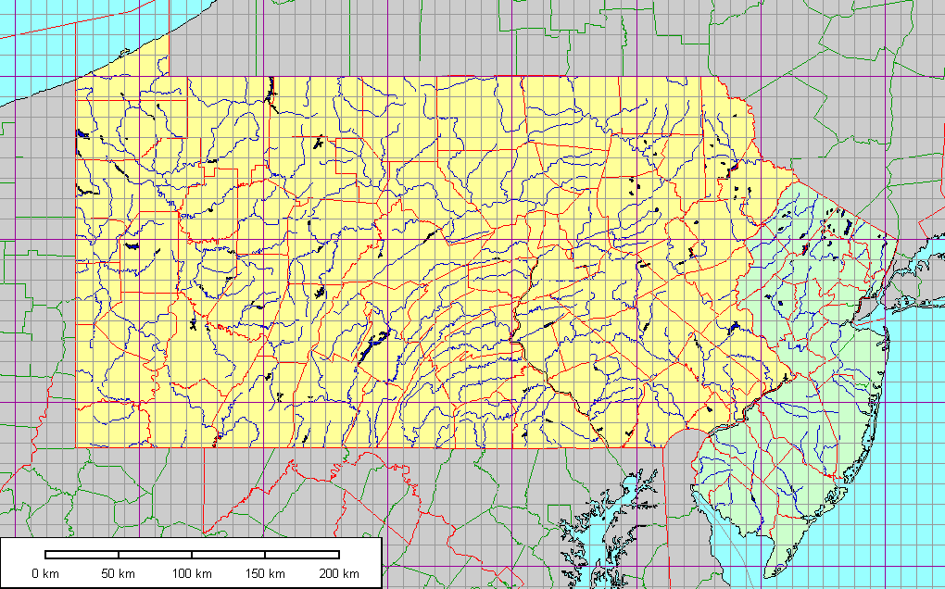
Pennsylvania Drinking Age
New Jersey Drinking Age
21
18
\
Where I went to college

Slide 30
Intergovernmental relations
Federal-state (federalism)
Interstate (confederalism)
Interstate compacts:
South Carolina contracted with Connecticut and New Jersey to allow their nuclear waste to be disposed of at the Barnwell site; no other states could use it)
Students who live in certain counties in NC and SC may qualify for in-state tuition for a program at a state university in the other state if it isn’t offered in their home state (UNC Charlotte and Winthrop)
Post-9/11 interstate security compacts, cooperation among law enforcement from different jurisdictions
Environmental compacts: clean air, water use
Pollution crosses state lines

Slide 31
Limits of federal control over state policy
U.S. v. Lopez (1995) limited federal power under the Interstate Commerce Clause (the Gun Free Schools Act was unconstitutional because this is a matter of state, not federal, jurisdiction)

Slide 32
Intergovernmental relations
Interstate:
There are national associations of governors, legislators, state election officials, etc.
State-local
States may give local governments responsibility for carrying out certain state policies
Local-local
Cooperation among counties, cities, regional councils of government

Slide 33
States Affect Each Other
North Carolina-South Carolina dispute over use of water from the Catawba River (case was settled, but would have been heard by US Supreme Court under original jurisdiction)
Policies tend to spread regionally
State lotteries
Competition for economic development, recruitment of factories and industry (should Boeing build its new plant in WA or SC?)
“Race to the Bottom” – as states cut taxes and otherwise offer economic incentives for business, schools and social services may suffer

Slide 34
Full Faith and Credit Clause
Article IV of the Constitution: States are required to recognize each other’s legally binding acts and contracts
Until the U.S. Supreme Court declared a national Constitutional right to same sex marriage in June 2015, it was not resolved whether states where it was illegal were required to recognize those marriages performed in other states where it was legal.

