Slide 1
THE JUDICIARY

Slide 2
Current Justices of the U.S. Supreme Court (President making appointment, year took office)
Chief Justice John G. Roberts, Jr. (G.W. Bush, 2005)
Associate Justices:
Anthony M. Kennedy (Reagan, 1988)
Clarence Thomas (G.H.W. Bush, 1991)
Ruth Bader Ginsburg (Clinton, 1993)
Stephen G. Breyer (Clinton, 1994)
Samuel A. Alito (G.W. Bush, 2005)
Sonia Sotomayor (Obama, 2009)
Elena Kagan (Obama, 2010)
Neil Gorsuch (Trump, 2017)

Slide 3
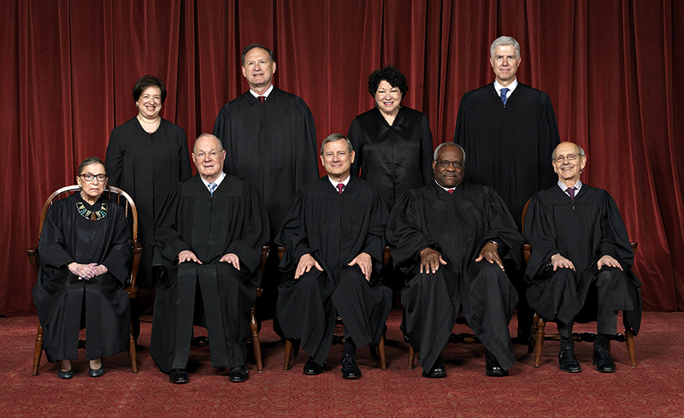
Kagan Alito Sotomayor Gorsuch
Ginsburg Kennedy Roberts Thomas Breyer

Slide 4
Article III of the Constitution
Section 1:
Creates the Supreme Court
Authorizes Congress to create additional courts
Judges serve during a term of “good behavior” (until death, resignation or impeachment)
May not be removed for incapacity, unpopular decision, bad legal judgment; impeachment and conviction are only for commission of a crime
Congress can’t reduce a judge’s salary during his term of office (removes opportunity for political manipulation/forcing someone to resign)

Slide 5
Article III of the Constitution
Does not define “judicial power” beyond giving the courts the power to resolve disputes.
Does not specify the size of the Supreme Court (left up to Congress)
Number of Justices as set by Federal law (Chief Justice plus additional Associate Justices):
1789: 6
1807: 7
1837: 9
1863: 10
1866: 7*
1869: 9 (still in effect)
*President Andrew Johnson was extremely unpopular, and Congress didn’t want to give him the power to appoint anyone to the Court. A law was passed eliminating three Associate Justices’ seats when they became vacant, but only two actual vacancies occurred before the law was amended in 1869. There were never fewer than eight justices during this time.

Slide 6
Court-Packing (1937)
oooooo|ooo|oooooo
Six justices over 70, three under 70, six more FDR wanted to appoint
During President Franklin D. Roosevelt’s first term, the Supreme Court struck down much of his New Deal legislation as unconstitutional. Roosevelt wanted to change the Court to support his programs.
He originally wanted to mandate a retirement age of 70, which would have allowed him to immediately replace six of the nine sitting Justices.
When this failed, he suggested that a president be able to appoint an additional Justice whenever a sitting Justice reached 70. This would have increased the size of the Court to 15 at that time. This was seen (even by FDR’s supporters, including the Vice President) as a transparently political attempt to manipulate the Court, and the Administration suffered one of its worst political defeats as a result.

Slide 7
Judiciary Act of 1789
Established the basic structure of the Federal court system which is still in effect (Welch, p. 393) – Circuit Courts and District Courts
Established the jurisdiction of lower courts
Gave the Supreme Court power to issue writs of mandamus and apparently expanded the Court’s original jurisdiction, which was the basis of the Court’s finding in Marbury v. Madison (1803) that this was unconstitutional

Slide 8
Federal Judges
Federal judges are appointed by the President and confirmed by the Senate. The President generally tries to find a nominee who supports his or her political philosophy, but once on the Court, the judge is not bound by politics or personal loyalty, but only by his or her reading of the law.
In U.S. v. Nixon (1974), the Supreme Court unanimously ruled that President Nixon had to comply with a court order to turn over tape recordings which showed his complicity in the Watergate conspiracy. Three of the eight Justices who participated in the case had been appointed by Nixon himself. They didn’t owe him a favor as a result.

Slide 9
Political ideology on the Court
Many Supreme Court Justices have turned out to be more liberal or conservative than the President who appointed them expected.
Dwight D. Eisenhower (Republican) appointed Chief Justice Earl Warren, who wrote the decision in Brown v. Board of Education (1954) outlawing segregation in public schools, and Justice William J. Brennan, Jr., who served for 34 years and wrote many opinions expanding civil liberties.

Slide 10
Political ideology on the Court
Richard M. Nixon (Republican) appointed Justice Harry Blackmun, who wrote the opinion in Roe v. Wade (1973) striking down most state restrictions on abortion.
George H.W. Bush (Republican) appointed Justice David H. Souter, who turned out to be more liberal than his previous career would have indicated.
“Liberal” and “conservative” don’t have quite the same meanings when applied to judges that they have when applied to elected officials.

Slide 11
Life terms
Justice William O. Douglas, who was appointed by Franklin D. Roosevelt in 1939, eventually became the longest-serving member of the Court, retiring in 1975.
He suffered an incapacitating stroke about a year before his retirement. He was mentally unable to do his job but could not be forced to retire. The other Justices “worked around him” until he eventually agreed to retire.
He was replaced by Justice John Paul Stevens, who served until 2010 (becoming the third-longest-serving Justice in history).
This particular Supreme Court seat changed hands only once between 1939 and 2010.
Justice Ruth Bader Ginsburg, who will be 85 in March 2018, was politically pressured (which she was free to ignore) by some liberal groups and commentators to retire while President Obama was in office to guarantee the appointment of a liberal successor. She has refused to retire, and reportedly stated before the election that she wanted Hillary Clinton to appoint her successor.

Slide 12
Judicial Review
The main power of the courts is the power of judicial review, the power to review acts of the other branches of government (legislative and executive) for consistency with the Constitution. A law or act which conflicts with the Constitution is unconstitutional and cannot be enforced.

Slide 13
Judicial Review
Judicial review is not mentioned in the Constitution, although Alexander Hamilton anticipated it in his writings on the Court in The Federalist Papers.
Judicial review is derived from the courts’ power to interpret the laws.
Judicial review was first asserted by the Supreme Court in the case of Marbury v. Madison (1803). It has been accepted ever since as part of our legal system.

Slide 14
Marbury v. Madison (1803)
Federalist President John Adams was defeated by Democratic-Republican Thomas Jefferson in the presidential election of 1800.
Shortly before leaving office, Adams appointed a number of his political supporters to long-term positions in the federal government. One of these was William Marbury, named to be a magistrate (local judge) in the District of Columbia.

Slide 15
Marbury v. Madison (1803)
Adams’ Secretary of State, John Marshall, failed to deliver Marbury his commission (the official certificate of appointment) before Adams’ term expired.
When Jefferson took office as President, he ordered his Secretary of State, James Madison, not to deliver the commissions to Marbury and others who had received appointments from Adams.

Slide 16
Marbury v. Madison (1803)
Marbury sued, asking the Supreme Court to issue a writ of mandamus (an order) to Madison to deliver the commission.
Adams had appointed John Marshall as Chief Justice shortly before leaving office. Marshall was now hearing a case brought about by his own failure to deliver the commission. Today, this would be considered a conflict of interest and the judge would be expected to recuse himself (not participate in the case).

Slide 17
Marbury v. Madison (1803)
The Supreme Court’s power to issue the writ was granted by the Judiciary Act of 1789.
On the facts of the case, Marbury was entitled to the job. He was appointed by President Adams when Adams had the authority to do so. The fact that his commission was not delivered was not his fault and did not negate the appointment.

Slide 18
Marbury v. Madison (1803)
The Supreme Court could therefore not rule that Marbury was not entitled to the job.
However, Marshall was afraid that if the Court issued the writ, Jefferson and Madison would simply ignore it, and this would weaken the power of the judicial branch.
Marshall found a way out of this problem and asserted the power of judicial review.

Slide 19
Marbury v. Madison (1803)
Using the Court’s power to interpret the law, Marshall found that the Judiciary Act of 1789, giving the Court the power to issue the writ, expanded the Court’s power beyond what was specified in the Constitution.
The Judiciary Act said the Court had the power to issue the writ, but the Constitution did not.
There was a conflict between the Judiciary Act and the Constitution.
That portion of the Judiciary Act was unconstitutional and therefore unenforceable.
So the Court ruled that it had no power to issue the writ. Marbury never received his commission and therefore never got the job he was appointed to.

Slide 20
Marbury v. Madison (1803)
Judicial review is not mentioned in the Constitution. The irony is that Marshall’s ruling, that the Court could not do something that was not specified in the Constitution, gave the Court a power not specified in the Constitution.
Judicial review has since been accepted as part of our legal system.

Slide 21
Original vs. appellate jurisdiction
A court of original jurisdiction is the first court to hear a case. The Constitution gives the Supreme Court original jurisdiction in a very small number of cases in specifically defined areas (such as disputes between states). It must hear these cases.
A court of appellate jurisdiction hears a case on appeal after another court has heard it first. Almost all of the Supreme Court’s cases are heard on appellate jurisdiction, and the Court has almost complete discretion in deciding which cases to hear on appeal.

Slide 22
Writ of certiorari
When the Supreme Court is asked to hear a case on appeal, four of the nine Justices must agree to hear it. This does not mean that they will rule in favor of the person making the appeal, but that they believe the case has issues that the Court needs to hear and resolve.
When the Court agrees to hear a case, it issues a writ of certiorari, also known as “granting cert.”

Slide 23
Cases before the Supreme Court
The Court is petitioned to hear about 8000 appeals per year. It agrees to hear about 80 of these cases.
99% of the time, the Court chooses not to hear the case.
The Court is most likely to hear the case in certain circumstances, e.g., disagreeing opinions by two lower courts which the Supreme Court must then resolve.

Slide 24
Cases before the Supreme Court
The attorneys representing the parties in the case, and interest groups who wish to express their views, file briefs with the Court.
The Court then schedules oral argument. Each attorney has one half-hour to present his or her case to the Court and answer questions from the Justices.
The Court then deliberates and eventually makes its decision.

Slide 25
Opinions of the Court
A decision agreed to by the majority of the Court is the “opinion of the Court” and becomes binding law.
The opinion is assigned to a member of the majority by the senior Justice in the majority. The Chief Justice is automatically considered the most senior even if he does not have the longest service.
A Justice who disagrees with the opinion may write a “dissenting opinion,” which has no legal force.
The decision only goes as far as any five Justices will agree to allow it to go.

Slide 26
Example: The Patient Protection and Affordable Care Act of 2010
The Supreme Court was asked in 2011 to rule on the constitutionality of the new federal law requiring everyone to purchase health insurance or pay a tax penalty by 2014.
The Constitution gives Congress the power to regulate interstate commerce. Does this requirement fall under that power, or is it an impermissible act by Congress?

Slide 27
Example: The Patient Protection and Affordable Care Act of 2010
National Federation of Independent Business v. Sebelius (2012)
Four Justices (Ginsburg, Breyer, Sotomayor and Kagan) held that Congress could pass this requirement under the Interstate Commerce Clause.
Four Justices (Scalia, Kennedy, Thomas and Alito) held that it could not.
Chief Justice Roberts agreed that this was not permissible under the Interstate Commerce Clause, but that it was permissible under Congress’s power of taxation. So Roberts plus the four Justices in the first paragraph joined to find that the law is constitutional.
Result: Congress cannot require people to buy health insurance, but can require them to pay a tax penalty if they don’t buy insurance.

Slide 28
Does Congress have this power under the Interstate Commerce Clause?
YES: Justices Ginsburg, Breyer, Sotomayor, Kagan.
NO: Justices Scalia, Kennedy, Thomas, Alito.
Chief Justice Roberts: Congress does not have the power to require people to buy health insurance under the Interstate Commerce Clause, but it does have the power to require people to pay a tax penalty if they don’t buy it.
END RESULT: Five Justices ruled that people may be required to buy health insurance or pay a tax penalty, so this portion of the Affordable Care Act is constitutional.

