Slide 1
Congress

Slide 2
CONGRESS
Senate: Two Senators per state regardless of population (2 x 50 = 100). Six-year terms.
House of Representatives: Based on population but the Constitution guarantees each state one member. Two-year terms.
Total has been 435 since 1912, capped by federal law since 1929
Seven states each have one representative
California has 53
The House also includes five “Delegates” from Washington, DC; the territories of the Virgin Islands, Guam, American Samoa and the Northern Mariana Islands; and a Resident Commissioner from Puerto Rico (who is the only House member with a 4-yr. term)
They can introduce legislation and vote in committee, but cannot vote in the full House

Slide 3
Staggered terms
2010 2012 2014 2016 2018 2020 2022
House |====|====|====|====|====|====|
Sen I <06====|==============|========24>
Sen II <08=========|==============|===26>
Sen III |==============|==============|
Pres./VP<08====|=========|=========|===24>

Slide 4
Vacancies
Vacancies in the House must be filled by special election.
The Constitution gives state legislatures the power to decide how vacancies in the Senate are filled for that state. In most states, the Governor has the power to appoint someone to serve until the next election.

Slide 5
Example
The only time both Senate seats from the same state are up for election at the same time is if there’s a vacancy.
2008: Sen. Lindsey Graham elected to 6-year term.
2010: Sen. Jim DeMint elected to 6-year term.
2013: Sen. DeMint resigns to become head of the Heritage Foundation.
Gov. Haley appoints Rep. Tim Scott to serve in the Senate until the next election (Nov. 2014).
Scott resigns from the House and his seat is filled by a special election (Mark Sanford returns to the House).
2014: Sen. Scott elected to a two-year term and Sen. Graham re-elected to another six-year term.
2016: Sen. Scott re-elected to a six-year term.

Slide 6
Reapportionment
Redistributing the number of seats in the House following each Census (every ten years) to reflect changes in population
Redistricting: Redrawing the district lines within each state so that each district is equal in population
Gerrymandering: Redistricting in a particular way to benefit a specific party or group
In most states, district lines are drawn by the state legislature, so it matters which party controls it and which party the Governor is
Majority-minority districting: Drawing a district in which a majority of citizens or voters are members of a racial minority

Slide 7
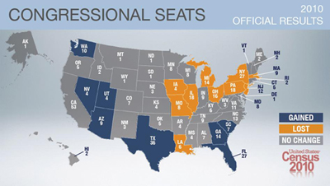
2010 reapportionment

Slide 8
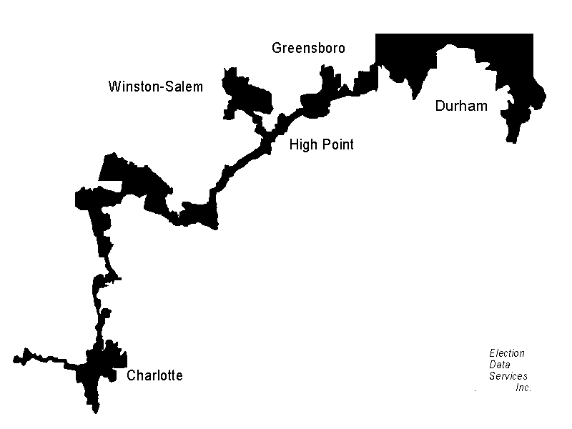
Majority-Minority Districting
North Carolina’s 12th Congressional District, 1992-1998

Slide 9
North Carolina US House Elections 2012
District | D | R | Other | Win | Win %
1 | 254,644 | 77,288 | 6,134 | D | 75.32%
2 | 128,973 | 174,066 | 9,358 | R | 55.72%
3 | 114,314 | 195,571 | 0 | R | 63.11%
4 | 259,534 | 88,951 | 0 | D | 74.47%
5 | 148,252 | 200,945 | 0 | R | 57.54%
6 | 142,267 | 222,116 | 0 | R | 60.96%
7 | 168,695 | 168,041 | 0 | D | 50.10%
8 | 137,139 | 160,695 | 4,446 | R | 53.16%
9 | 171,503 | 194,537 | 9,650 | R | 51.78%
10 | 144,023 | 190,826 | 0 | R | 56.99%
11 | 141,107 | 190,319 | 0 | R | 57.42%
12 | 247,591 | 63,317 | 0 | D | 79.63%
13 | 160,115 | 210,495 | 0 | R | 56.80%
Total | 2,218,157 | 2,137,167 | 29,588 | 9 R, 4 D
 | 50.59% | 48.74%

Slide 10
North Carolina US House Elections 2012
District | D | R | Other | Win | Win %
12 | 247,591 | 63,317 | 0 | D | 79.63%
1 | 254,644 | 77,288 | 6,134 | D | 75.32%
4 | 259,534 | 88,951 | 0 | D | 74.47%
3 | 114,314 | 195,571 | 0 | R | 63.11%
6 | 142,267 | 222,116 | 0 | R | 60.96%
5 | 148,252 | 200,945 | 0 | R | 57.54%
11 | 141,107 | 190,319 | 0 | R | 57.42%
10 | 144,023 | 190,826 | 0 | R | 56.99%
13 | 160,115 | 210,495 | 0 | R | 56.80%
2 | 128,973 | 174,066 | 9,358 | R | 55.72%
8 | 137,139 | 160,695 | 4,446 | R | 53.16%
9 | 171,503 | 194,537 | 9,650 | R | 51.78%
7 | 168,695 | 168,041 | 0 | D | 50.10%
Total | 2,218,157 | 2,137,167 | 29,588 | 9 R, 4 D
 | 50.59% | 48.74%

Slide 11
Demographics of the 115th congress (2017-2019)
https://fas.org/sgp/crs/misc/R44762.pdf

Slide 12
DOES CONGRESS “REPRESENT” AMERICA?
Sex
Race/ethnicity
Age
Economic status
Religion
Education
Sexual orientation
What difference does this make (why do we care?)

Slide 13
REPRESENTATION
Descriptive representation: Someone who looks like you
Substantive representation: Someone who shares your policy views

Slide 14
INCUMBENCY ADVANTAGE
Name recognition
David Mayhew: Credit-claiming, “advertising” oneself
Fundraising advantage
http://www.opensecrets.org/overview/incumbs.php
Federal spending (pork barrel)
Franking (free mailing)
Constituency service/casework
Morris Fiorina: They deliberately make programs complicated so constituents need help with them

Slide 15
Committees
http://www.house.gov/committees/
http://www.senate.gov/pagelayout/committees/d_three_sections_with_teasers/committees_home.htm

Slide 16
Why join a committee?
Personal interest
Constituency needs
Policy expertise
Fundraising advantage
Richard Fenno: Influence, re-election, policy

Slide 17
How a Bill Becomes a Law (Most of Them Don’t)
https://www.govtrack.us/congress/bills/statistics
https://www.youtube.com/watch?v=FFroMQlKiag
https://www.youtube.com/watch?v=JUDSeb2zHQ0

Slide 18
LEGISLATIVE PROCESS Senate
Submission and referral
S. 806, the “College for All Act”
Sponsored by Sen. Bernie Sanders
https://www.congress.gov/bill/115th-congress/senate-bill/806?r=10
Referred to the Committee on Health, Education, Labor, and Pensions:
https://www.help.senate.gov/

Slide 19
Committees in the Legislative Process
Committee action
Subcommittee referral (not always in the Senate)
https://www.help.senate.gov/about/subcommittees
Committee action
Hearing
https://www.help.senate.gov/hearings
Markup
Vote and committee report to Senate

Slide 20
Legislative Process: Senate
Majority Leader sets the schedule and terms of debate under a unanimous consent request
http://www.gpo.gov/fdsys/pkg/CCAL-114scal-2015-09-21/pdf/CCAL-114scal-2015-09-21.pdf
Filibuster, cloture (60 Senators)
https://www.congress.gov/crec/2013/09/24/CREC-2013-09-24-pt1-PgS6699-3.pdf (p. 6732)
Other ways to delay
Debate in full Senate, vote

Slide 21
LEGISLATIVE PROCESS House of Representatives
Submission and referral
Committee action
Subcommittee referral
Hearing
http://edworkforce.house.gov/news/documentsingle.aspx?DocumentID=398597
Markup, vote
Full committee hearing
Markup
http://edworkforce.house.gov/calendar/eventsingle.aspx?EventID=399156
Vote and committee report to House
http://www.gpo.gov/fdsys/pkg/CRPT-114hrpt46/pdf/CRPT-114hrpt46-pt1.pdf

Slide 22
LEGISLATIVE PROCESS
House Rules Committee sets terms of debate
http://www.gpo.gov/fdsys/pkg/BILLS-114hres421eh/pdf/BILLS-114hres421eh.pdf
Action by full House
http://www.gpo.gov/fdsys/pkg/BILLS-114hr3134eh/pdf/BILLS-114hr3134eh.pdf
Conference Committee
http://www.gpo.gov/fdsys/pkg/CRPT-113hrpt564/pdf/CRPT-113hrpt564.pdf
Vote on committee report by House and Senate
Sent to President
https://www.whitehouse.gov/the-press-office/2015/03/31/memorandum-disapproval-regarding-sj-res-8
Veto override if necessary

Slide 23
Authorization and Appropriations
Authorization: A bill which gives a program the legal authority to operate
Appropriations: A bill which actually spends the money for the program to operate (12 appropriations bills are supposed to be passed each year, covering different sectors of government)
Continuing resolution: A catch-all spending bill which funds the government if the appropriations bills are not passed on time; otherwise, parts of the government may shut down
The fiscal year starts on Oct. 1 and either the appropriations bills must be passed or a continuing resolution must be passed.

Slide 24
Appropriations Bills
http://www.appropriations.senate.gov/news/first-six-years-senate-committee-completes-work-all-12-appropriations-bills
http://appropriations.house.gov/news/documentsingle.aspx?DocumentID=394312
https://www.congress.gov/resources/display/content/Appropriations+for+Fiscal+Year+2016

Slide 25
Decision-making (Fenno)
Delegate: There to represent the views of a majority of your district
Trustee: There to exercise your own judgment regardless of public opinion
Politico: Delegate or trustee depending on the issue
(Note that if your views didn’t coincide with a majority of the voters a majority of the time, you wouldn’t have been elected in the first place)

