Slide 1
South Carolina Politics 101
John T.R. Holder, Ph.D.
Department of Political Science
John C. West Forum on Politics and Policy
Winthrop University
NEW Leadership South Carolina Forum
May 15, 2017

Slide 2
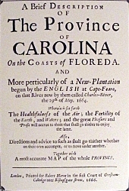

Slide 3
“Province of Carolina”
Royal Charter granted by King Charles II, 1663, revised 1665
Northern boundary: present Va.-NC state line
Southern boundary: northern edge of Spanish territory in Florida (south of present-day Jacksonville)
Western boundary: “South Seas” (Pacific Ocean)
Charles Town (Charleston) established 1670
North Carolina and South Carolina were separated for administrative convenience in 1710 or 1712
Georgia was split off from SC in 1732
Tennessee was split off from NC in 1790’s

Slide 4
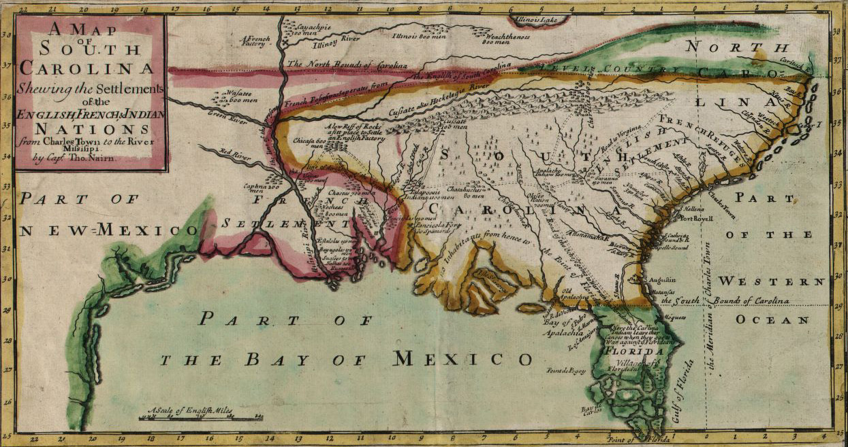

Slide 5
Constitutions
John Locke wrote the “Fundamental Constitutions of Carolina” in 1669, even before the province was settled by Europeans.
The current state Constitution was drafted in 1895 and ratified in 1896, after former Confederates had regained political power. It is the eighth Constitution in state history.
Designed to preserve white supremacy and disenfranchise most blacks and poor whites.

Slide 6
SOUTH CAROLINA GENERAL ASSEMBLY
Constitutionally strongest branch of state government
Senate and House of Representatives
Each elected from individual districts
46 Senators serve 4-yr. terms elected in Presidential election years
Currently 27 R, 18 D, one vacancy (special election on May 30, 2017)
124 Representatives serve 2-yr. terms
Currently 78 R, 43 D, three vacancies
One special election on May 30 and two on June 20
Lieutenant Gov. is President of the Senate
This will change in 2018; the Lt. Gov. will become entirely a member of the executive branch, and the Senate will elect its President from the membership
Speaker of the House is elected from the membership
Senate is structured on seniority and has the filibuster
House is “more of a democracy” and has no filibuster

Slide 7
SOUTH CAROLINA EXECUTIVE BRANCH
Governor
Lieutenant Governor
Secretary of State
Attorney General
State Treasurer
Comptroller General
Superintendent of Education
Adjutant General (commander of Nat’l. Guard)
Commissioner of Agriculture
All individually elected in off-years (2010, 2014, etc.)
In 2010, for the first time in history, Republicans won all nine statewide offices; this was repeated in 2014
Beginning in 2018, the Governor and Lieutenant Governor will run as a ticket, and the Governor will appoint the Adjutant General

Slide 8
SOUTH CAROLINA JUDICIARY
Almost all judges in SC are elected by the General Assembly
Most judges are former legislators
Supreme Court: 5 Justices, 10-year terms (but mandatory retirement at 72), elected at two-year intervals
Longest-serving traditionally serves as Chief Justice
The current Chief Justice is Donald W. Beatty
The first woman to serve on the SC Supreme Court, Jean Hoefer Toal, retired in 2015
The second woman, Justice Kaye Hearn, is on the court now
Court of Appeals: 9 judges, six-year terms
46 Circuit Court judges, six-year terms
Family Court, Probate Court
Local courts, magistrates

Slide 9
State Legislatures 2017

Slide 10
DIVERSITY?
Nikki Haley was the first Governor of South Carolina who was not a white male. She appointed Tim Scott as the first black U.S. Senator from SC in 2013.
Nancy Stevenson (served 1979-1983) was the only woman to be Lieutenant Governor.
Chief Justice Jean Toal (Associate Justice, 1988-1999; Chief Justice, 1999-2015) and Justice Kaye Hearn (2009-present) are the only women ever to have served on the SC Supreme Court. Toal was previously the first woman committee chair in the General Assembly.
Elizabeth Patterson of Spartanburg (served 1987-1993) is the only woman ever elected to Congress from South Carolina who did not succeed her deceased husband.
James Clyburn and Tim Scott are the only black members of Congress from South Carolina since Reconstruction.
South Carolina has never had a woman U.S. Senator.
From 2008 to 2012, the SC Senate was the only state legislative body in the country without a woman member. One woman was elected in 2012, a second in 2015, and two more in 2016. There are now four.

Slide 11
Traditionalistic Political Culture
Defined by Daniel J. Elazar, 1984
Belief that the role of government is to preserve order (as opposed to making a “better society” through things like social welfare programs)
Preservation of order = resistance to change (men have run things for thousands of years, why stop now?)
Preservation of order = military defense and law enforcement, which require physical strength, so women traditionally have not been entrusted with these responsibilities
Result: Very few women in positions of political authority

Slide 12
A Tale of Two States
 | Kansas | S.C.
Trump % 2016 | 57 | 55
Clinton % 2016 | 36 | 41
Women on state Supreme Court | 2 of 7 | 1 of 5
First woman Governor | 1990 | 2010
Second woman Governor | 2002 | Not yet
First Congresswoman who didn't | 1932 | 1986
succeed her husband
First woman U.S. Senator | 1978 | Not yet
Second woman U.S. Senator | 1996 | Not yet

Slide 13
KANSAS SENATE 2017
40 members
31 Republicans, 9 Democrats
25 men, 15 women
20 Republican men
11 Republican women
5 Democratic men
4 Democratic women
Leadership positions held by women:
President of the Senate (R)
Assistant Majority Leader (R)
Majority Whip (R)
Minority Whip (D)
Assistant Minority Leader (D)
There are more Republican women Senators (11) than there are total Democrats (9).

Slide 14
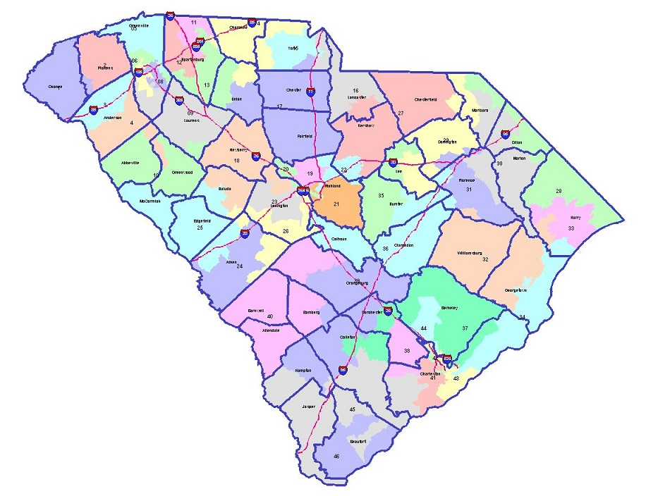
South Carolina
Senate Districts

Slide 15
LACK OF COMPETITION: 2016 SC SENATE (46 Seats)
25 Republican incumbents sought re-election
12 were unopposed
11 had opponents in the Republican primary but not the general election
1 had a Democratic opponent in the general election
1 had a third-party opponent in the general election, but no Democrat
17 Democratic incumbents sought re-election
7 were unopposed
4 had opponents in the Democratic primary but not the general election
6 had Republican opponents in the general election
3 open seats had Republican primaries but no Democratic candidate
1 open seat had both Democratic and Republican candidates
*Only 8 of 46 seats had both Democrats and Republicans running in the general*
37 of 46 members were re-elected

Slide 16
LACK OF COMPETITION: 2016 SC HOUSE (124 Seats)
70 Republican incumbents sought re-election
42 were unopposed
8 had opponents in the Republican primary but not the general election
10 had Democratic opponents in the general election but no Republican primary opponent
4 had third-party opponents in the general election, but no Democratic opponent
6 had both a Republican primary opponent and a Democratic general election opponent
40 Democratic incumbents sought re-election
26 were unopposed
6 had opponents in the Democratic primary but not the general election
5 had Republican opponents in the general election, but no Democratic primary opponent
1 had a third-party opponent in the general election, but no Republican opponent
2 had both a Democratic primary opponent and a Republican general election opponent
14 open seats
4 had only Republican candidates
1 had only Democratic candidates
9 had both Democratic and Republican candidates
*Only 32 of 124 seats had both Democrats and Republicans running in the general*
103 of 124 members were re-elected

Slide 17
Lack of Competition…
It was mathematically impossible for the Democratic Party to gain control of the Senate because there aren’t enough Democrats running, even though every seat was up for election. Of the 124 House seats, 58 had no Democratic candidate.
Most turnover in legislatures occurs through open seats (retirements, deaths, resignations) rather than incumbents being defeated when they run for re-election.
But when there’s no competition, there’s no possibility of turnover.
When there’s no turnover, there’s no opportunity for new people to serve.
If new people don’t have the opportunity to serve, there’s no way to increase the number of members from underrepresented groups.
Why no competition?
Partisan gerrymandering
If an incumbent is defeated, it’s more likely to be in the primary than in the general election
Incumbency advantage – fundraising, networking, etc.
Term limits exist for state legislatures in 15 states, but not in SC.

Slide 18
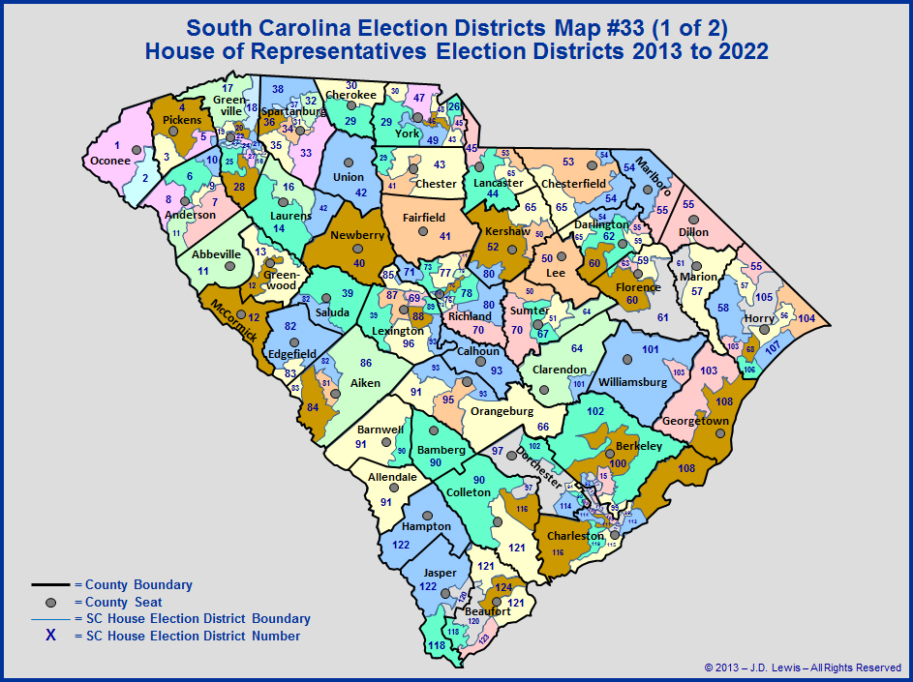

Slide 19
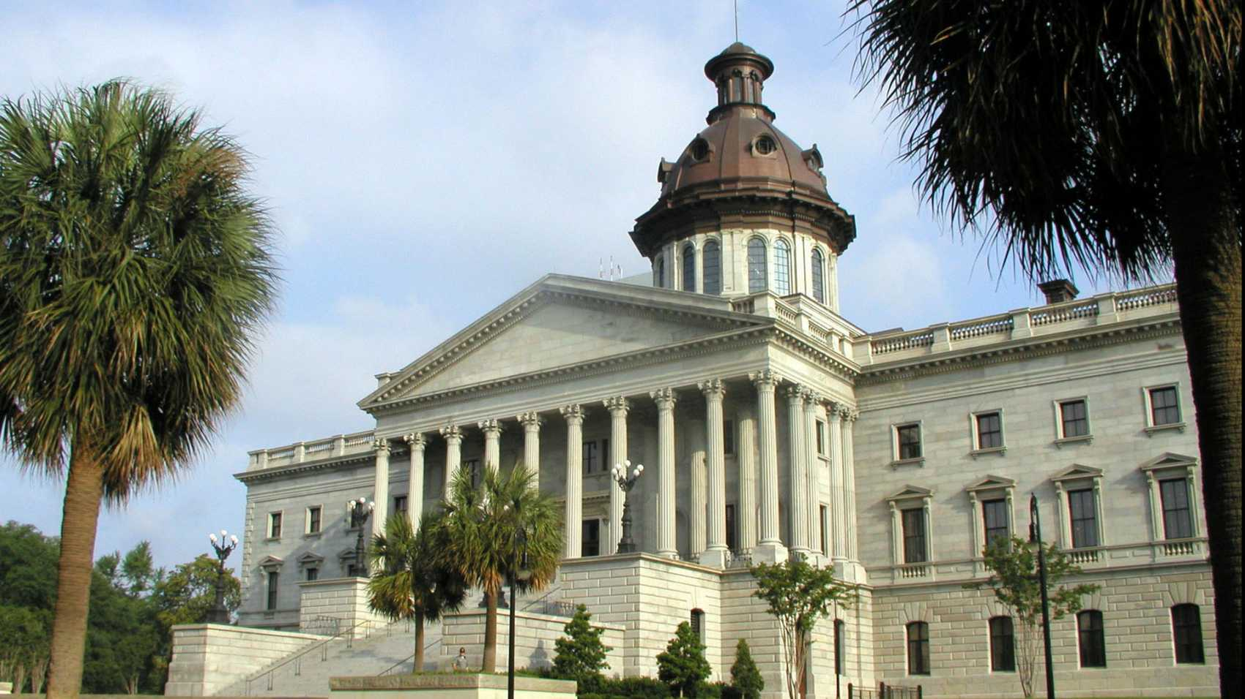

Slide 20
History of the State House
Political disputes between the Charleston aristocracy and the rest of the state led to an agreement to move the state capital inland.
Columbia was established in 1786 as the first city in the US specifically founded as a state capital.
The first State House in Columbia burned down while under construction in 1788.

Slide 21
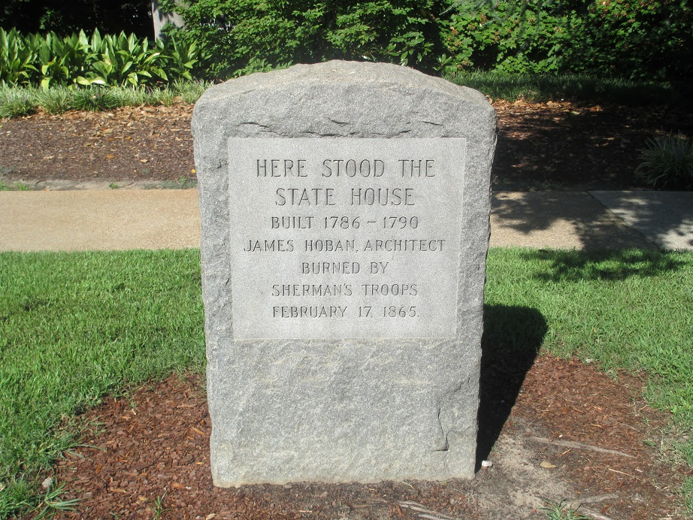
History of the State House
The second State House in Columbia was built in 1790, next to the current one. Hoban also did the White House.

Slide 22
History of the State House
Construction on the current State House began in 1851 and was interrupted by the Civil War.
The building was damaged by Union troops, Feb. 1865.
Construction was completed in 1903.
The building was extensively renovated between 1995 and 1998. It is now earthquake-proof.

Slide 23
Interesting Things to See at the State House
The Ordinance of Secession is engraved in marble in the entryway of the main lobby, while the U.S. Constitution is on a plaque in a corner of the basement. (Priorities?)
The John C. Calhoun statue in the lobby has a chunk broken off from its base. When it was being moved back into the building after the 1990’s renovation, the crane dropped it.

Slide 24
Interesting Things to See at the State House
The House office building is named for Solomon Blatt.
Blatt was a state representative from Barnwell County from 1929 until his death in 1986 at age 90 (over 57 years). By comparison, Strom Thurmond was in the US Senate for less than 48 years.
Blatt was Speaker of the House for all but four years from 1937 to 1973.
At the time of his death, Blatt was described as the longest-serving member of an elected legislative body in the non-Communist world.

Slide 25
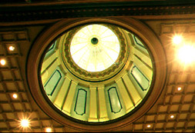
Interesting Things to See at the State House
In the lobby, if you look up to the rotunda, you are not seeing the inside of the dome which is visible outside. There are actually two domes, one inside the other.

Slide 26
George Washington Statue
Sherman’s troops broke off the cane in Washington’s hand. It has deliberately never been repaired.

Slide 27
Brass stars where Sherman’s artillery hit the building, deliberately never repaired.

Slide 28
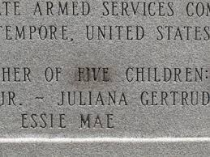
Strom Thurmond Statue
Thurmond’s children’s names are engraved on it. After his death, when Essie Mae Washington-Williams was acknowledged to be his daughter, her name was added to the statue.
“Father of Four Children” had to be altered to “Father of Five Children.” The re-engraving is not perfect and you can see where it was changed. A recently published biography of Sen. Thurmond has as its epilogue a chapter called “The Scarred Stone,” referring to this.

