Slide 1
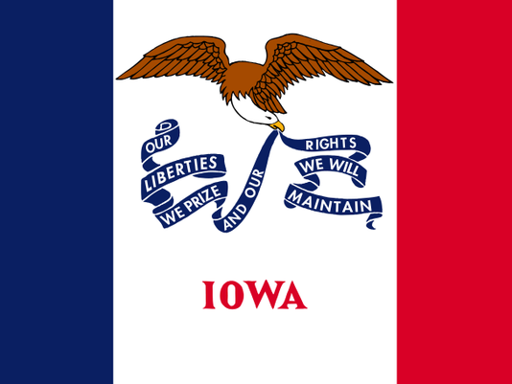
CAUCUS SIMULATION

Slide 2
IOWA CAUCUS SIMULATION
Draw a candidate to support.
You may switch off with another student
Draw a precinct to represent.
The voters in each precinct will meet as a caucus.

Slide 3
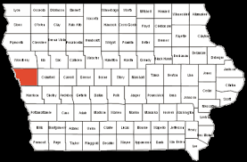
MONONA COUNTY, IOWA

Slide 4
County Seat: Onawa, Pop. 2998 The Eskimo Pie Was Invented Here

Slide 5
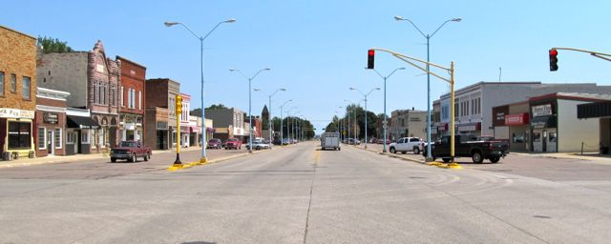
Onawa claims to have the widest main street in the country.

Slide 6
Simulation Voting Age Population 61
Precincts Voters Delegates
Blencoe 5 3
Castana 3 1
Franklin 5 3
Mapleton 7 5
Moorhead 5 3
Onawa 13 7
Rodney 5 3
Soldier 5 3
Turin 5 3
Ute 3 1
Whiting 5 3

Slide 7
Viability Threshold
One delegate – whoever gets the most votes gets the delegate.
Three delegates – 16.66% of voters (one-sixth, but since each 3-delegate precinct has five voters, it’s one-fifth)
Four or more delegates (Mapleton, Onawa): 15% of votes.

Slide 8
CANDIDATE SUPPORT
Des Moines Register/Bloomberg Poll, Jan. 2016
Clinton 42% = 25 of 61 voters
Sanders 40% = 24 voters
Uncommitted 14% = 9 voters
O’Malley 4% = 3 voters

