Slide 1
Objects, If, Routines

Slide 2
Creating Objects
an object is a fundamental software element that has a state and a set of behaviors.
Ex: bank account or student.
a variable holds a primitive value (integer, float, double) or a reference to an object
use the new operator to create an object

Slide 3


Random generator // creates a reference with the address of the object
generator = new Random // calls the Random constructor to set up the new object
numStudents 35 numStudents = 35;
generator
GradingSystem gs;
GradingSystem gs= new GradingSystem();
Two class systems: Run main object (Read about this in Ch 4.1-4.4)

Slide 4
Two-way and Multi-branch If statements
If-else Statement
if ( condition )
statement1;
else
statement2;
If the condition is true, statement1 is executed; if the condition is false, statement2 is executed
One or the other will be executed, but not both

Slide 5
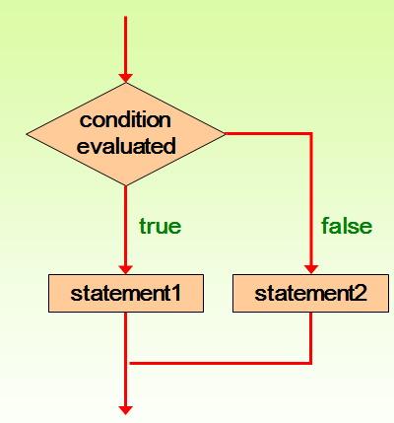
The statement controlled by the if is indented to show the relationship
Remember that indentation is for the human reader, and is ignored by the compiler

Slide 6
if (depth >= UPPER_LIMIT)
delta = 100;
else
System.out.println("Reseting Delta");
delta = 0;
System.out.println("Delta" + delta);
When value is printed. If depth is equal UPPER_LIMIT?

Slide 7
Multi-branch if is done using else if, to consider more options:
If (num1 < num2)
Win = “try again”;
else if (num1 = num 2)
Win = “you win”;
else
Win = “you lose”;

Slide 8
Three types of “routines” (named sequence of statements)
Main – one per system. Execution starts here
Constructor – usually one per class. Same name as the class. These are invoked to create objects using new. You must create objects before doing anything else with that class.
Method – as many as needed. These give the objects their behavior. Can use any name you want.

Slide 9
General format
The format for the constructor is similar except there is no return type.
public gradingStstem()

