Slide 1
Anzaldúa Slide Show
CRTW 201
Dr. Fike

Slide 2
Texts
You must have Anzaldúa’s texts in order to participate today. If you do not, go get them. You may rejoin the class in progress.

Slide 3
Questionnaire
Please take a moment to fill out the handout.

Slide 4
Group Work: Points of View
Do some thinking about this question: What argument is Anzaldúa making about borderlands with respect to the following sub-topics? Use as many elements as you can as you discuss and analyze.
  Group 1: Biological stuff (snake, tongue, bodies, etc.). Be sure to cover the opening poem on 72 and the cobra on 79.
  Group 2: Mythology and anthropology (especially Guadalupe), pages 73-78.
  Group 3: Psychology (psychic functioning): Your job includes 79-83.
  Group 4: Literature/academia(especially “How To Tame a Wild Tongue,” 85-93).

Slide 5
The Method
The Method is particularly well suited for today’s chapters.
What repeats? (patterns like the word "snake")
What goes with what? (strands like things that are psychological)
What is opposed to what? (binaries, T chart below)
What doesn't fit? (anomalies like multiple languages and poetry)
Re. all of these questions: So what?

Slide 6
Overview
Today we are going to do an exercise in interpretation.
It partly involves a technique from WA called “collapsing the binary.”

Slide 7
Preliminary Remarks
Anzaldúa’s chapters are a “montage,” which means a mixture of subjects, languages, styles, and genres. In other words, her format is to TEXT what John Berger’s collages are to images (his book is called Ways of Seeing).
In each author’s case, juxtaposition is important. Relationships are there, but our reader-response is a key part of the interpretation. In other words, implications are evoked in us rather than being directly stated in the text. We supply the missing links.

Slide 8
The Key Concept
Write down in your notebook what you think is the key concept in Anzaldúa’s chapters. The answer is on the next slide.

Slide 9
The Key Concept
Borderland:
  “borderland”: the region on both sides of the Texas-Mexico border
  “Borderland” includes other types of Borderlands such as psychological, sexual, and spiritual.
Find the definition in par. 1 of the head note on page 70 and write it in your notebook.
Then do an SEE-I for it. Half of you do borderland; the other half, Borderland.
My SEE-I is on the next slide.

Slide 10
SEE-I
S: A borderland is a geographical place where cultures and classes meet and interact.
E: In other words, it is an “interface” between opposite or adjoining cultures.
E: For example, the area along the US/Mexico border participates in both countries’ cultures.
I: It’s like brunch, which combines elements of both breakfast and lunch, a little of both, but is not purely one or the other. Or: It’s like the middle section of a venn diagram where categories overlap.

Slide 11
Problem
There is a problem with my SEE-I, though. Write down in your notebook what you think it is. How is it insufficient (that is, not enough)? The answer is on the next slide.

Slide 12
Problem
The SEE-I does not capture the idea that one of the cultures has more power than the other. In other words, there is an imbalance: one culture is dominant (hegemonic); the other is subordinate (subaltern). This power dynamic is very much present in Anzaldúa’s thinking.
I intend the next slide to help you understand that Anzaldúa’s text is based on what WA calls “binaries.” Copy the terms in your notebook and complete the exercise by adding the subordinate pieces.
Distribute grid handout.

Slide 13
What Goes with These Concepts?
Mind | Body
Human | Animal
Male | Female
Light | Dark
Spanish | Aztec
Aztec | Nomadic tribes
Rationality | Spirituality
Reason | Imagination
Western | Non-Western
Europe | New world
Empiricism | Psychic functioning / La facultad
American | Mexican
Mexican | Chicano
Christian | Pagan
Class system | Tribal society
Chicano | Black

Slide 14
Caveat
The interpretation on the next slide does not characterize the views of Dr. Fike, the Department of English, or Winthrop University.
The next slide simply explains the preceding slide in order to help you understand what the author is saying.

Slide 15
Here Is Another View
Aztecs > nomadic tribes :: Spanish > Aztecs :: Americans > Mexicans :: Chicanos > blacks.
The Aztecs are superior (in terms of power) to nomadic tribes, as the Spanish are superior to the Aztecs, and as the Americans are superior to both Mexicans and Chicanos, as those folks are presumed to be superior to blacks. That is the reality that Anzaldúa is addressing. She is not saying that it is morally right; she is just giving an accurate summary of her perception of race relations.
POINT: In a borderland, the meeting of opposites reflects asymmetrical power relationships.

Slide 16
Anzaldúa’s Purpose
Her purpose is to subvert these binaries by doing a kind of FEMINIST DECONSTRUCTION.
  Feminist means that the objective is to elevate the position of women and others in subordinate positions.
  Deconstruction means that this goal is achieved not, in this case, by flipping binaries but by merging them—showing the common ground.
So her goal is what she calls “balanced duality” on page 78 (last par.: mark your text). This point is in the spirit of the well-known statement that “the whole is greater than the sum of the parts.”

Slide 17
In Other Words
Anzaldúa wants to advocate for greater recognition of those things that exist in the “subaltern” position, the secondary or subordinate position (second column of your chart).
She wants us to think not in terms of binary oppositions (negations) that involve hierarchy—that is, “black-and-white thinking”—but in terms of pairings that can coexist without the need for subordination (contraries, antinomies). Difference is not deficiency.
Thus, her goal is to bring the things in the right column into sync with those in the left column so that a new third thing—a hybrid—is produced. She seeks to bridge or balance the paired terms so that power is more equal. There is a clear political purpose here: she hopes to effect political change.

Slide 18
Writing Analytically 94-97
Page 95: “Discover that the two terms of your binary are not really so separate and opposed after all but are actually parts of one complex phenomenon or issue. (This is a key analytical move known as ‘collapsing the binary.’)”
Page 97: “This move is known as collapsing the binary: coming to see that what had appeared to be an opposition is really two parts of one complex phenomenon.”

Slide 19
Okay, But How?
I mentioned earlier that reader-response is very important here. The assumption is that Anzaldúa’s readers are people like us: from the dominant culture, English-speaking, and mostly white.
How did you all feel when you had to read a text that included untranslated words in a foreign language?
Anzaldúa is attempting to give you the experience of being in a subordinate position in a borderland. She simultaneously evens the power relationship between dominant, mostly white, English-speaking culture and her own subordinate, Chicana, Spanish-speaking culture.
The result is the text, a new third thing that bridges binary oppositions and leads to a new hybrid state in which new possibilities arise. That is her hope anyway. She seeks not just to elevate the items in the right column of the chart but also to merge the left and the right columns in a new and creative way. In this fashion, she attempts to bring enhanced positive attention to the borderlands.
Your reader-response is that new third thing that is greater than the sum of its parts. It is neither purely English nor purely Spanish but a hybrid/montage of both.

Slide 20
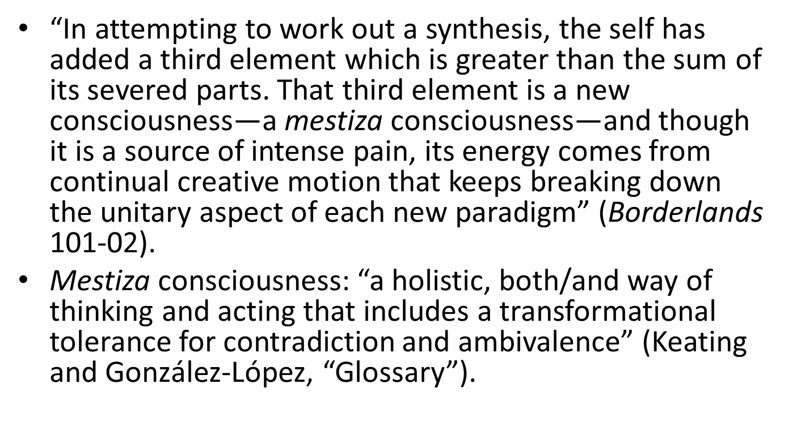
The New Third Thing
“In attempting to work out a synthesis, the self has added a third element which is greater than the sum of its severed parts. That third element is a new consciousness—a mestiza consciousness—and though it is a source of intense pain, its energy comes from continual creative motion that keeps breaking down the unitary aspect of each new paradigm” (Borderlands 101-02).
Mestiza consciousness: “a holistic, both/and way of thinking and acting that includes a transformational tolerance for contradiction and ambivalence” (Keating and Gonz$\text{á}$lez-López, “Glossary”).

Slide 21
Anzaldúa Herself Is
That New Third Thing
She is a lesbian Chicana. As a lesbian, she considers herself to be both male and female. As a Chicana, she is halfway between English and Spanish.
She is a bridge figure, as she indicates on page 92: “Deep in our hearts we believe that being Mexican has nothing to do with which country one lives in. Being Mexican is a state of soul—not one of mind, not one of citizenship. Neither eagle nor serpent, but both. And like the ocean, neither animal respects borders” (emphasis added).

Slide 22
Anzaldúa Is a Guadalupe Figure
See pages 75-76.
Anzaldúa “is a Basque name, where ‘an’ means above, the upper worlds, the sky, the spirit [eagle]; ‘zal’ means the underworld, the world of the soul, of images, of fantasy [serpent]; and ‘dúa’ is the bridging of the two; and the bridge, to me, is the interface” (“Creativity” 103). “I span abysses,” she states in “La Prieta” (209).

Slide 23
The Juan Diego Story
See today’s handout online for the J. D. story.

Slide 24
Binaries
Juan Diego, who shuttles back and forth between Tepeyác (also called Guadalupe) and the bishop’s location, acts as a bridge and signifies nepantla. Through his in-between agency, binaries meet and start to interact: upper and lower classes, city and country, male and female, human and divine, the bishop’s intellect (eagle) and the virgin mother’s several numinous appearances as well as her miraculous cure of Juan’s dying uncle (serpent).

Slide 25
Homework
You have two things to think about for next time:
  Read it if you have not done so already.
  Group work (next slide).
  Sacred cows: Did Anzaldúa tip over any of yours? Consider the questions two slides below. (This slide is a bit like Tart’s “Western Creed Exercise.”)

Slide 26
Group Work: Points of View
Do some thinking about this question: What argument is Anzaldúa making about borderlands with respect to the following sub-topics? Use as many elements as you can as you discuss and analyze.
  Group 1: Biological stuff (snake, tongue, bodies, etc.). Be sure to cover the opening poem on 72 and the cobra on 79.
  Group 2: Mythology and anthropology (especially Guadalupe), pages 73-78.
  Group 3: Psychology (psychic functioning): Your job includes 79-83.
  Group 4: Literature/academia(especially “How To Tame a Wild Tongue,” 85-93).

Slide 27
Sacred Cow Exercise: Assumptions
Did Anzaldúa's text activate any of your own FBIs? Extract assumptions from Anzaldúa’s two chapters (those she believes to be accurate as well as those she wants to overturn). List as many as you can and write them on the white/black boards. You might well begin with the section on which your group reported. Then ask yourself this question: At what points did you feel yourself pushing back? Why? What “sacred cows” did Anzaldúa violate for you as a reader of her text? Think back to Tart’s “Western Creed Exercise” as you work back through the two chapters. How did your body and emotions FEEL as you read her chapters? Finally, did you find any fallacies in her material—any places where she violates the spirit of her own project? Here are some prompts re. assumptions; feel free to add your own to this list.

Slide 28
Here Are Some Areas of Inquiry To Get You Started
The study of literature
The spirit world
Psychic ability, the suprahuman
North American culture
Borders
Language
Women and minorities
Feminism and feminists
Standard English
Cultural hegemony
The body
The unconscious mind
The soul

Slide 29
Clarification
The statements on the next slide do not represent the positions of Dr. Fike, the Department of English, or Winthrop University. They are designed to help you think about what you think and to explore why you think it.

Slide 30
Sacred Cows (Assumptions)
We should study literature by white men in Western tradition (the Western canon).
There is no spirit world—or, if there is, we cannot access it while we are alive (or we CAN access it, but it is dangerous, demonic).
We are not psychic. Psi is not real.
White North American culture is the best. Borders should be respected.
We are not equal to our language. It is just a tool. But everybody should speak standard English.
Women and minorities should keep silent.
Feminists are man haters and lesbians.
Cultural hegemony (superiority, authority) is ours because we are better. Americans are born with special privileges.
The body is bad.

Slide 31
Traits
The critical-thinking character traits (habits of mind) appear on pages 175-76. In what ways does Anzaldúa illustrates these traits?
  Confidence in reason
  Intellectual humility
  Intellectual courage
  Intellectual empathy
  Intellectual integrity
  Fair-mindedness
  Intellectual engagement
  Intellectual perseverance
  Intellectual autonomy

Slide 32
Final Application
What things from Anzaldúa’s two chapters might help you write your final paper about a global cultural event?

Slide 33
Evaluation: Standards
Here is a bit of evaluation to consider.
There are fallacies on page 81:
  “all violence”
  “all life, beauty, pleasure”
  “totally ignore the soul”
By overgeneralizing, is Anzaldúa violating the spirit of borderlands consciousness, which seeks to bring oppositions together? Isn’t she doing, say, to Christianity the thing she attacks Christianity for doing to native religions? Isn’t this dualism/hierarchy rather than duality/unity? What standards is she violating?

Slide 34
SEE-Is
Do an SEE-I for the following terms:
  Identity, 91
    The unconscious
    Soul
    The suprahuman (supra = above or beyond)
  Mediatrix
  La Facultad
  END

