Slide 1
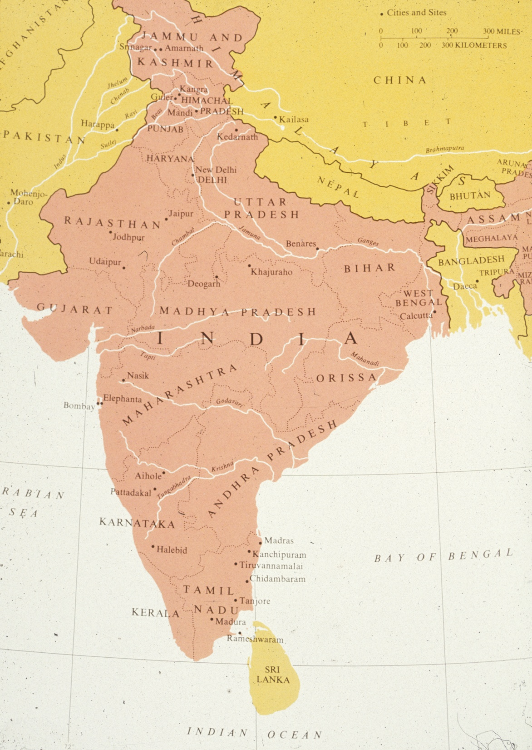
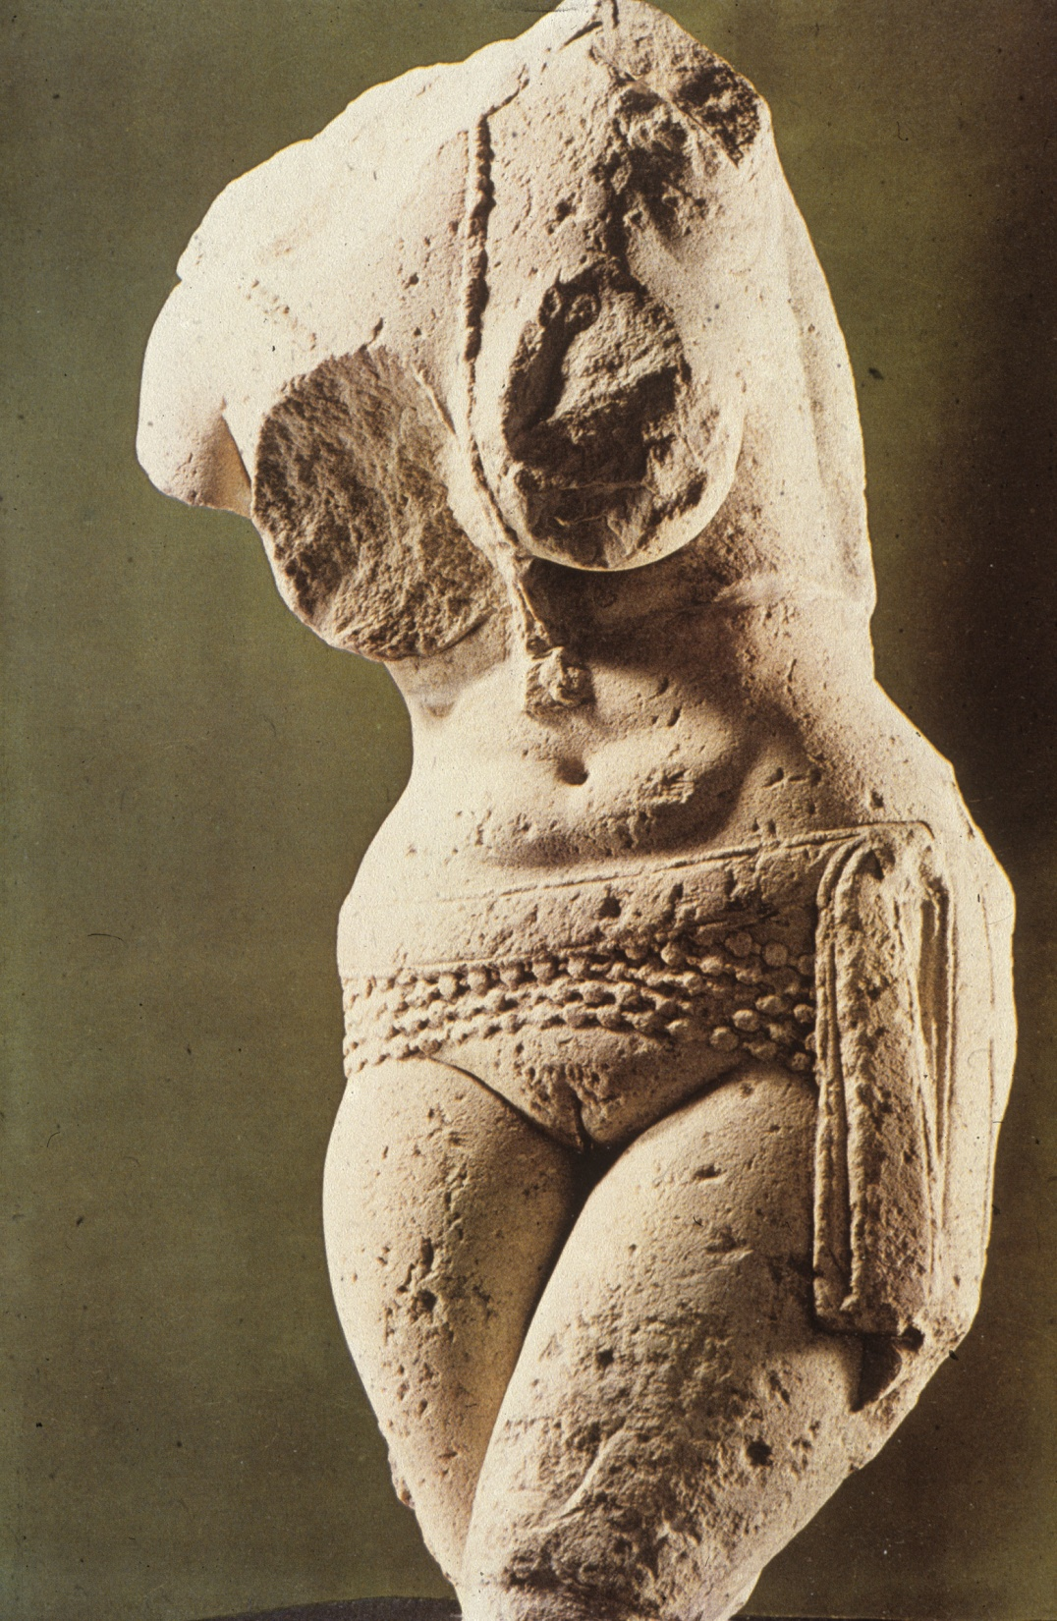
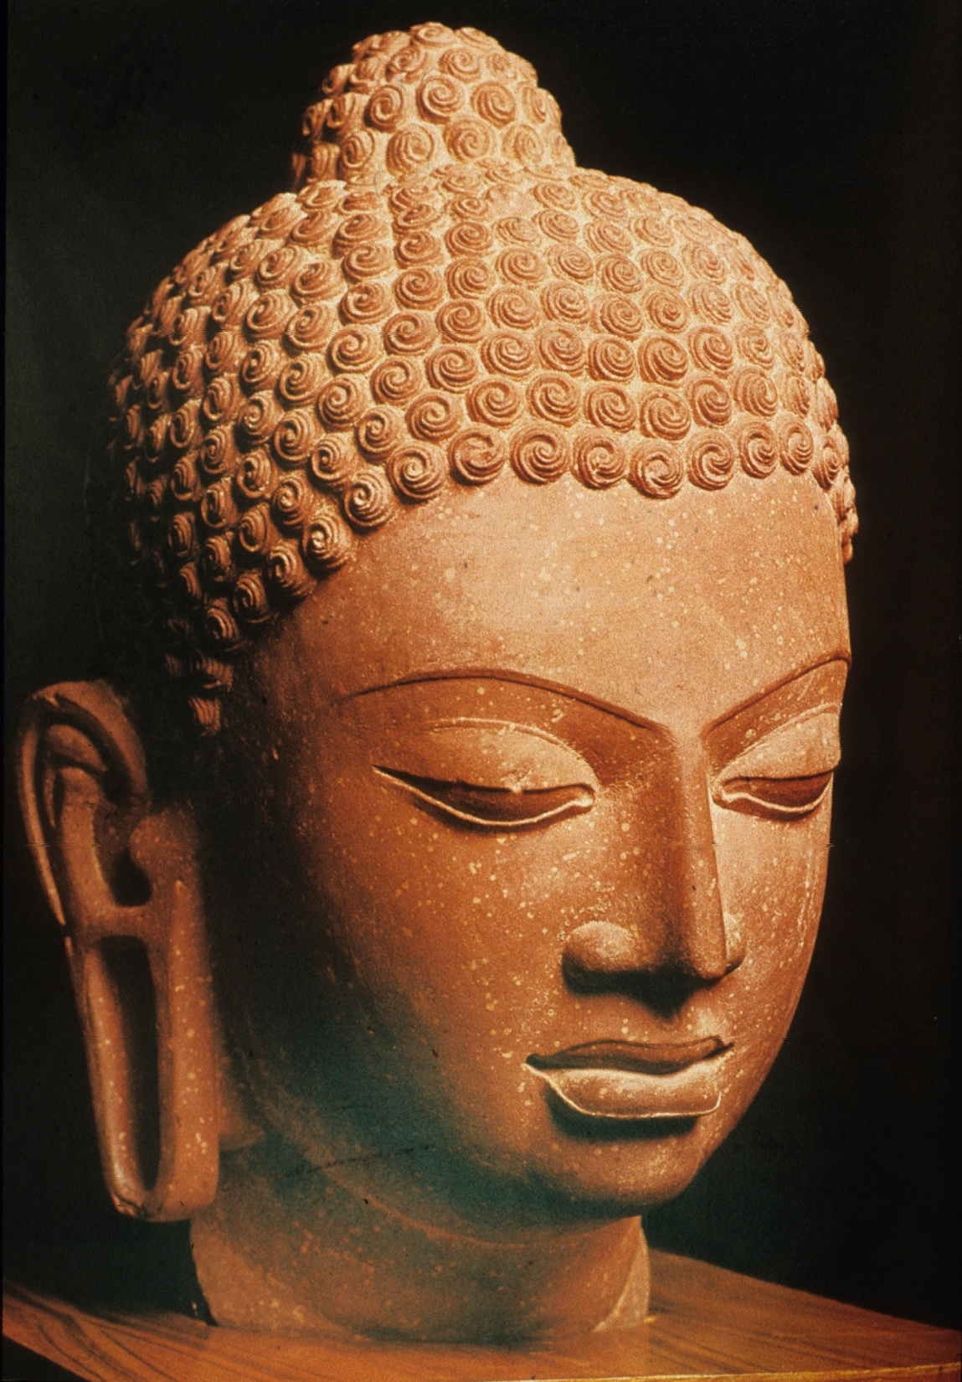
Buddhism & Hinduism
Brahmanism (Vedic Tradition)
Buddhism
Hinduism

Slide 3
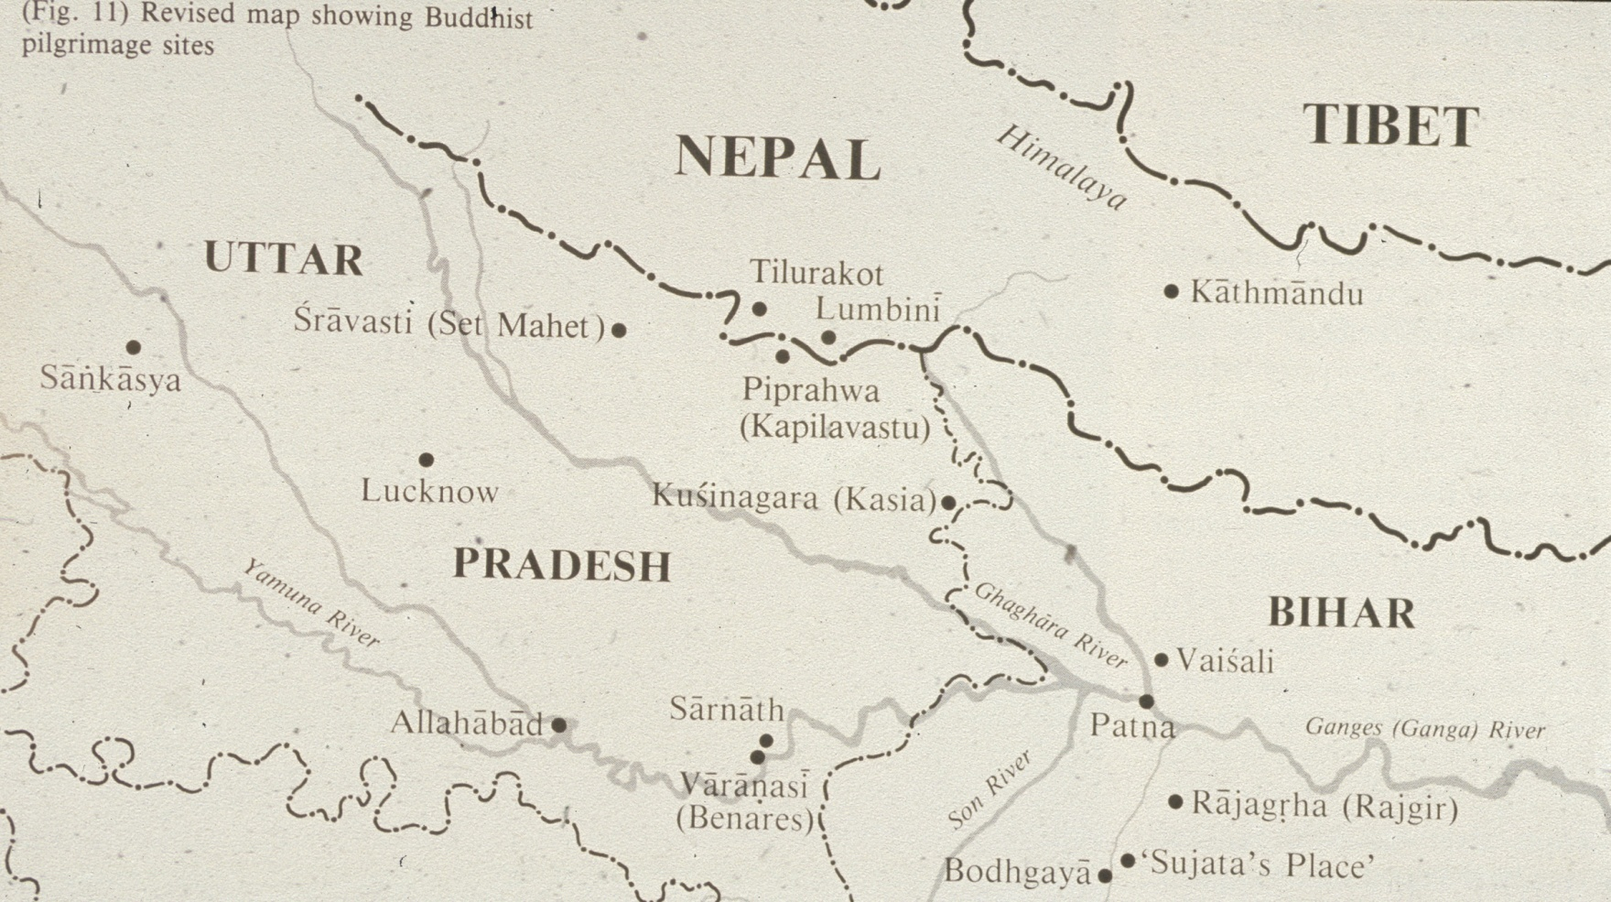

Slide 4
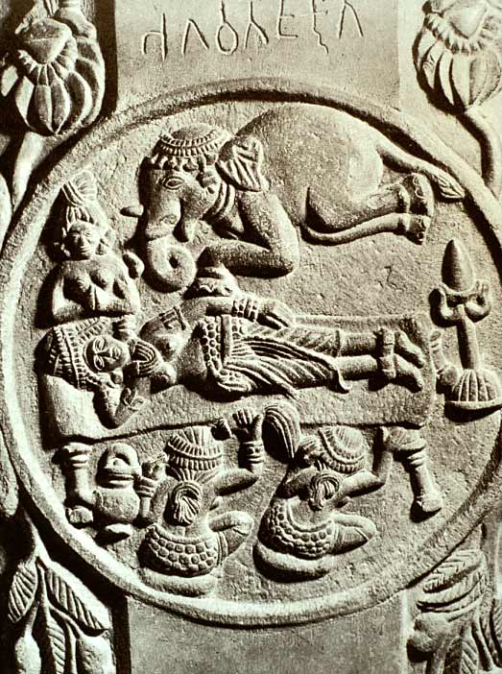
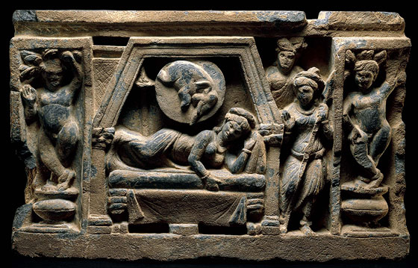
Dream of Queen Maya 2nd century bce
(left in book)

Slide 5
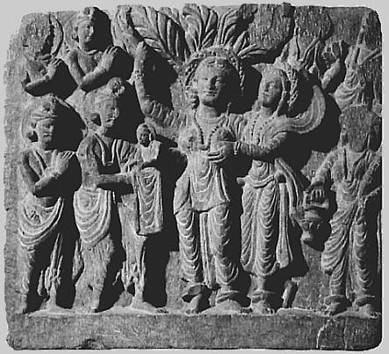
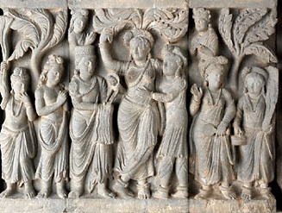
Maya gives birth to Buddha
2-3rd century ce left

Slide 6
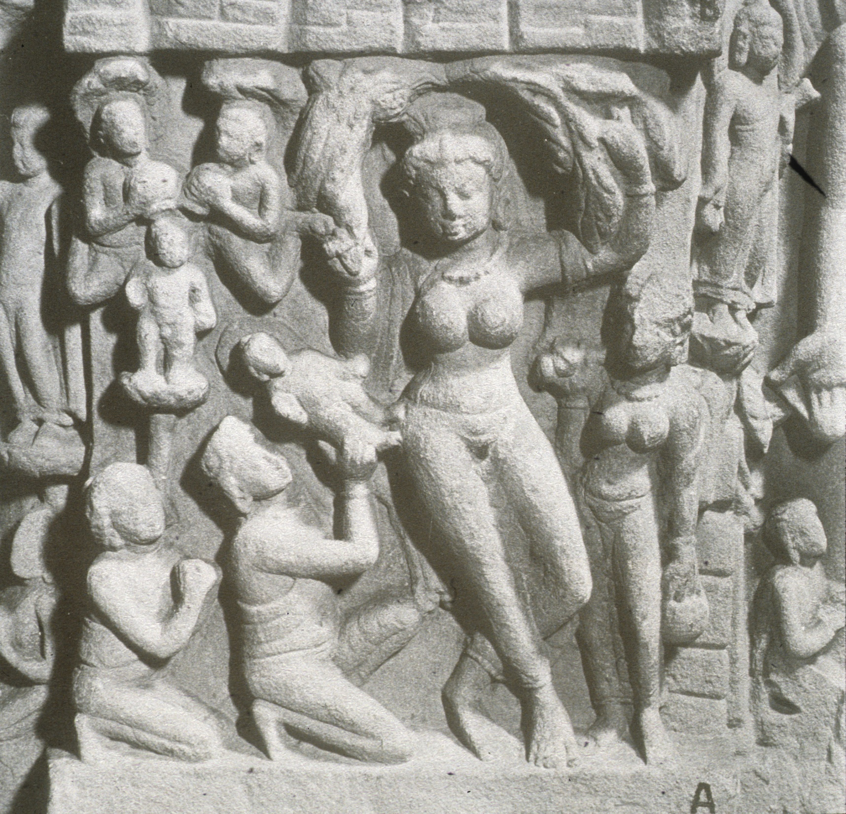
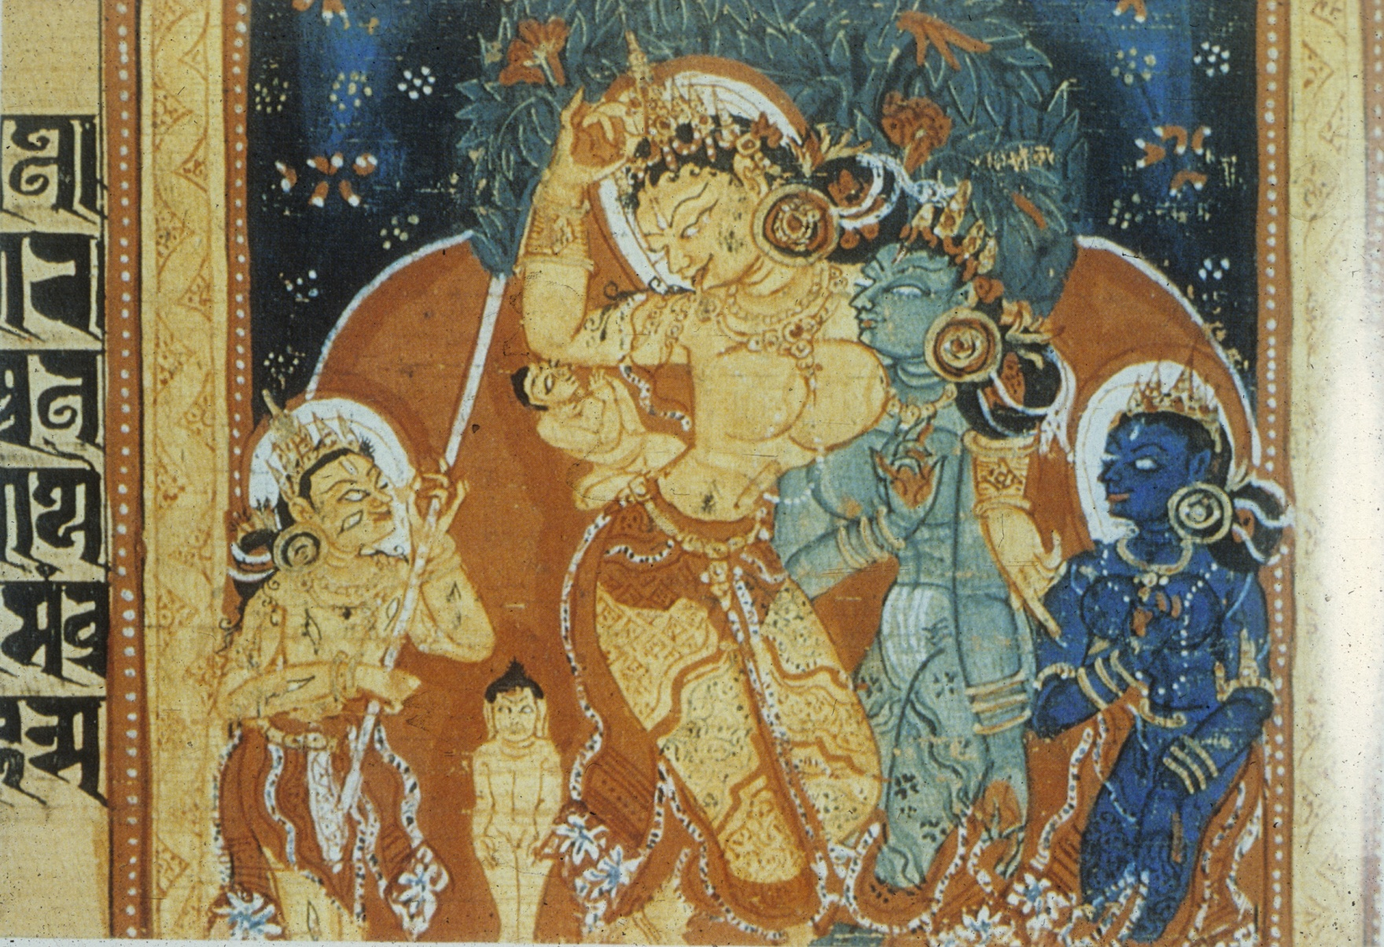

Slide 7
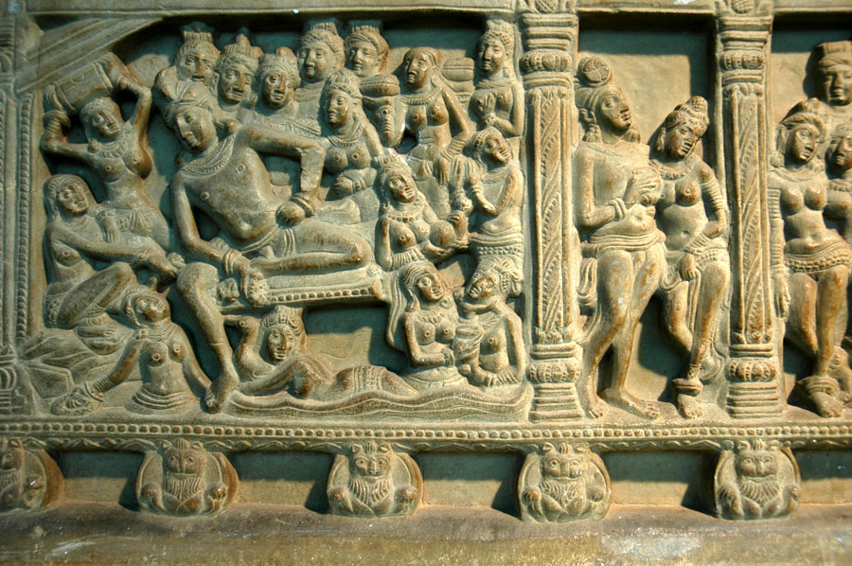
Prince Siddhartha in Palace 3rd century ce

Slide 8
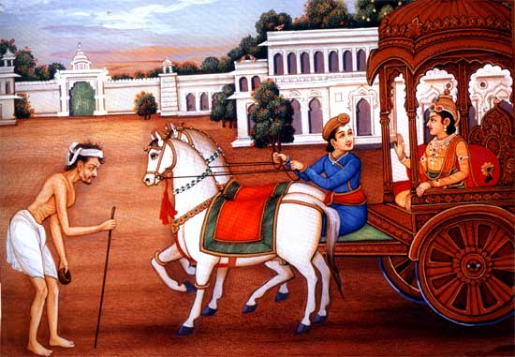
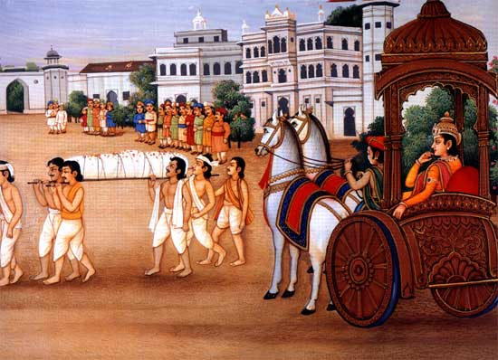
Suffering
Illness
Death
Monk (ascetic)

Slide 9
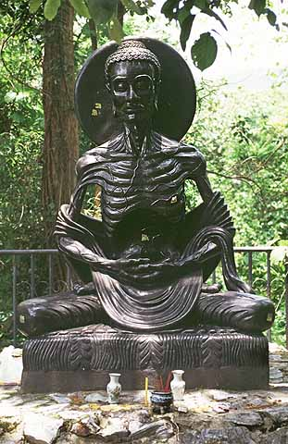
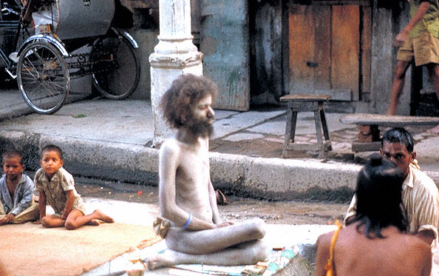
years as an ascetic (yogi)

Slide 10
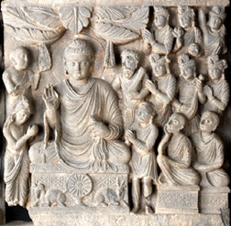
Meditates under Pipal Tree
Now known as Bodhi (enlightenment) tree
4 truths:
Life is suffering
Suffering is caused by desire/attachment
Can overcome desire by conquering ignorance
Follow the 8-fold path

Slide 11
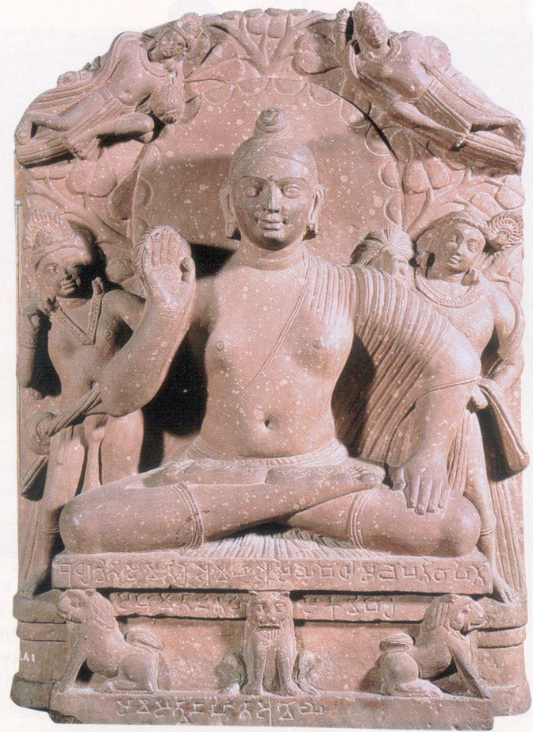
8 -fold path
Right understanding
Right goals
Right speech
Right behavior
Right calling
Right effort
Right alertness
Right thinking

Slide 12
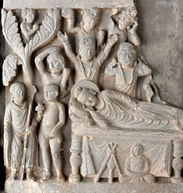
Death of the Buddha
Mahayana – greater wheel – Buddha a God
Hinayana – lesser wheel – Buddha a teacher

Slide 13
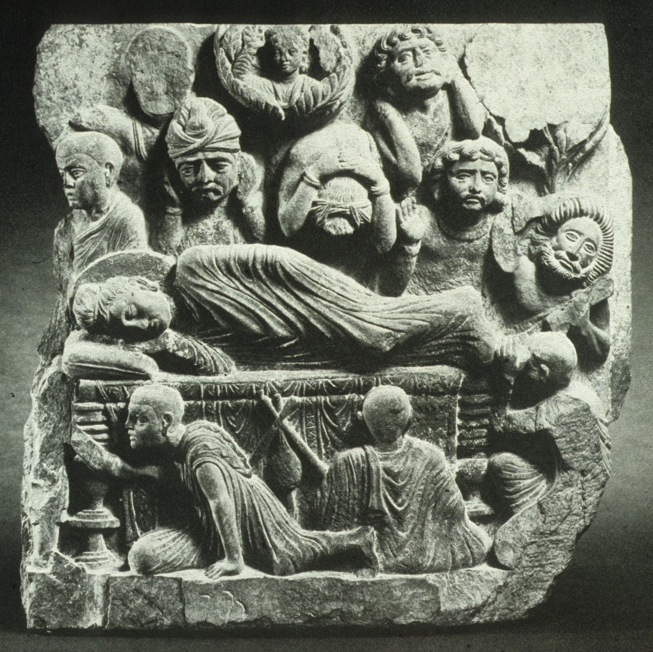

Slide 15
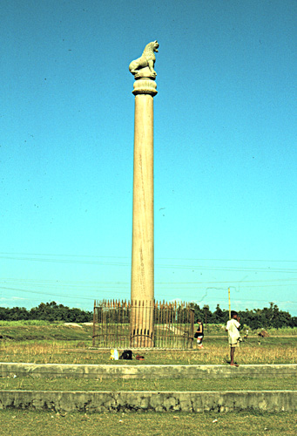
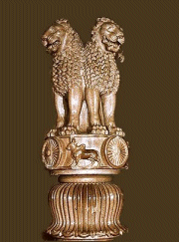
King Ashoka
Ashokan Lion Capital 7’
Column 50’ 250 bce

Slide 16
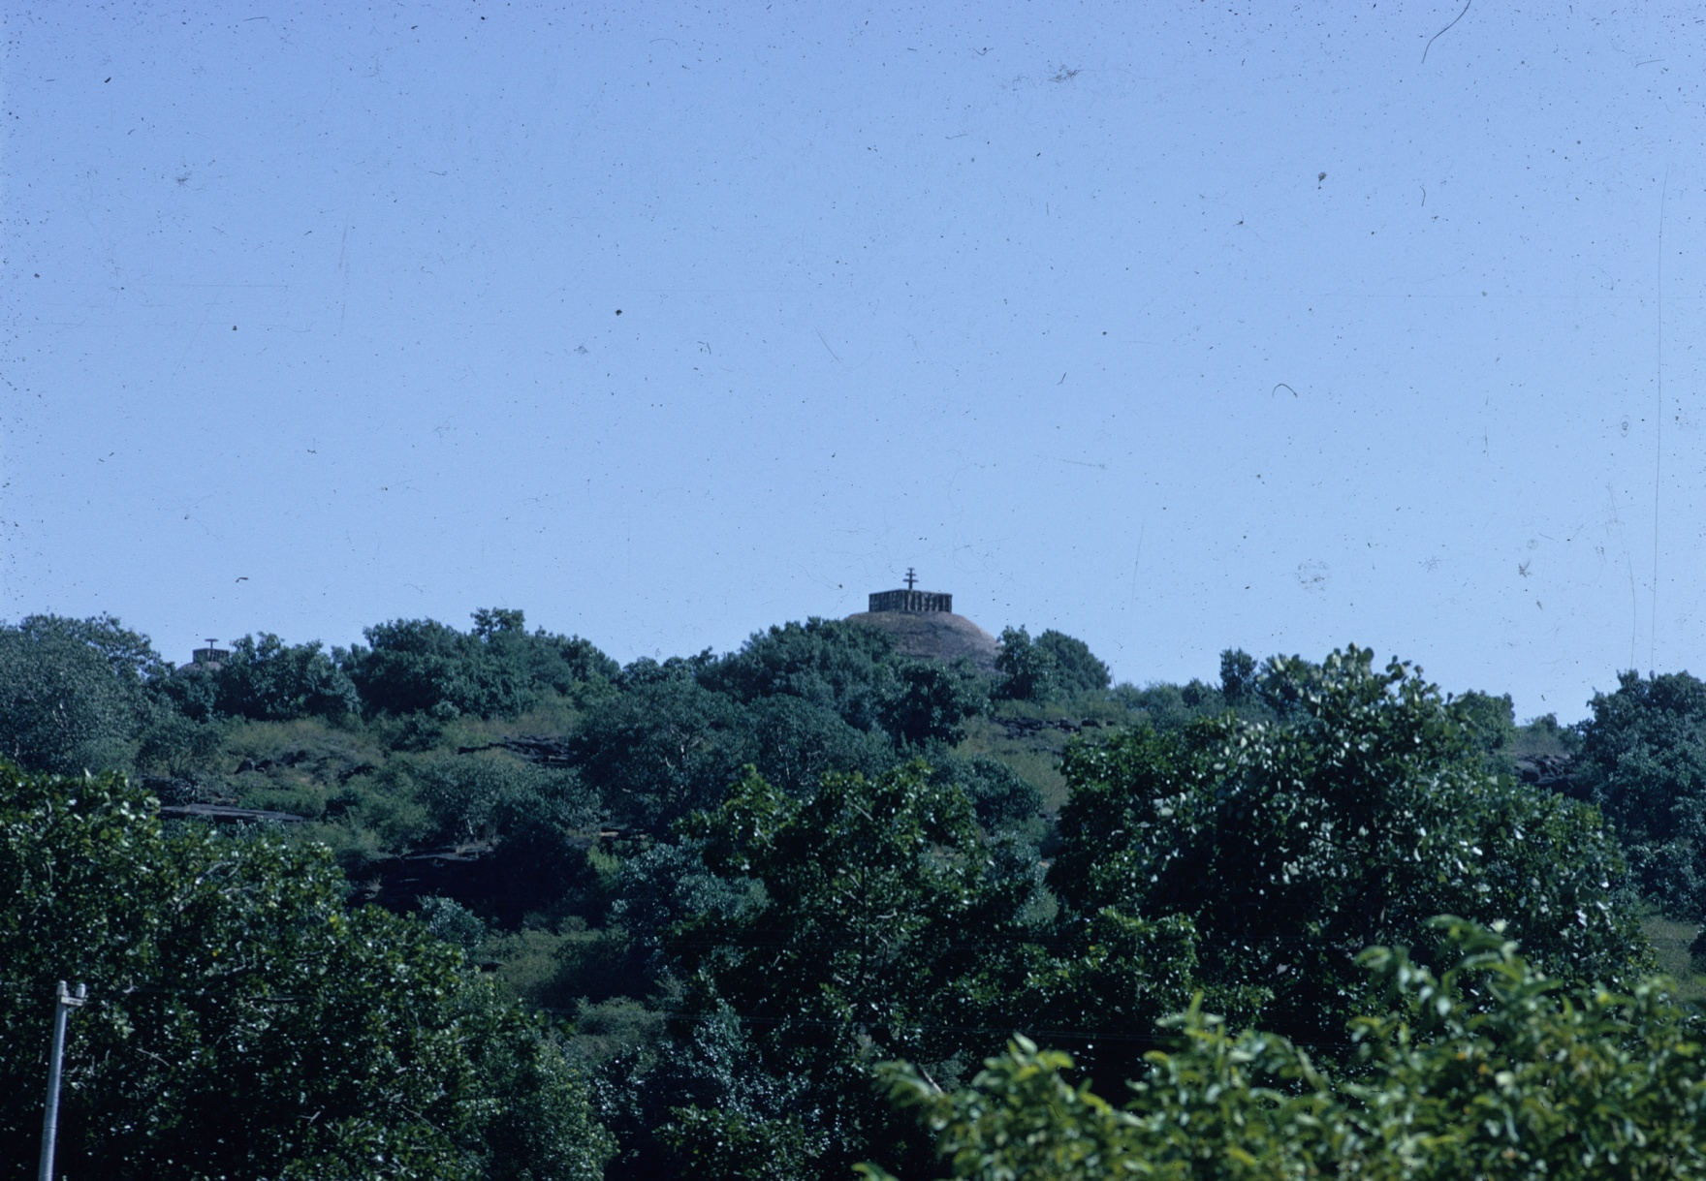
Great Stupa at Sanchi
Built by King Ashoka?

Slide 17
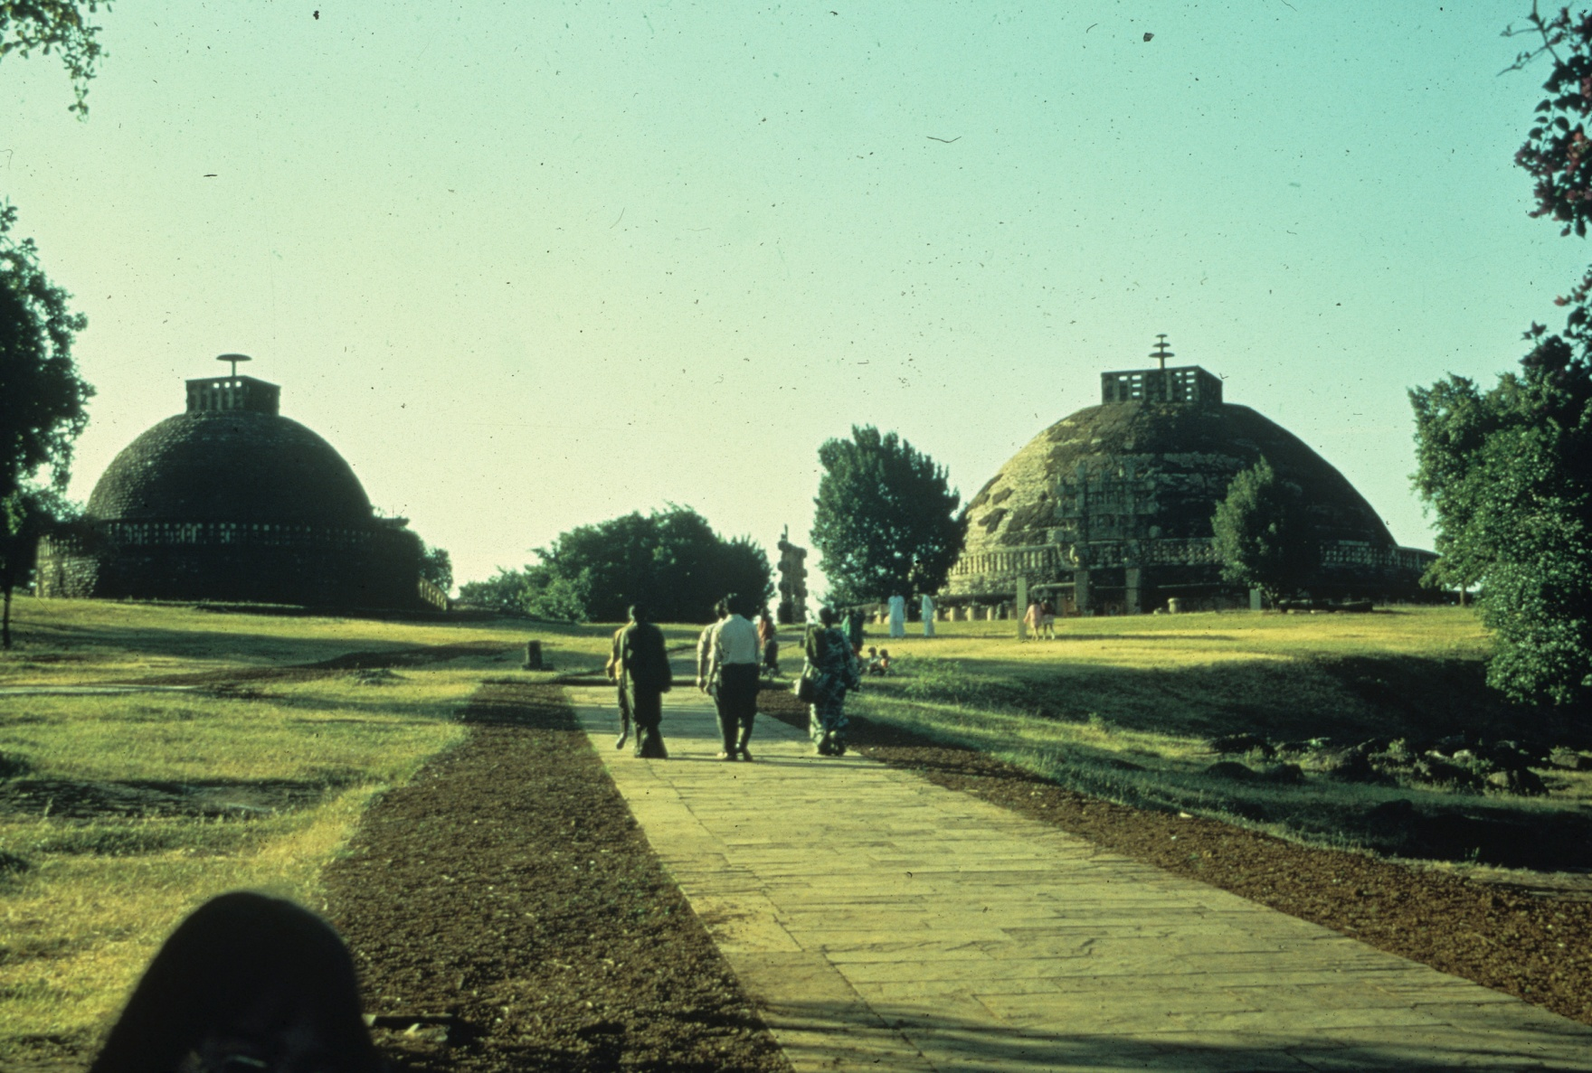

Slide 18
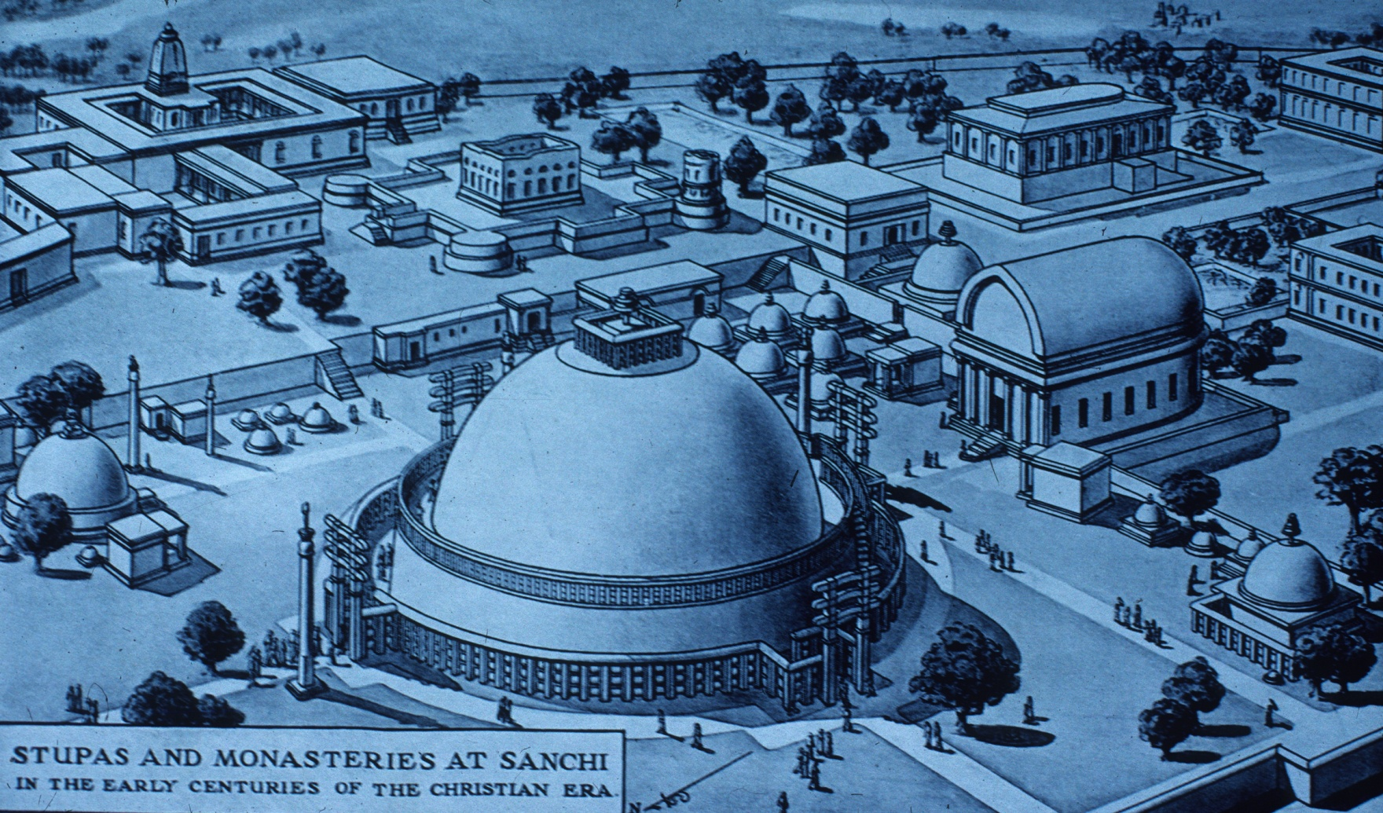

Slide 19
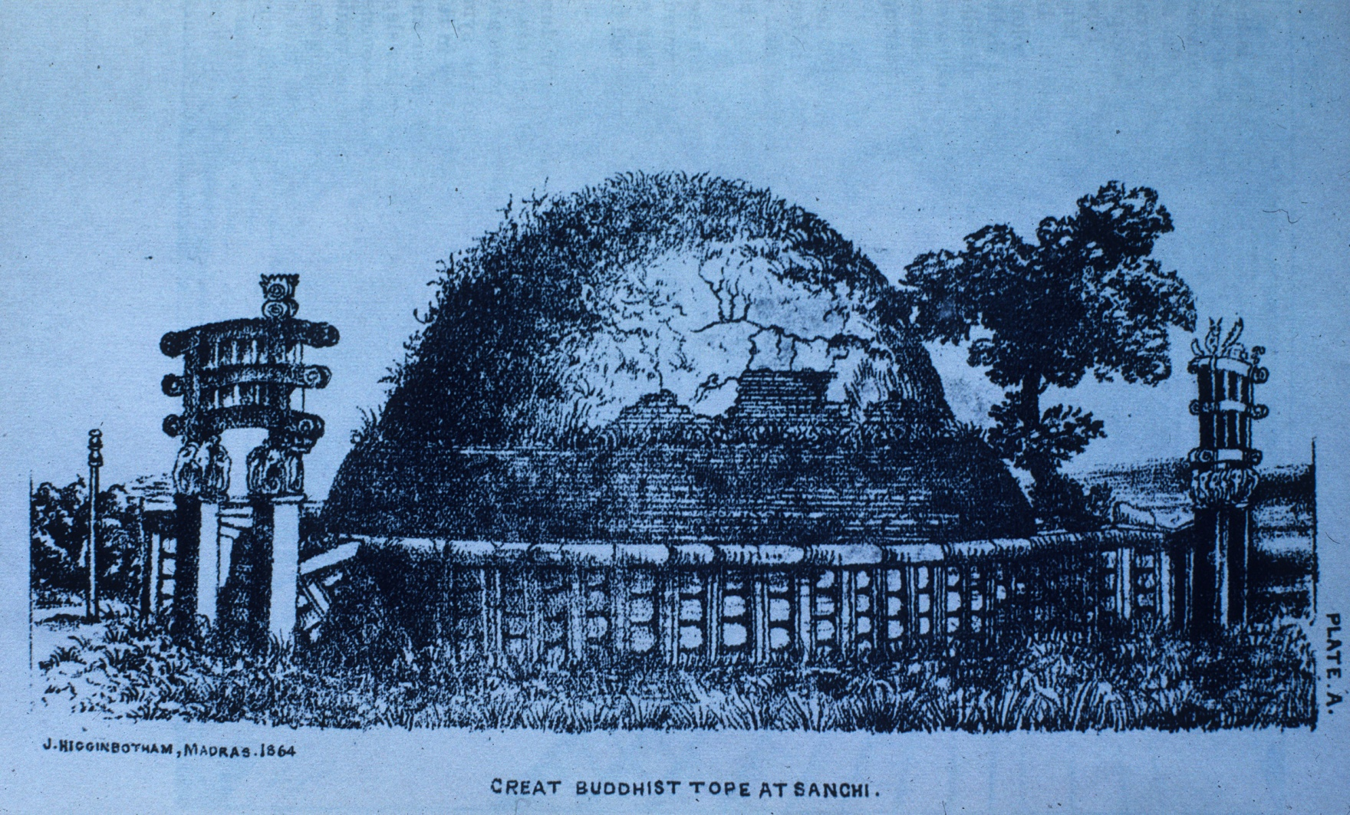

Slide 20
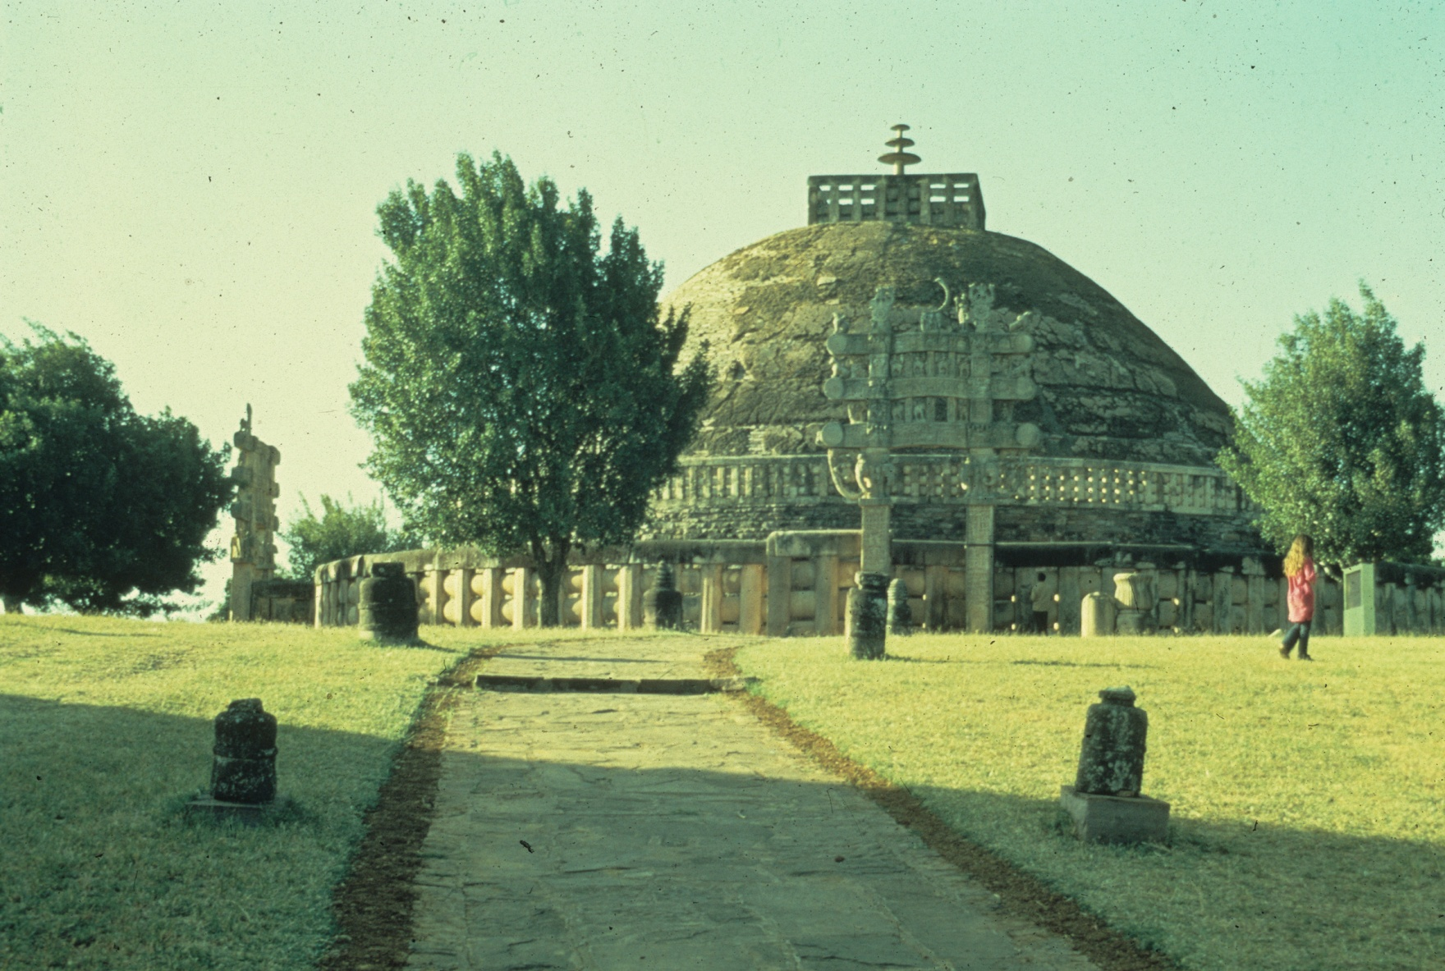

Slide 21
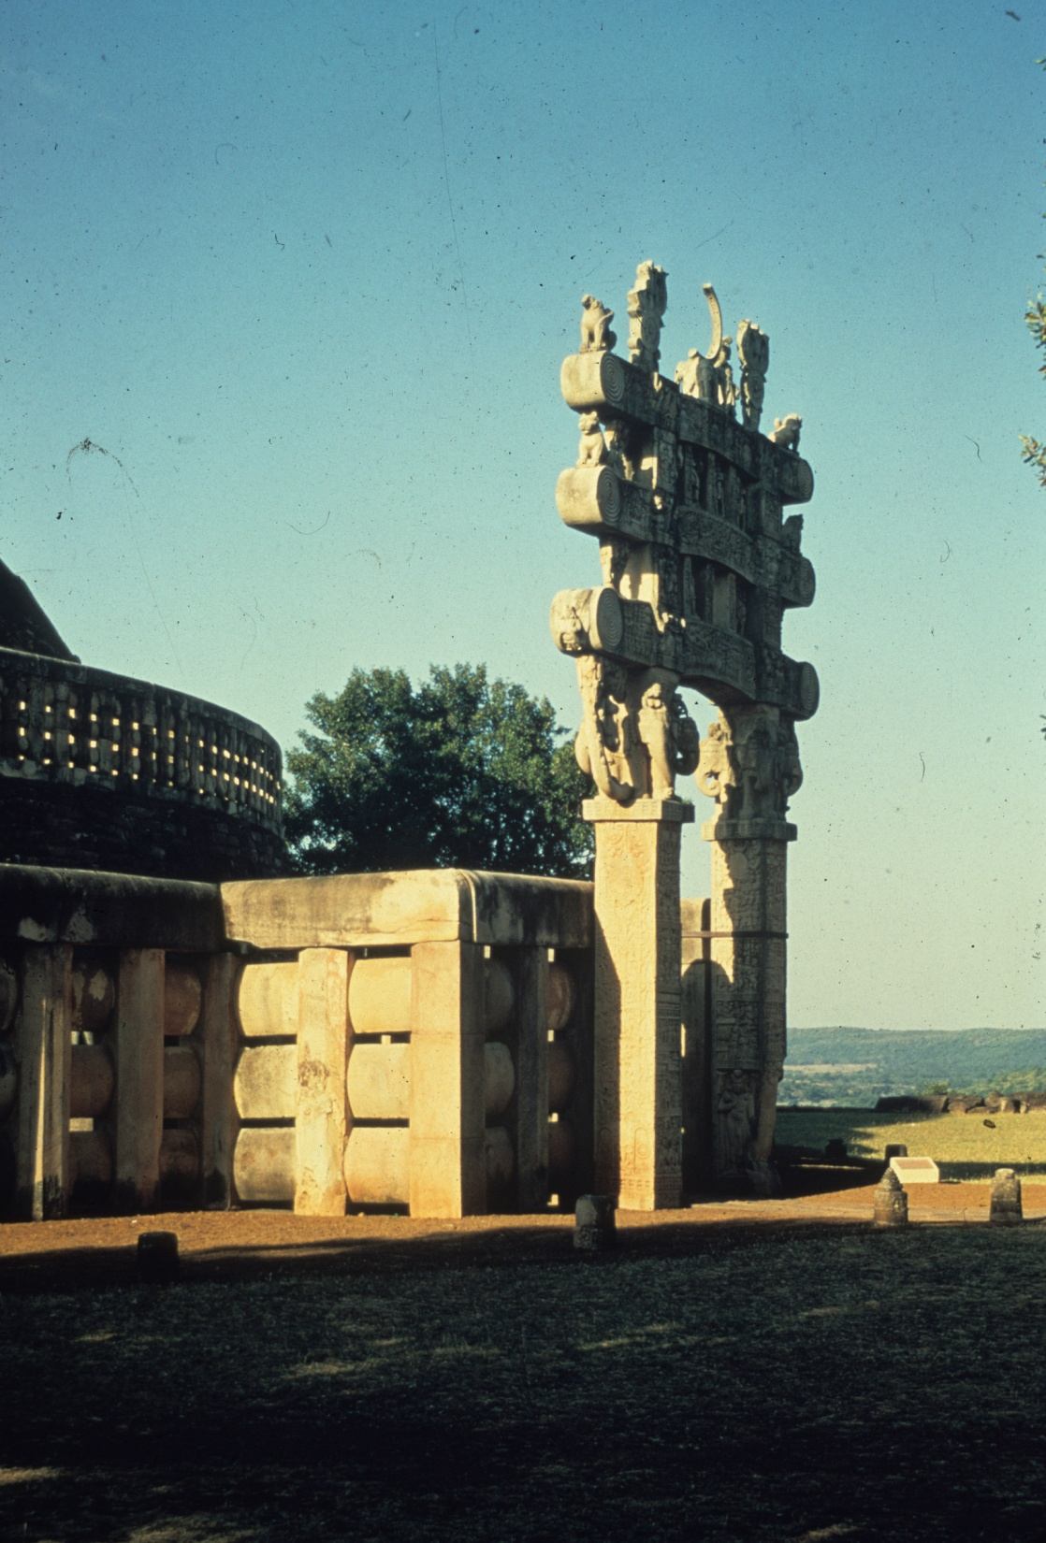

Slide 22
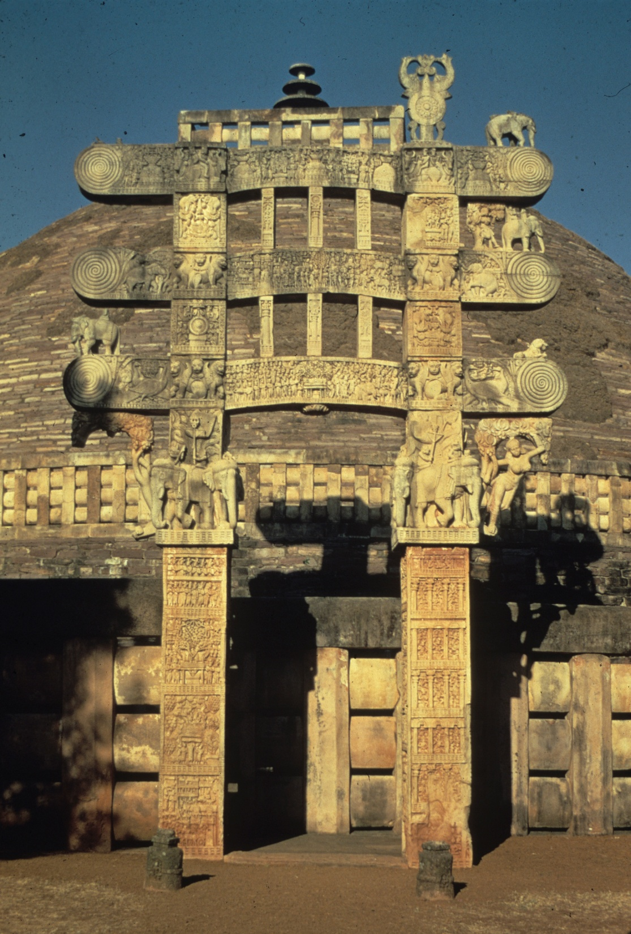

Slide 23
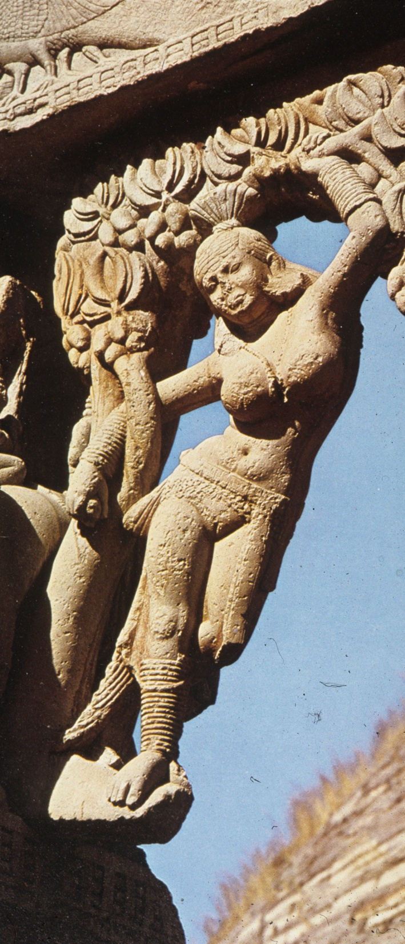

Slide 25
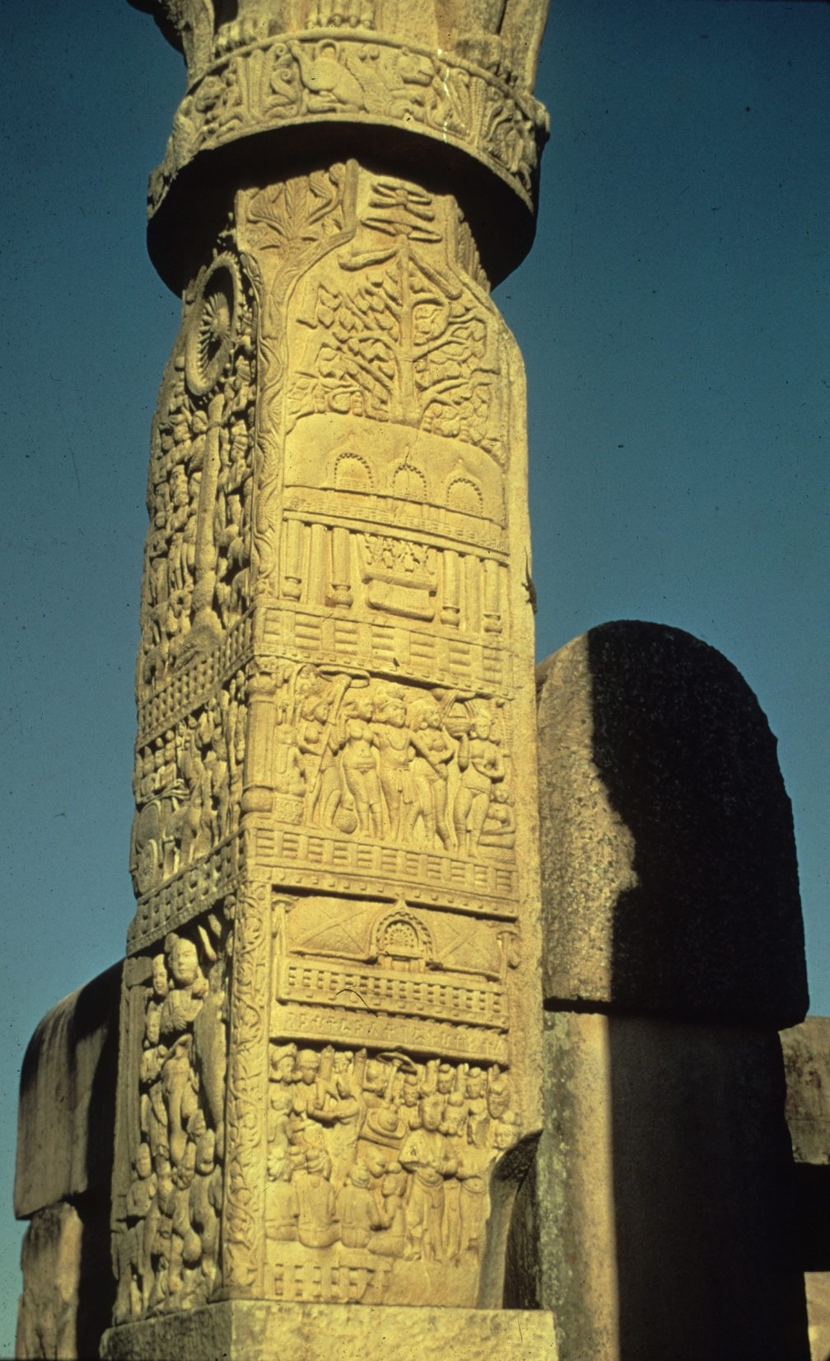

Slide 26
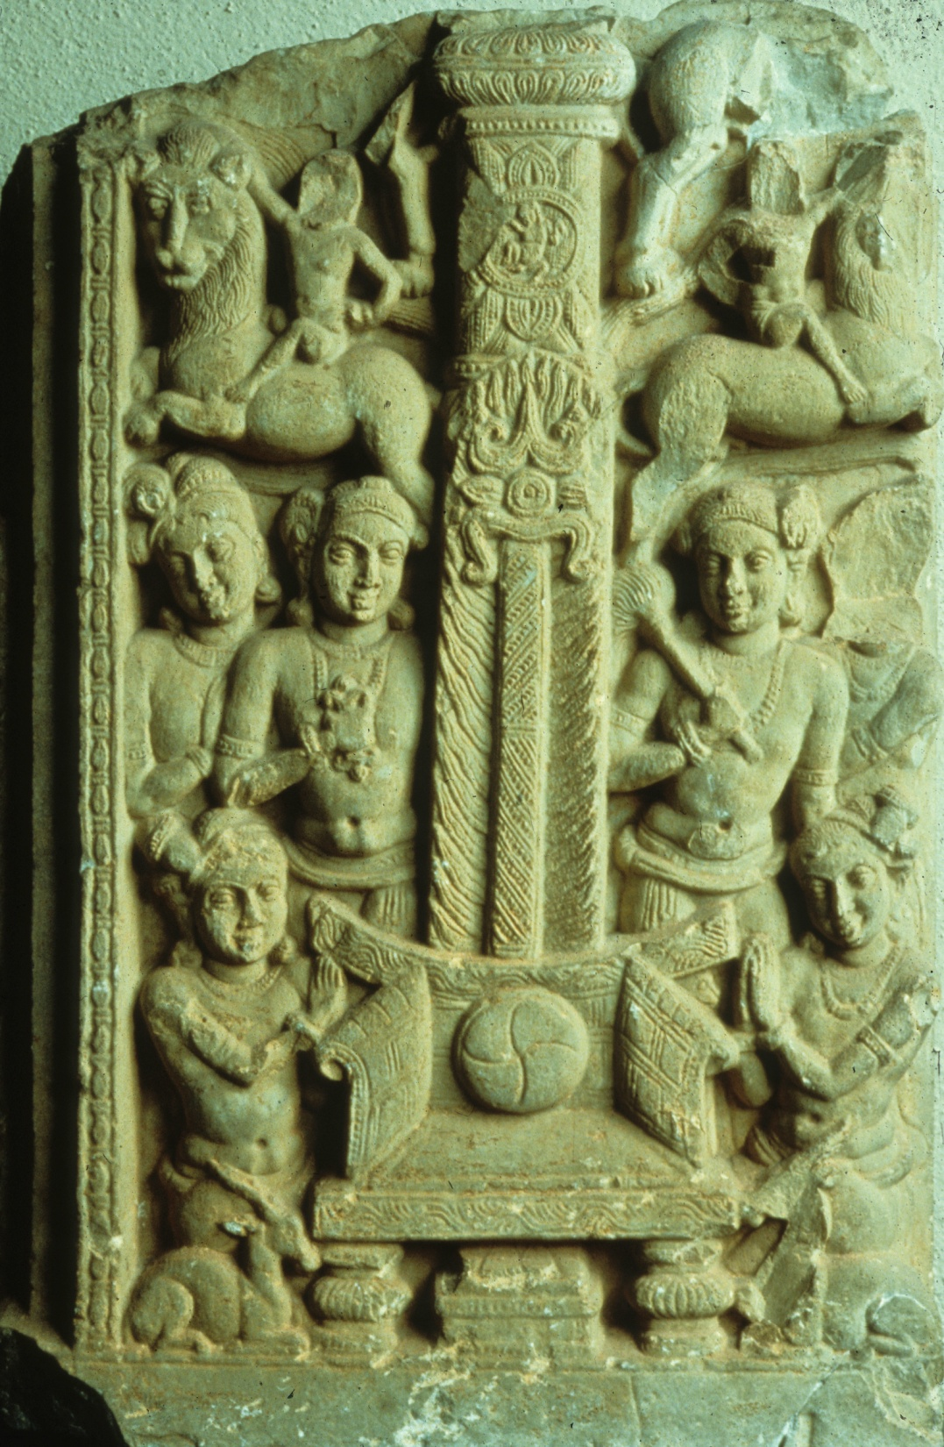
Empty throne =
Buddha
No figurative tradition yet

Slide 27
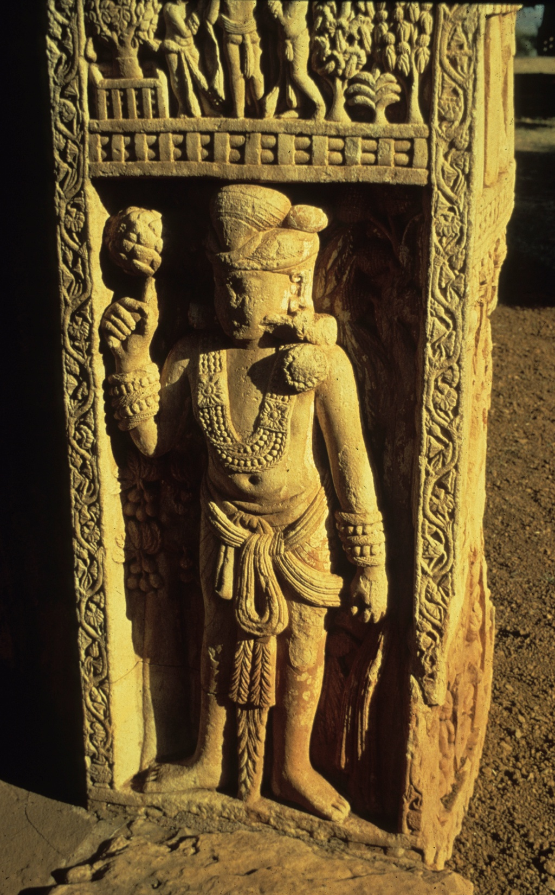
Guardian figure
Holding lotus

Slide 28
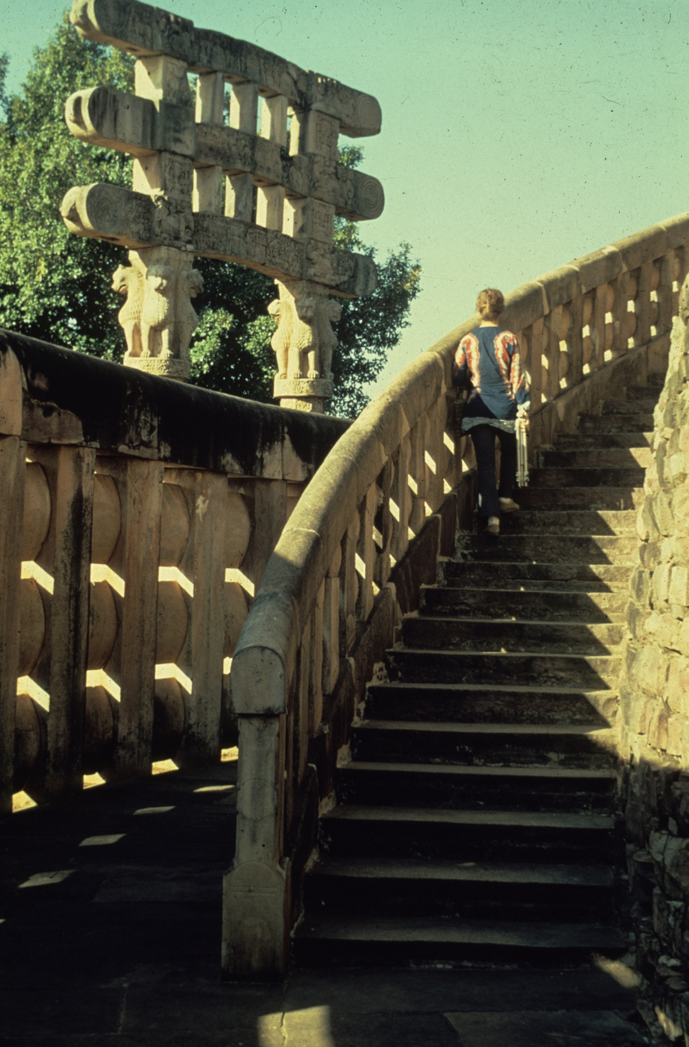

Slide 29
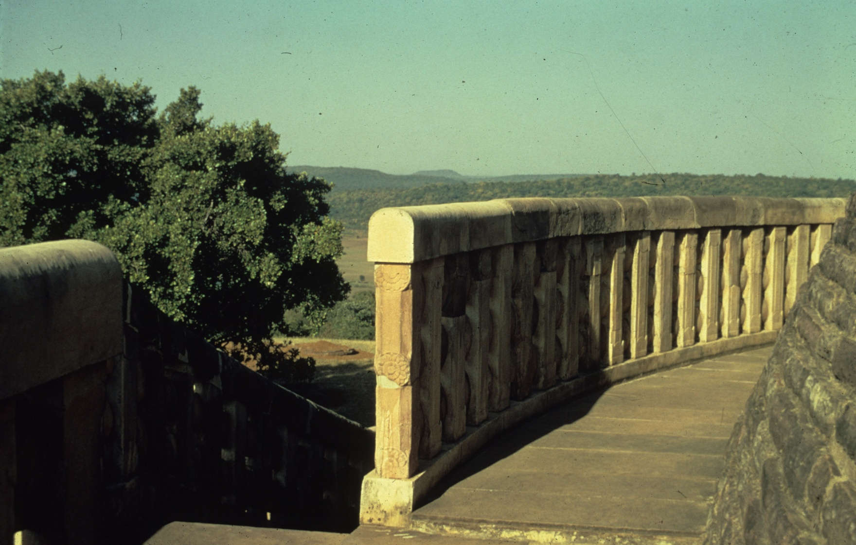

Slide 30
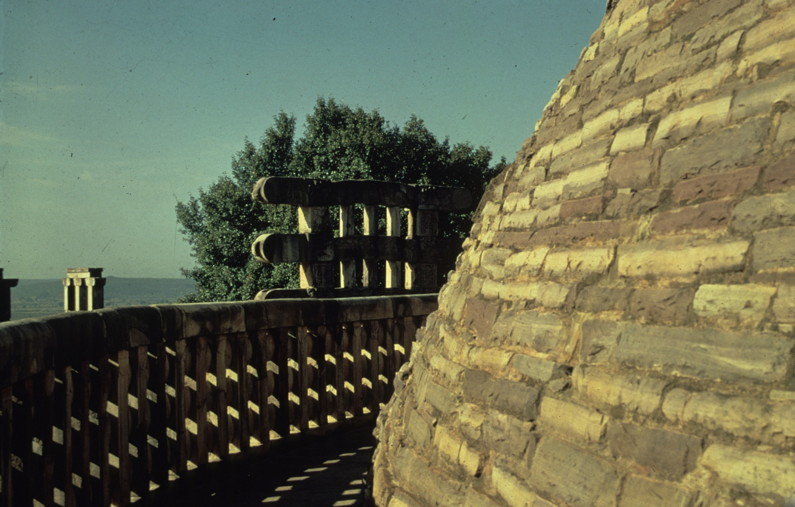

Slide 31
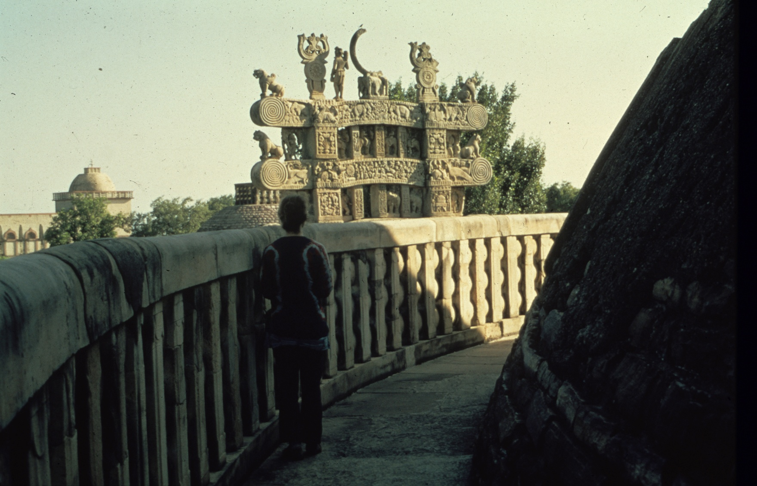

Slide 32
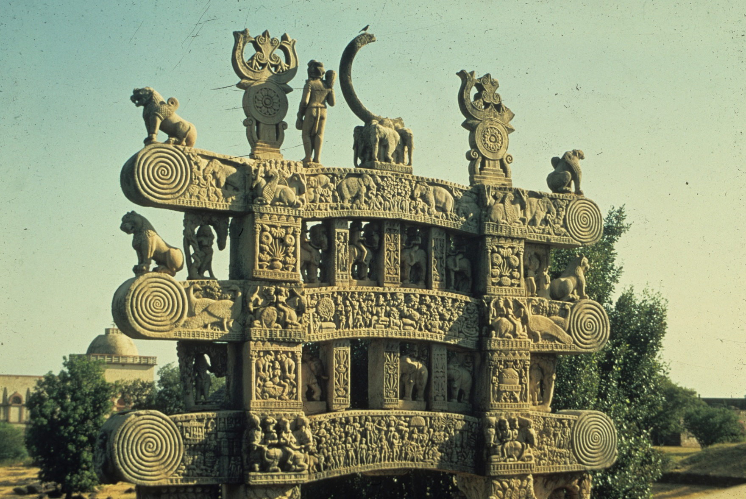

Slide 33
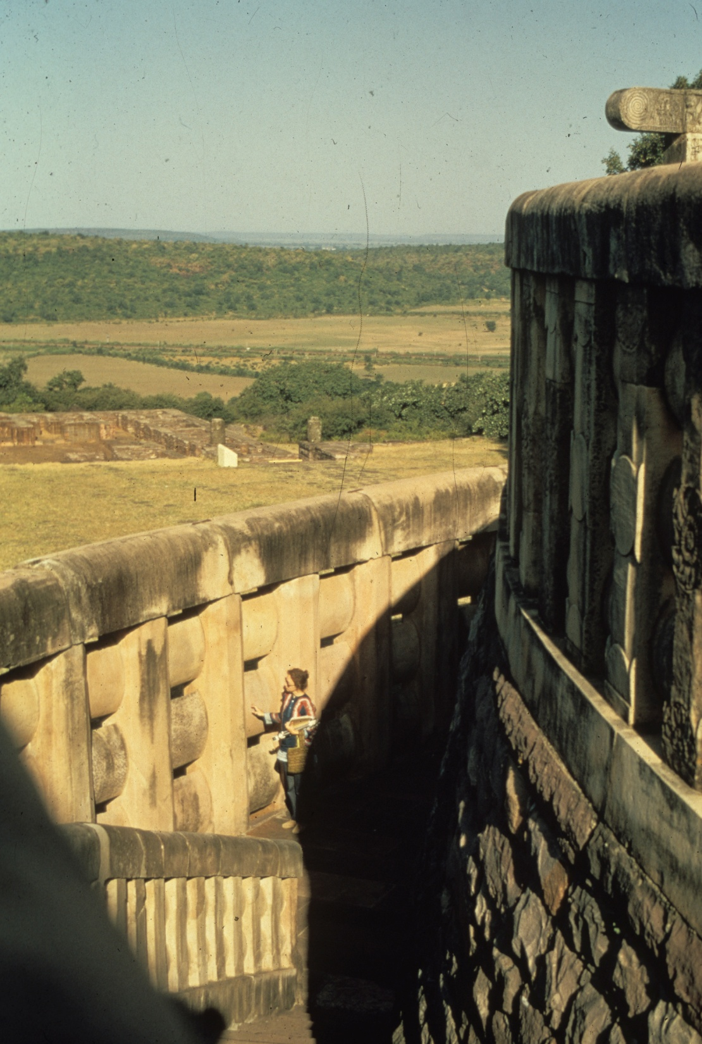

Slide 34
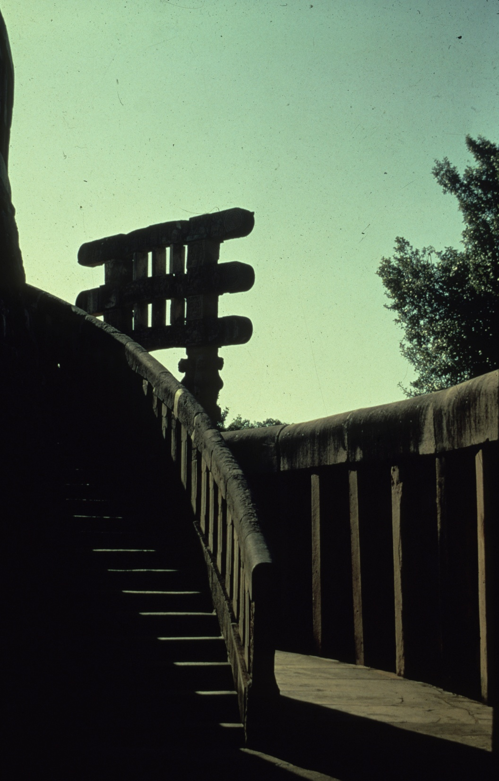

Slide 35
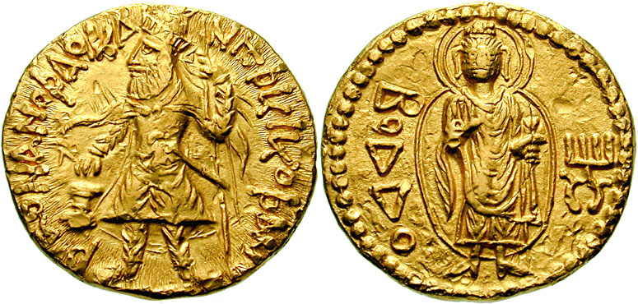
Beginning of Figurative
Portrayal of Buddha
Kanishka Coin
(100 B.C.)
Kanishka (Kushan Period) King one side,
Boddo (Buddha) on obverse

Slide 36
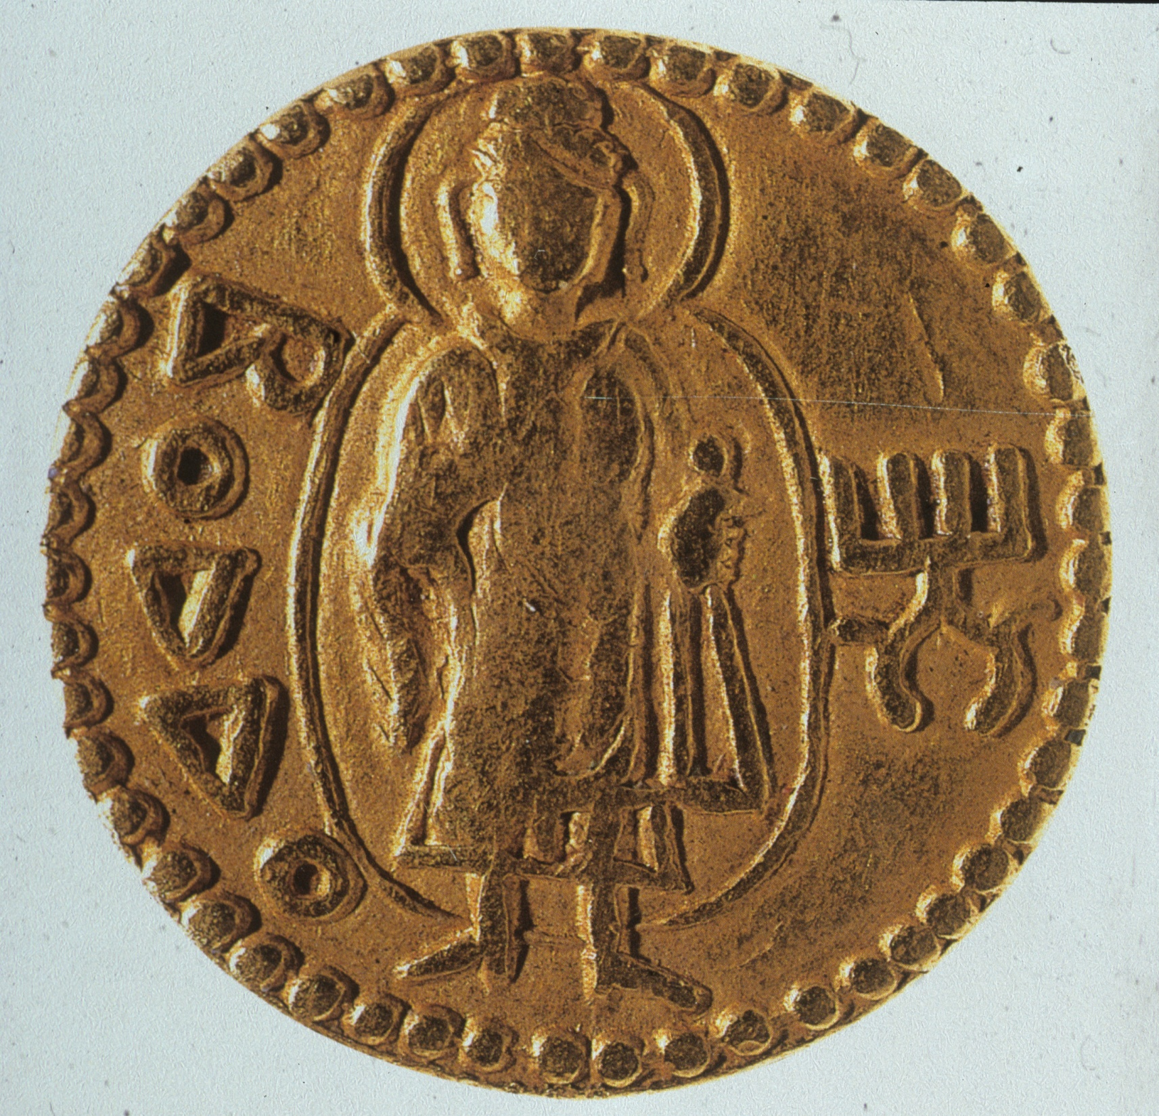
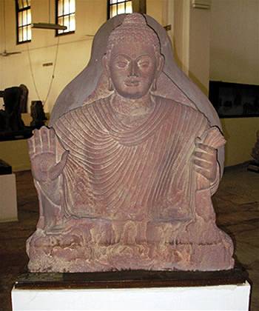
From coin to figure
Mathura Buddha
Late Kushan
1st century AD?

Slide 37
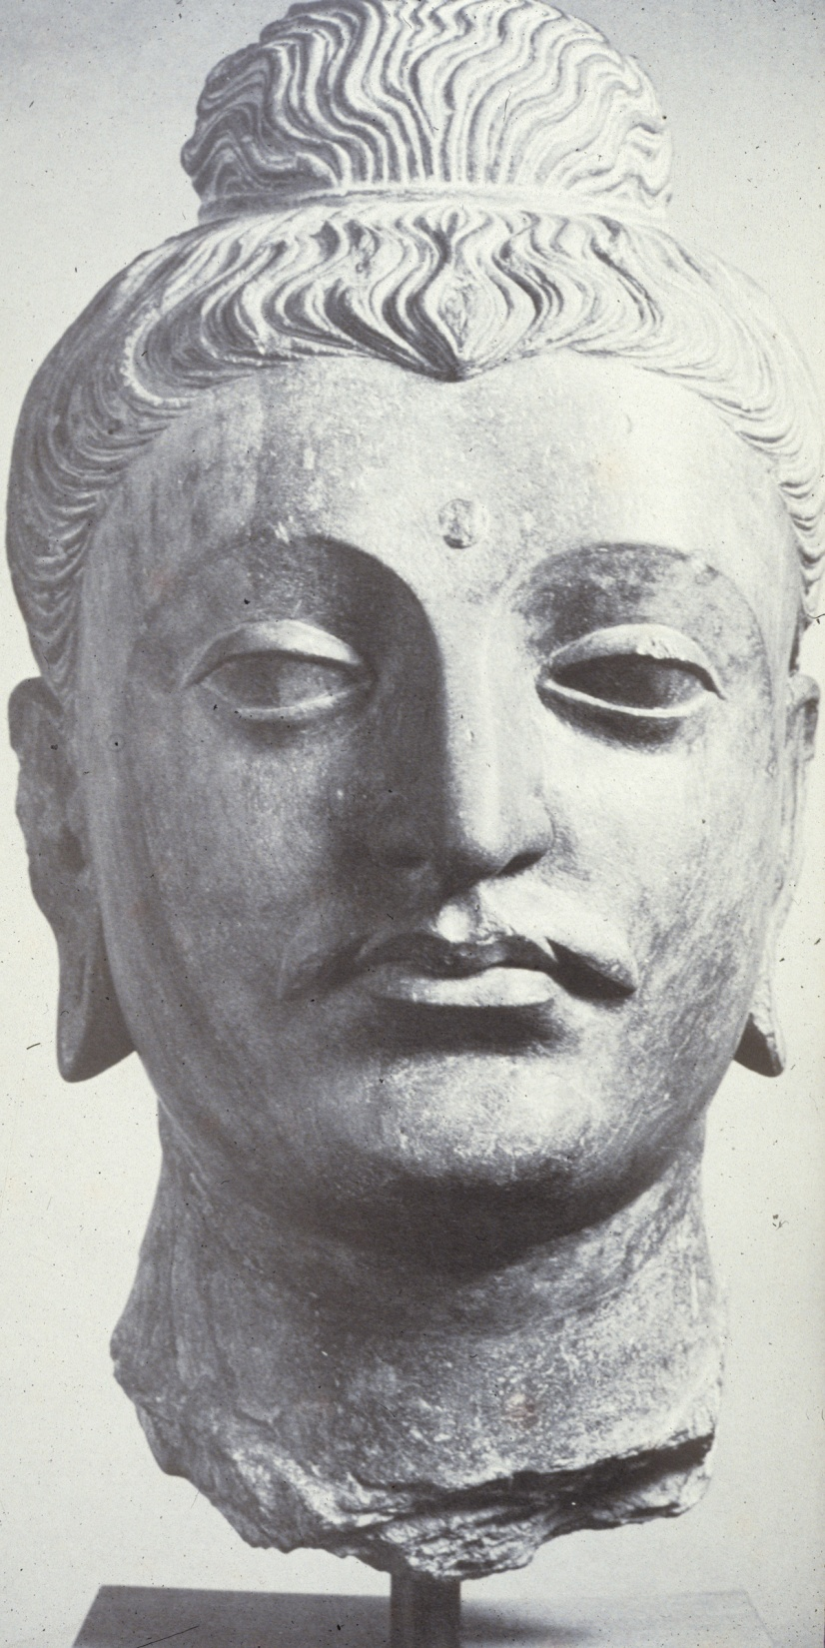

Slide 38
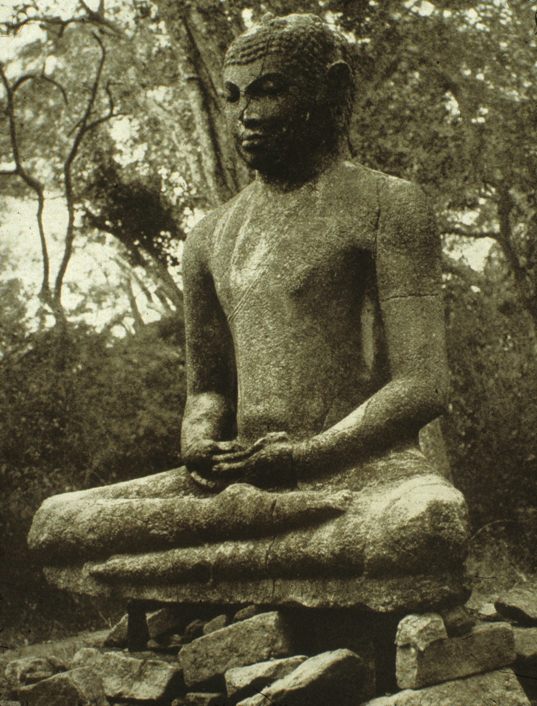
Figurative
Portrayal of Buddha
Note
“breath” filled
Abdomen
Tubular body
Emphasis on breath filled body
not skeletal/muscular system
as in western classical tradition

Slide 39
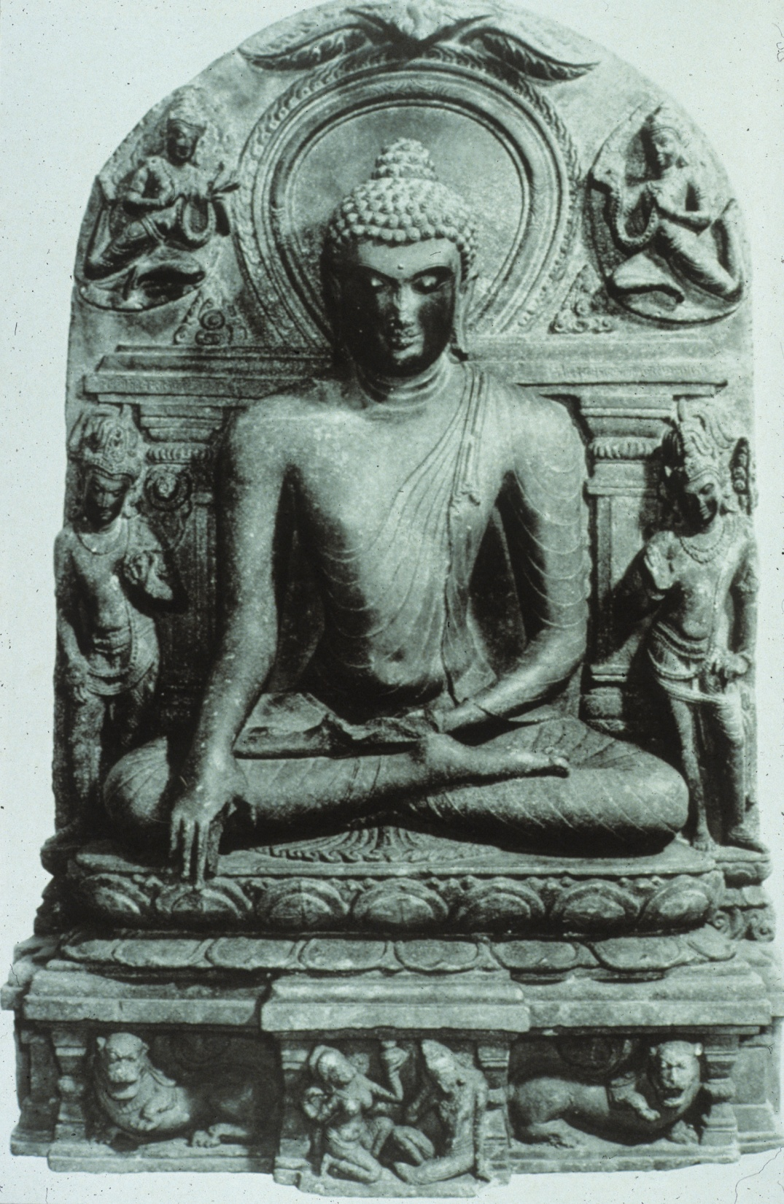
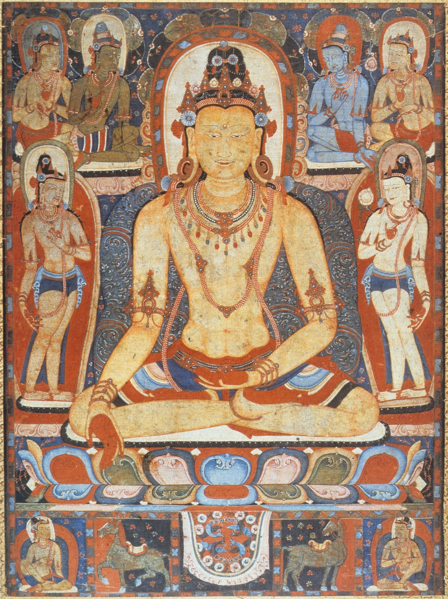

Slide 40
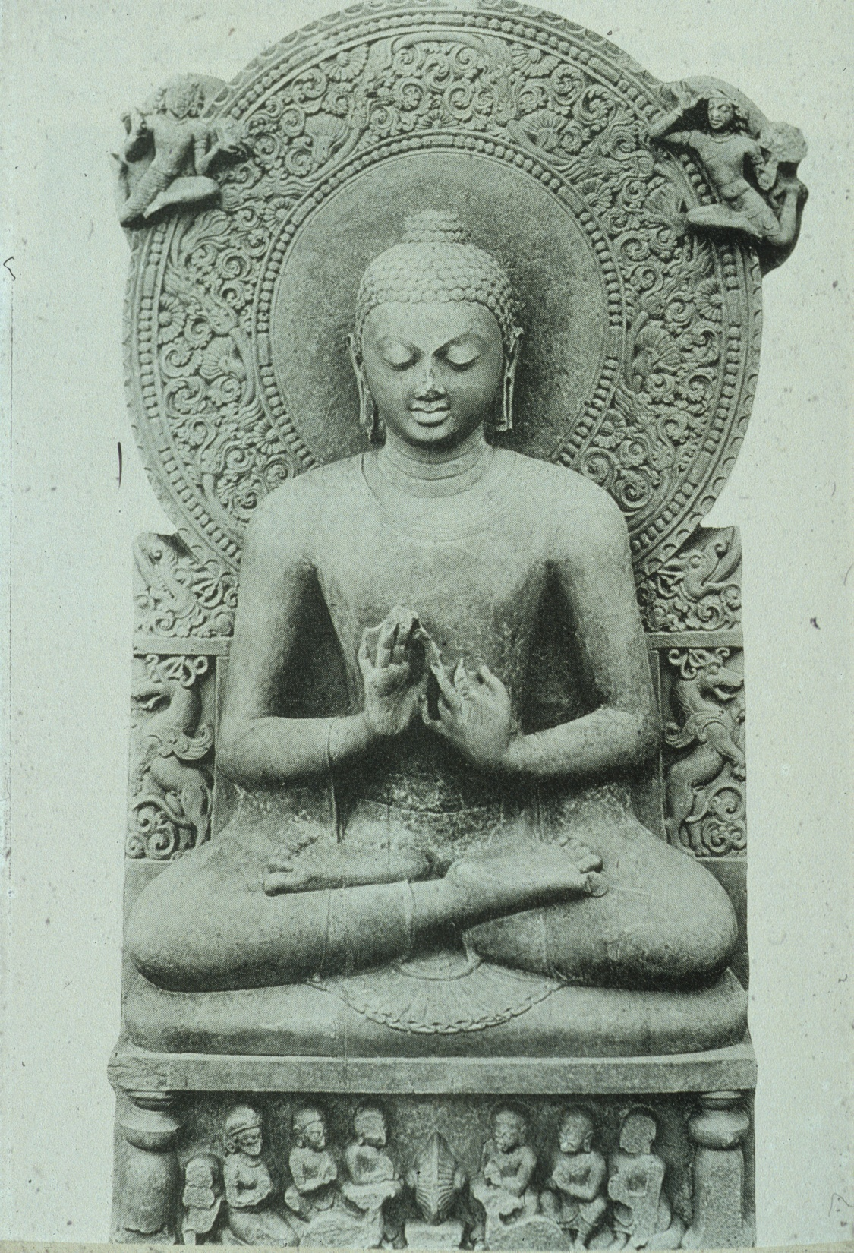
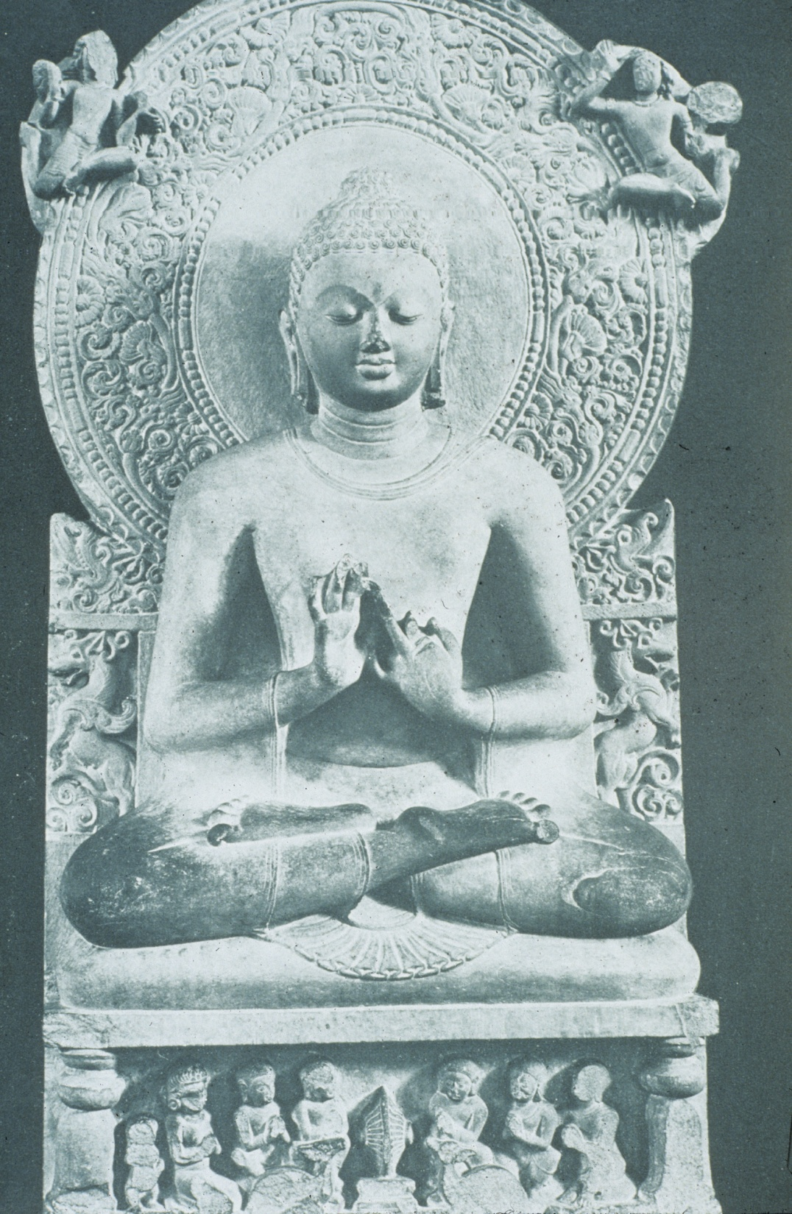

Slide 41
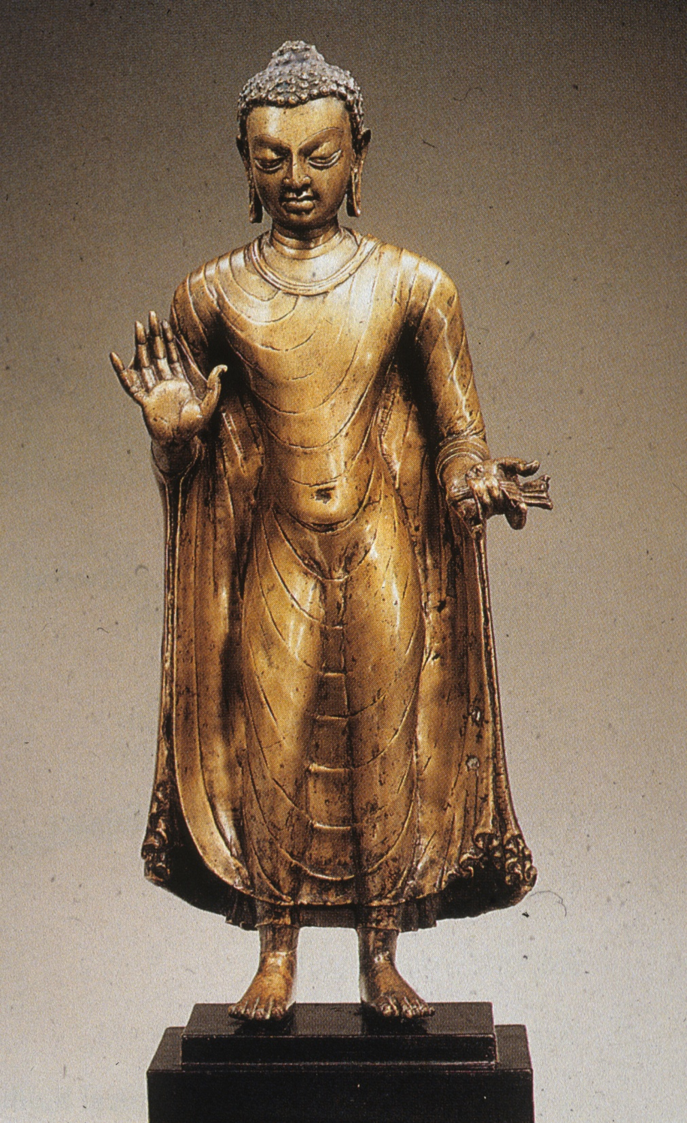

Slide 42
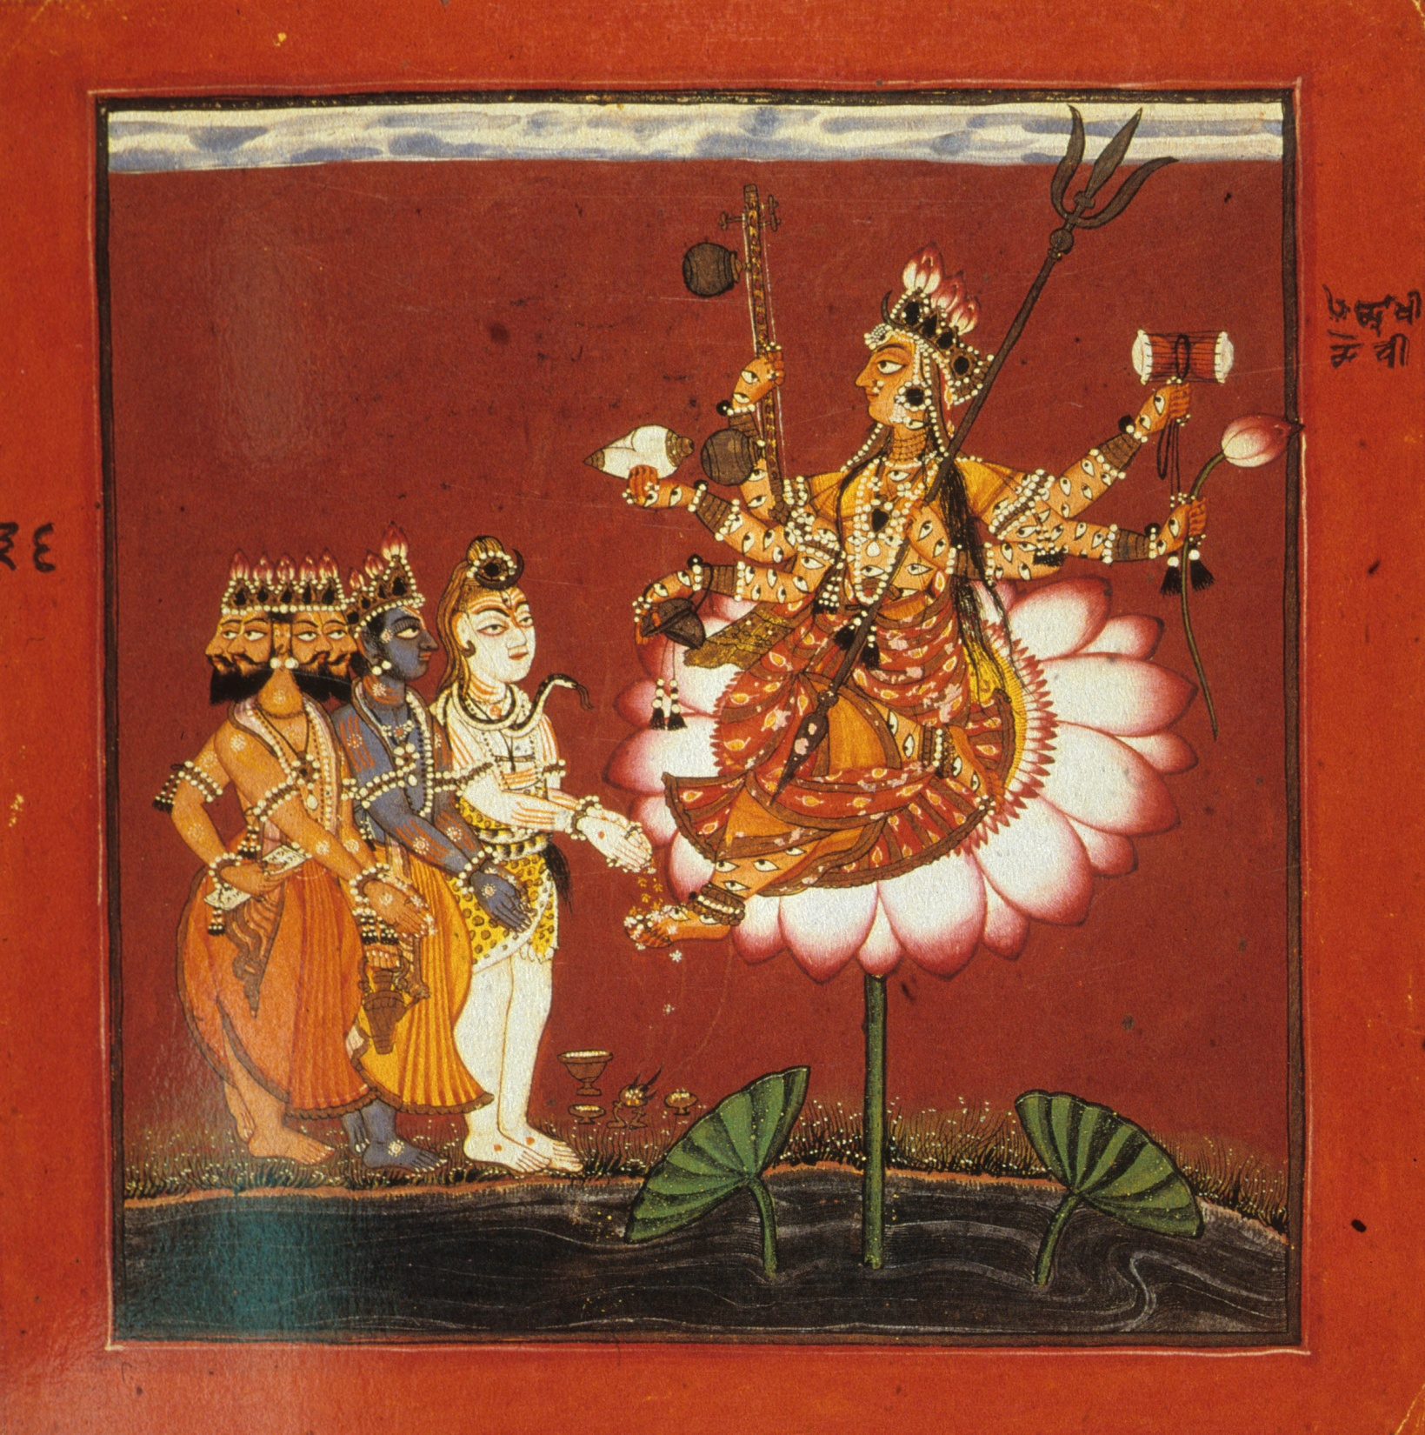
Hinduism
17th painting
Brahma
Vishnu
Shiva
Devi (female)

Slide 71
Processions

Slide 88
6th century

Slide 89
8th century
NE India

Slide 90
Early 8th
Century
central west
India

Slide 91
8th century
S. India

Slide 92
8th century
W. India

Slide 95
18th century NW India

Slide 96
Mithila
Folk painting
20th century
NE India

