Slide 1
Linked Lists

Slide 2
Objectives
At the conclusion of this lesson, students should be able to:
Describe the basic operation and structure of a linked list
* Inserting into the list
* Removing from the list
* Iterating through the list
Write code that implements a singley linked list

Slide 3
The Linked List is an important data structure
that every computer scientist should understand.

Slide 4
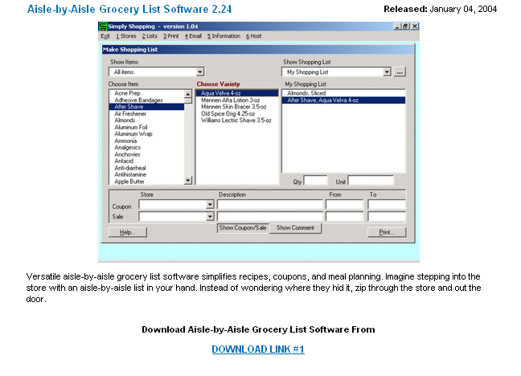
Motivation
Suppose you wanted to write this application …

Slide 5
Motivation
To keep a grocery list like this you probably need
a data structure that
* is easy to keep in “some” order (by aisle)
* is easy to insert items into the middle of
* is easy to delete items from the middle of
* is easy to iterate through
* grows and shrinks as items are added and deleted

Slide 6
What’s Wrong With an Array?
Apples
Bread
Milk
Hamburger
Carrots

Slide 7
What’s Wrong With an Array?
Apples
Bread
Milk
Hamburger
Carrots
Chicken
Add Chicken to the list

Slide 8
What’s Wrong With an Array?
Apples
Bread
Milk
Hamburger
Carrots
Chicken
But I really want Chicken by Hamburger (both in the meat dept)

Slide 9
What’s Wrong With an Array?
Apples
Bread
Milk
Hamburger
Chicken
Carrots
If there is a lot of stuff in the array, moving elements
to free up a space in the middle is expensive!

Slide 10
What’s Wrong With an Array?
Apples
Bread
Milk
Carrots
Hamburger
Corn
Remove milk
from the list (your spouse bought some
on the way home from work)

Slide 11
What’s Wrong With an Array?
Apples
Bread
Can’t have “empty”
slots in an array
Carrots
Hamburger
Corn
Remove milk
from the list (your spouse bought some
on the way home from work)

Slide 12
What’s Wrong With an Array?
Apples
Bread
Milk
Carrots
Hamburger
Corn
Add popcorn
to the list
An array is fixed in size. Once it is full we cannot add more.

Slide 13
We need a data structure ...
That can grow and shrink as needed
That is not in contiguous memory
That has fast insertion/deletion in the middle

Slide 14
The ideal data structure is a linked list.
Linked lists (and variations) are used in
all kinds of computer science problems.
I good understanding of how a linked list
works is essential for every CS student.

Slide 15
A linked list is an ideal candidate!
this is called a node. Each node in the
list contains some data and a pointer
to the next node. Nodes are dynamically
allocated as new items are added to
the list.
head
rolls
A linked list has
a “head” that points
to the first node in
the list.
24
butter
1 lb
eggs
1 dz
Note that the pointer in the
last node in the list is set to nullptr.
nullptr

Slide 16
Adding a new item to the front of the grocery list!
Create a new node using the new operator,
Nodes are always dynamically allocated.
head
nnnnn
rolls
xxxxx
milk
24
newNode
2 gals
butter
nullptr
1 lb
eggs
1 dz
null
Node* newNode = new Node(“milk”, “2 gals”);

Slide 17
Adding a new item to the front of the grocery list!
milk
head
2 gals
nnnnn
nnnnn
rolls
24
xxxxx
butter
newNode
1 lb
eggs
1 dz
nullptr
2. copy the address stored in head into the pointer in the new node.

Slide 18
Adding a new item to the front of the grocery list!
milk
head
2 gals
rolls
nnnnn
24
xxxxx
xxxxx
butter
newNode
1 lb
eggs
1 dz
nullptr
3. Store the address of the new node in the head.

Slide 19
Adding a new item to the front of the grocery list!
milk
head
2 gals
rolls
nnnnn
24
xxxxx
butter
newNode
1 lb
eggs
1 dz
nullptr

Slide 20
Adding a new item in the middle of the grocery list!
milk
head
2 gals
rolls
24
1. Create another new node using
the new operator
butter
1 lb
eggs
1 dz
nullptr
newNode
soda
12 cans
nullptr

Slide 21
Adding a new item in the middle of the grocery list!
milk
head
2 gals
rolls
24
2. Locate the node
you want to insert
after.
butter
1 lb
eggs
1 dz
nullptr
newNode
soda
12 cans
nullptr

Slide 22
Adding a new item in the middle of the grocery list!
milk
head
2 gals
rolls
24
butter
3. Store the pointer from
this node in the new
node.
1 lb
nnnnn
eggs
1 dz
nullptr
newNode
soda
12 cans

Slide 23
Adding a new item in the middle of the grocery list!
milk
head
2 gals
rolls
24
4. Store the address of the
new node in this node.
butter
1 lb
eggs
1 dz
xxxxx
nullptr
xxxxx
newNode
soda
12 cans
nnnnn

Slide 24
Adding a new item in the middle of the grocery list!
milk
head
2 gals
rolls
24
4. Store the address of the
new node in this node.
butter
1 lb
eggs
1 dz
xxxxx
nullptr
xxxxx
newNode
soda
12 cans
nnnnn

Slide 25
Delete an item from the front of the grocery list!
head
nnnnn
rolls
24
xxxxx
butter
1 lb
eggs
1 dz
nullptr

Slide 26
Delete an item from the front of the grocery list!
head
nnnnn
rolls
24
xxxxx
butter
oldHead
1 lb
eggs
1 dz
nullptr
1. Save the address stored in head.

Slide 27
Delete an item from the front of the grocery list!
head
temp
nnnnn
rolls
24
xxxxx
butter
oldHead
1 lb
eggs
1 dz
nullptr
2. Get the pointer contained in the first node.

Slide 28
Delete an item from the front of the grocery list!
head
temp
nnnnn
rolls
xxxxx
xxxxx
24
xxxxx
butter
oldHead
1 lb
eggs
1 dz
nullptr
3. Store it in head.

Slide 29
Delete an item from the front of the grocery list!
head
temp
nnnnn
rolls
xxxxx
xxxxx
24
xxxxx
butter
oldHead
1 lb
eggs
1 dz
nullptr
4. Delete the dynamically allocated node object.

Slide 30
Let’s Develop Some Code

Slide 31
The Node Class
Node
what are the
data members?
- item: string
- quantity: string
- next: Node*
+Node(:string, :int)
+setQuantity(:string) :void
+getQuantity( ) :string
+setItem(:string) :void
+getItem( ) :string
+setNext(:Node*) :void
+getNext( ) :Node*
what are the
operations?

Slide 32
The Head Class
Head
what are the
data members?
- first: Node*
+Head( )
+push_front(:Node*) :void
+pop_front( ): void
what are the
operations?

Slide 33
Add a new item to the front of the list
head
size
node
first
item
rolls
quantity
24
next
void Head::push_front ( Node* n )
{
n->setNext(first);
first = n;
}

Slide 34
Delete an item from the front of the list
head
size
node
first
item
rolls
quantity
24
node
next
item
milk
quantity
1 gal
void Head::pop_front ( )
{
Node* byeByeNode = first;
first = first->getNext( );
delete byeByeNode;
}
next

Slide 35
Lab #14: Design a Linked List class
Project #9: Implement a Linked List

Slide 36
Your Node Class
A Book* that points to a Book object
A pointer to the next Node in the list.
Initially this pointer should be set to nullptr.
Constructor, getters and setters

Slide 37
The Book Class
A string containing the book’s title
A string containing the book’s author
A double containing the price of the book
Constructors, getters and setters

Slide 38
Your List Class
A Node* that points to the first node in the list.
Initially this pointer should be set to nullptr.
A Node* that points to the last node in the list.
Initially this pointer should be set to nullptr.
An integer that keeps track of how many nodes
are in the list.

Slide 39
Your List Class (Part II)
A default constructor that creates an empty list object
A destructor
A push_front(Node*) function
A pop_front( ) function
You also need a stand-alone function that takes a List
object as its parameter and outputs each book in the List.

Slide 40
The List Class (Part III)
A push_back(Node* ) function
A pop_back( ) function.

Slide 41
This project is part of your final exam.
You are expected to do your own work.
You only have one chance to submit your
Project. Whatever you submit will be graded
as-is. Projects cannot be corrected and re-
submitted.
You can turn your project in early for a 5 point bonus.
projects will not be accepted after 11:59pm on Sunday
April 24.

