Slide 1
Estimation using COCOMO
More Science, Less Art

Slide 2
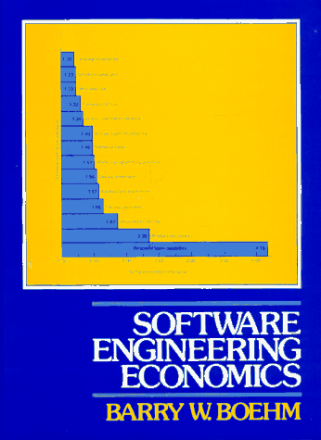
COCOMO History
Constructive Cost Model
Dr. Barry Boehm
TRW in 1970s
1981 - COCOMO81
1996 - COCOMOII

Slide 3
Modes (project types)
Organic
  Relatively small software teams develop software in a highly familiar, in-house environment
Semi-detached
  between organic and embedded
Embedded
  Needs to operate within tight constraints. The product must operate within (is embedded in) a strongly coupled complex of hardware, software, regulations, and operational procedures.

Slide 4
Levels (sophistication of estimate)
Basic
  for rough estimates
Intermediate
  several more input variables
Detailed
  phase-sensitive effort

Slide 5
Basic's Effort Formula
E = a × Size^{b}
E = person-months
Size = KLOC
 | Organic | Semi | Embedded
a | 2.4 | 3.0 | 3.6
b | 1.05 | 1.12 | 1.20

Slide 6
Estimation Type = Basic
Organic Semi-detached Embedded

Slide 7
Basic's Duration Formula
TDEV = 2.5 × E^{b}
TDEV = development time in months
Organic Semi Embedded
b 0.38 0.35 0.32

Slide 9
Intermediate Effort Formula
E = a × Size^{b} × C
E = person-months
Size = KLOC
C = 15 Cost Drivers
 | Organic | Semi | Embedded
a | 3.2 | 3.0 | 2.8
b | 1.05 | 1.12 | 1.20

Slide 10
Cost Drivers
very low extra high
Product attributes
Required software reliability 0.75 0.88 1.00 1.15 1.40
Size of application database 0.94 1.00 1.08 1.16
Complexity of the product 0.70 0.85 1.00 1.15 1.30 1.65
Hardware attributes
Run-time performance constraints 1.00 1.11 1.30 1.66
Memory constraints 1.00 1.06 1.21 1.56
Virtual machine environment volatility 0.87 1.00 1.15 1.30
Required turnaround time 0.87 1.00 1.07 1.15

Slide 11
Cost Drivers
very low extra high
Personnel attributes
Analyst capability 1.46 1.19 1.00 0.86 0.71
Software engineer capability 1.29 1.13 1.00 0.91 0.82
Applications experience 1.42 1.17 1.00 0.86 0.70
Virtual machine experience 1.21 1.10 1.00 0.90
Programming language experience 1.14 1.07 1.00 0.95
Project attributes
Use of software tools 1.24 1.10 1.00 0.91 0.82
Application of SwEng methods 1.24 1.10 1.00 0.91 0.83
Required development schedule 1.23 1.08 1.00 1.04 1.10

Slide 12
Example of Intermediate
http://sunset.usc.edu/research/COCOMOII/cocomo81_pgm/cocomo81.html

Slide 13
Detailed
Broken into system, subsystem, and module
Cost Drivers applied to each module

Slide 14
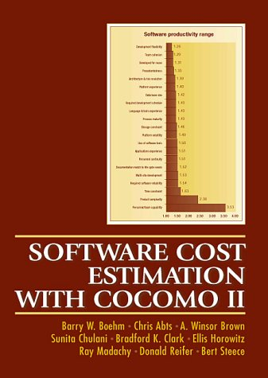
Why COCOMO II
Changes in development
  less waterfall
  more reuse
  more design time
  more real-time, less mainframe
COCOMO81 based on SLOC not FPs
  COCOMOII supports FP, Object Points, and SLOC

Slide 15
COCOMO II
The Application Composition Model
  used early for rough estimate
  based on Object Points
The Early Design Model
  used once requirements are stable
  uses a small set of new Cost Drivers, new estimating equations
  based on Unadjusted Function Points or KSLOC
The Post-Architecture Model
  used after development of overall architecture
  new cost drivers, new line counting rules, new equations

Slide 16
Application Composition Model
Object Points used for sizing, not LOC
Based on
  number and complexity of screens
  number and complexity of reports
  amount of code reuse
  experience of developers

Slide 17
Object Points
Object point complexity levels
for screens and reports
Number of data tables
views Total <4 Total <8 Total 8+
<3 simple simple medium
3-7 simple medium difficult
8+ medium difficult difficult

Slide 18
Object Complexity Weight
Object type Simple Medium Difficult
Screen 1 2 3
Report 2 5 8
3GL component - - 10

Slide 19
COCOMOII Rough Estimate of Effort
NOP = (object points) x (100 – r) / 100
NOP = new object points
r = % of code reuse
E = NOP / PROD
PROD = productivity based on experience
Developer Experience
very low low nominal high very high
4 7 13 25 50

Slide 20
Next…
Building a Manageable Schedule
Exam One

