Slide 1
Intro to Estimating
Part Art, Part Science

Slide 2
TED Video Response
Tali Sharot: The optimism bias
What does this talk have to do with Software Project Management?
Do we learn more from positive data or negative data? Why?
Does awareness of the Optimism Bias destroy it?
How can the information in this video help you with software project cost estimation?

Slide 3
Importance of Good Estimates
Time (Realistic Deadlines)
  most software projects are late because the time was underestimated
  work expands to fit the time available
  going too fast influences quality
Money
  within 20% is probably close enough for most software projects
Software Project Management by Hughes and Cotterell

Slide 4
Accuracy is based on:
degree to which the planner has properly estimated the size of the product
ability to translate a size estimate to a time estimate (time = $)
degree to which the project plan reflects the abilities of the software team
stability of product requirements and project environment
Software Engineering: Practitioner's Approach by Pressman

Slide 5
Basis of Good Estimates
Consistent Methods
Gathering of Historical Data
Minimal variance in Teams' Skill
Avoidance of Politics and Egos
Experience

Slide 6
Warning: You are not as smart as you think you are.
Schoemaker and Russo gave questionnaires to 2,000 executives to measure knowledge of their industries.
  99% of respondents overestimated their success.
  computer executives
    95% confident their answers were right
    81% were wrong

Slide 7
Decision Traps
http://dirkracine.blogspot.com/2010/06/decision-traps-russo-schoemaker.html
Additional common problems from Schoemaker and Russo :
Plunging In: Gathering info and arriving at conclusion too quickly.
Frame Blindness: Solving the wrong problem. The current situation might look like a past situation.
Overconfidence: Failing to collect key information due to confidence in solution or judgment.
Shortcuts or "Rules of Thumb": Not collecting key information or anchoring on convenient facts.
Shooting from the hip: Trying to keep all of factors straight in your head versus using a systematic approach.
Group Failure: Assuming that a group of smart people will make good choices.
Fooling yourself about feedback: Misreading past evidence to your advantage. The classic behavioral trap, if something went right, it was skill, if something went wrong, it was bad luck.
Not keeping track: Not tracking results, so no feedback loop.

Slide 8
How good at estimating are you?
Suppose we have two strings wrapped around the earth at the equator. String A is on the ground. String B is one foot off the ground.
Question : How much longer is B than A.
Answer : 6.28 feet
  Circumference = 2 pi r
  if r increases by 1 foot, then C increases by just 6.26 feet

Slide 9
If you have a railroad track one mile long, break it in the middle, then push each end together by 6 inches, how far does the middle rise up?
Answer = 51 feet.
  c² = a² + b²
  c = .5 miles
  a = .5mile - .5 foot
c
b
a

Slide 10
Estimation Approaches
Analogy
Decomposition Methods
  lines of code
  function points
Empirical Methods

Slide 11
Decompositional
LOC-Based
divide, divide, divide; down to modules
for each module create optimistic, pessimistic, and probable sizes
size estimate = (opt + prob*4 + pess) / 6
look up LOC/pm for past modules in this domain
time = size / productivity

Slide 12
Why LOC is not a good measure
Each of these inverts the sign of a number. E.g. -12 to +12 or +12 to -12
n = -n
n = (0xffffffff ^ n) + 1;
n = ~--n;
n = ~n + 1;
int x = numberToInvertSign;
boolean pos = x > 0;
for(int i = 0; i < 2*Math.abs(x); i++)
{ if(pos)
{ numberToInvertSign--; }
else{ numberToInvertSign++; }
}

Slide 13
Decompositional
Function Point-Based Step One
Info Domain Value | Count | Simple | Average | Complex | Total
External Inputs |  | 3 | 4 | 6
External Outputs |  | 4 | 5 | 7
External Inquiries |  | 3 | 4 | 6
Internal Logical Files |  | 7 | 10 | 15
External Interface Files |  | 5 | 7 | 10

Slide 14
FP-Based Step Two
Rate each of the following from 0 to 5.
Does system require reliable backup and recovery?
Specialized data comm required to transfer data to/from app?
Distributed processing?
Is performance critical?
System to be run in existing environment?
System requires on-line data entry?
Data entry over multiple screens?
ILFs updated on-line?
Are inputs, outputs, files, or inquiries complex?
Is the internal processing complex?
Is the code designed to be reusable?
Are conversion and installation included in the design?
Is the system designed for multiple installations in different organizations?
Is the app designed to facilitate change and ease of use?

Slide 15
FP-Based
Step Three
FP = total count X
[0.65 + (0.01 X ∑(F_{I})I=1to14) ]
Step Four
use past measures of FP per person-month to determine time

Slide 16
Example Alarm
Inputs, Outputs, Data
  3 inputs - password, panic, on/off
  2 outputs - messages, sensor status
  2 inquiries - zone inquiry, sensor inquiry
  1 ILF - system configuration
  4 EIF - test sensor, zone setting, on/off, alert
assuming all are simple, total count = 50
Software Engineering: Practitioner's Approach by Pressman

Slide 17
Example Alarm
assuming moderately complex, adjustment = 46
FP= 50*[.65+(.01*46)] = 56
Past experience shows 12 FP/pm
Duration = 56/12 = 4.67person-months
Software Engineering: Practitioner's Approach by Pressman

Slide 18
Required Effort
A lot of people working for a short time.
One person working for a long time.
People
Total Effort to Complete the Project
Development Time

Slide 19
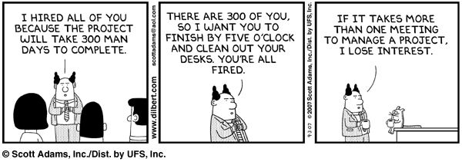

Slide 20

Real Required Effort
The work of 1 person over 6 months can not be done by 6 people in 1 month!
People
Total Effort
Development Time

Slide 21
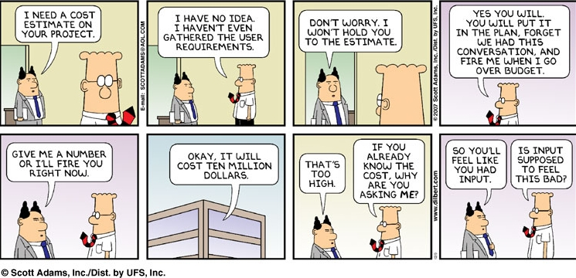
Other Factors
Reusing Code?
Level of Personnel's Experience?
?????

Slide 22
Next…
Empirical Estimation via COCOMO
  Constructive Cost Model
  E = a × Size^{b} × c
Exam One

