Slide 1
Software Project Failure
Night Two, Part One
CSCI 521 Software Project Management

Slide 2

Starter Question
In terms of a software development project,
define "success" and "failure".
Notes:
Cost, Time, Functionality, and Quality

Slide 3
Software Project Failure
Standish Group:
  90 percent of software projects are completed late
  66 percent are deemed failures
  30 percent are abandoned
That figure is probably falsely too high.
  probably 70% are late
  probably 30% are significantly late
  probably over 80% do not fulfill 100% of requirements
Everyone agrees the failure rate is too high.

Slide 4
Causes of Failure
Source:
“Critical Success Factors in Software Projects”
by John Reel, IEEE Software, June 1999
10 signs of IS project failure:
Project managers don’t understand users’ needs.
The project’s scope is ill-defined.
Project changes are managed poorly.
The chosen technology changes.
Business needs change.
Deadlines are unrealistic.
Users are resistant.
Sponsorship is lost.
The project lacks people with appropriate skills.
Managers ignore best practices and lessons learned.
1 – 7 occur before
even the design starts

Slide 5
Critical Success Factors
Source:
lots of reading by Dannelly
Stable Requirements
Accurate Estimations
Teamwork and Unified Vision
Attention to Risks
So how do we get these on a regular basis?

Slide 6
Process Models
Night Two, Part Two
CSCI 521 Software Project Management
Notes:
The remainder of the semester will be discussing parts of the development process. But first, let's look at the big picture of processes as a whole.

Slide 7
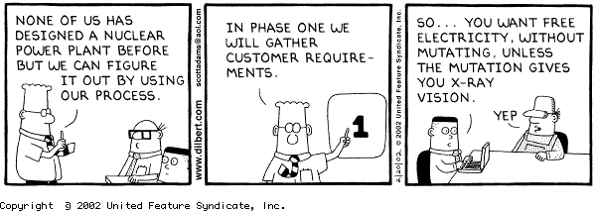
Why Establish a Process?
It is nearly impossible to consistently develop high quality products without a high quality process.

Slide 8
Benefits of Establishing a Standard Development Process
Less likely to miss something
Less likely to repeat a past failure
Establishes Organizational Responsibilities
Improves ability to train people for their tasks
Allows collection of meaningful Process Metrics
    better estimation of time and $
    more accurate tracking of progress

Slide 9
Process Management
formal process definition
process measurement
feedback
improvement
optimization

Slide 10
IEEE 1074
this standard describes a
process for developing a process
Software Life Cycle Model Process
selecting the project model
Project Management Processes
plan the project management
analyze risks
retain records
problem reporting process
define metrics
manage product quality
Predevelopment Processes
feasibility studies
identify the customer's needs
Development Processes
define software requirements
design
  architectural
  detailed
create test data
integration testing
Post-Development Processes
installation
training
Integral Processes
configuration management
documentation
training on the plan

Slide 11

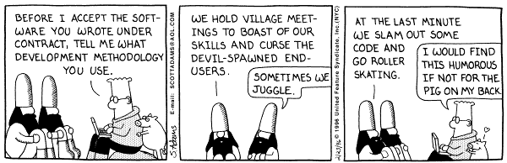
Process Models
Waterfall
Spiral
    incremental development, prototyping, etc
Rapid Application Development
and many, many, many more

Slide 12
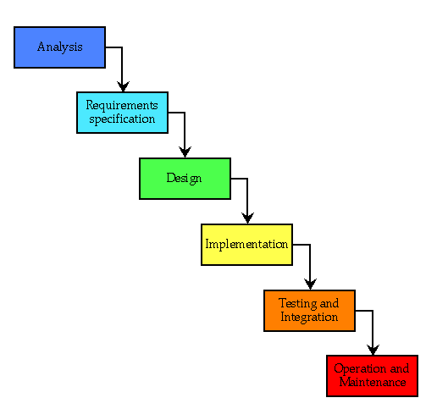
Waterfall Model
strengths
big errors found early
provides requirements stability
weaknesses
impossible if customer doesn't know what they want
document-driven (lots of paperwork)

Slide 13
Waterfall with SQA Activities
Requirements
Specification
Review the SRS
Defect Tracking
Documentation
Configuration Control
Design
Design Reviews
Coding
Standards
Coding
Unit
Testing
Test Procedures
and Tolerances
Integration
Testing
Validation
Installation &
Training
Maintenance

Slide 14
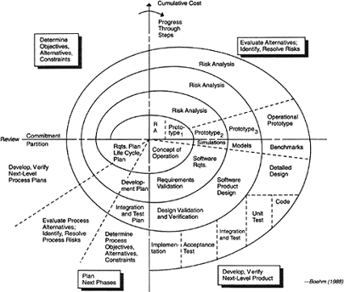
Spiral Model
strengths
well suited to ill-defined problems and new domains
weaknesses
little requirements stability

Slide 15
Rapid Application Development
Business Modeling
Data Modeling
Process Modeling
Application Generation
  probably mostly reuse of existing modules
Testing
  concentrating on interfaces

Slide 16
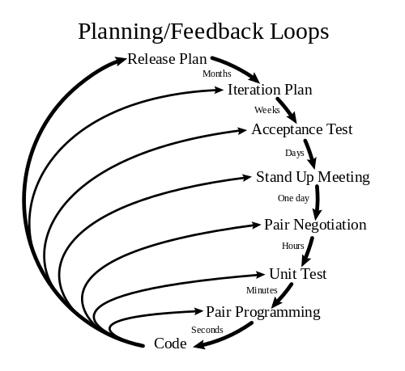
Extreme Programming a flavor of Agile Development
Kent Beck - 1999
5 Values
  Communication
    between customer and developers, between developers, developers and management, ...
  Simplicity
    the simplest idea is usually the best
  Feedback
    "Optimism is an occupational hazard of programming. Feedback is the treatment."
  Courage
  Respect

Slide 17
So which model is best?
when problem is really big
when requirements are only partially known
when problem is similar to other past projects
when the several aspects of the problem are very common problems
when the project will require a proof-of-concept
when the team has little expertise in this area
when the team is composed of excellent designers and analyzers
there is little available interaction with the customer
a system integration project

