Slide 1
The Linux File System
Navigating Directories

Slide 2
The Linux File System
Everything is a file
directories are files
sockets are files
stdin and stdout are files
soft links to files are files
processes are not files
It is all one big directory tree
drives are mounted onto the tree

Slide 3
The Linux Drive Structure
partition partition partition
boot blocks i-list data block data block directory block data block directory block
i-node number
0
1267
2300
2549
i-node number | Name
1267 | .
555 | ..
2549 | testdir
2300 | testfile
i-node number | Name
2549 | .
1267 | ..

Slide 4
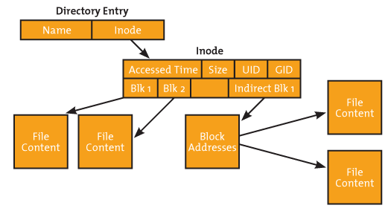
Contents of an I-Node

Slide 5
Directory Functions
DIR *opendir (char *pathname)
parameter is a string with a directory name (relative or absolute)
returns a pointer to a directory block
returns NULL if no such directory or permission denied
struct dirent *readdir (DIR *dp)
parameter is a pointer to a directory block
returns a pointer to a two-part struct for the next directory entry
d_ino --> i-node number
d_name --> name
returns NULL when no more entries
void rewind (DIR *dp)
int closedir (DIR *dp)

Slide 6
Example - myls1
#include <sys/types.h>
#include <dirent.h>
#include <stdio.h>
#include <stdlib.h>
int main(int argc, char *argv[])
{
DIR *dp; // ptr to directory block
struct dirent *entry; // ptr to next entry
/***** check the command line *****/
if (argc != 2)
{
printf ("Error: must provide a directory name\n\n");
exit (1);
}
/***** can we open that directory *****/
if ( ( dp = opendir(argv[1]) ) == NULL)
{
printf ("cannot open %s\n",argv[1]);
exit (1);
}
/***** loop through all entries *****/
while ( ( entry = readdir(dp) ) != NULL)
printf ( "%s\n", entry->d_name);
closedir (dp);
}

Slide 7
Inquiring about directory entries
Status Information for files and directories
struct stat {
st_mode file type
st_ino i-node number
st_uid user id of owner
st_size size in bytes
st_atime time of last access
st_mtime time of last modification
yadda yadda
Retrieving that status info for a file or directory
stat (char *pathname, struct stat *buffer);
Is it a file or directory
S_ISREG( mode )
S_ISDIR( mode )
yadda yadda

Slide 8
2nd Example - myls2
Prints the name, then i-node number, and if a directory
struct stat stat_info;
/***** process all directory entries *****/
while ( ( dirp = readdir(dp)) != NULL)
{
printf ("%20s %d",dirp->d_name,dirp->d_ino);
stat (dirp->d_name, &stat_info);
if (S_ISDIR(stat_info.st_mode))
printf (" directory\n");
else
printf ("\n");
}

Slide 9
Example Run
> ls
myls1 myls1.c myls2 myls2.c testdir
> myls1 .
myls1
myls2
.
myls2.c
testdir
..
myls1.c
> myls2 .
myls1 5113261
myls2 5113264
. 5113260 directory
myls2.c 5113266
testdir 5113263 directory
.. 5112686 directory
myls1.c 5113265

Slide 10
Your Assignment
Create a program to print a directory tree of variable depth.
Eat this elephant slowly:
compile myls2.c
put the traversal loop into a function
have the traversal function call itself
use depth as the stop condition for recursion
add the indenting

